Slide 1

Keep Bees Alive
Information and resources for keeping your bees healthy in the era of varroa
© 2019 Michigan State University
Graphic design by Anne Turnham, University of Minnesota Bee Lab

Slide 2
We lose a high number of honey bee colonies every year
Honey bee researchers and experts agree that bees are dying because of multiple, interacting factors including poor nutrition, pesticides, and pathogens
While pesticides and poor nutrition can weaken a colony, most of the winter deaths are due to disease spread by varroa mites
© 2019 Michigan State University
Graphic design by Anne Turnham, University of Minnesota Bee Lab

Slide 3
If we want to protect our bees, we need to manage the pests
We often can’t control the pesticide exposure and the poor landscape around our hives
While varroa aren’t the only problem for bees, they are a serious problem that we can control
We can control the parasite loads in our hives
© 2019 Michigan State University

Slide 4
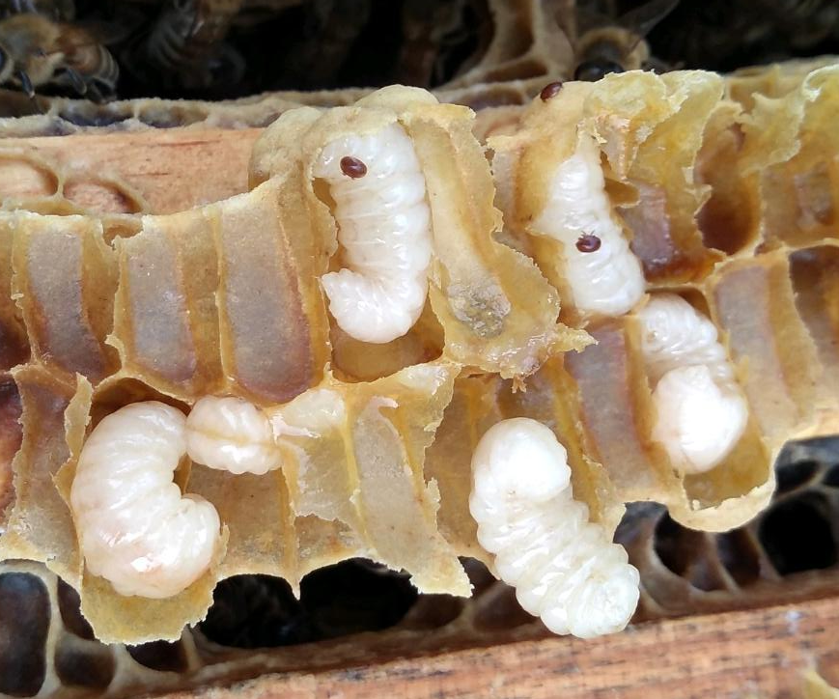
What is a varroa mite?
Scientific name → Varroa destructor
Originally a pest of Asian honey bee
Introduced to United States in 1987
In all beekeeping countries except Australia
Parasitizes pupa and adult bees
Vector for multiple viruses
© 2019 Michigan State University
© Dan Wyns
Slide modified from the Honey Bee Health Coalition

Slide 5
True or false?
Every honey bee colony in the continental United States and Canada either has Varroa mites today or will have them within several months.
© 2019 Michigan State University

Slide 6
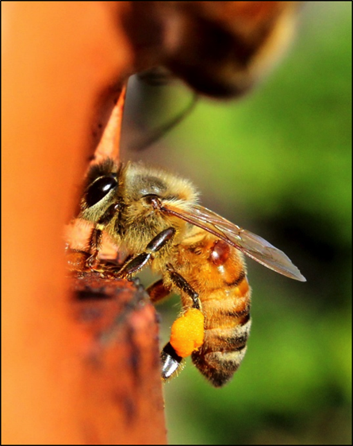
True
Every honey bee colony in the continental United States and Canada either has varroa mites today or will have them within several months
© Dan Wyns
© 2019 Michigan State University

Slide 7
Just because your colony will have varroa doesn’t mean that your colony has to die from varroa
The mites will enter our hives throughout the season on the backs of foragers and robbers
We can take actions to make sure that the populations of mites never reach dangerous levels
© Dan Wyns
© 2019 Michigan State University

Slide 8
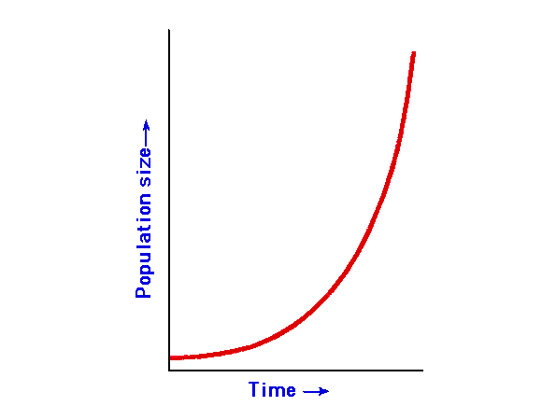
Varroa mite populations have an exponential growth curve
This means that the mite population starts off slow, and then explodes
10%
5%
Mite Infestation
0%
0 1 2 3 4 5
Months
© 2019 Michigan State University
Slide modified from the Honey Bee Health Coalition

Slide 9
Varroa mite populations have an exponential growth curve
Our job as beekeepers is to prevent this population explosion – to keep mites below dangerous levels
10%
5%
Mite Infestation
0%
0 1 2 3 4 5
Months
© 2019 Michigan State University
Slide modified from the Honey Bee Health Coalition

Slide 10
Varroa Transmission
Horizontal transmission of mites
Sick bees with mites and viruses abandon their colony and enter other colonies
In areas densely populated with bees and beekeepers, your varroa and virus problems can become everyone’s problem within 1+ mile of you
Slide modified from the University of Minnesota Bee Lab
© 2019 Michigan State University
Graphic design by Anne Turnham, University of Minnesota Bee Lab

Slide 11
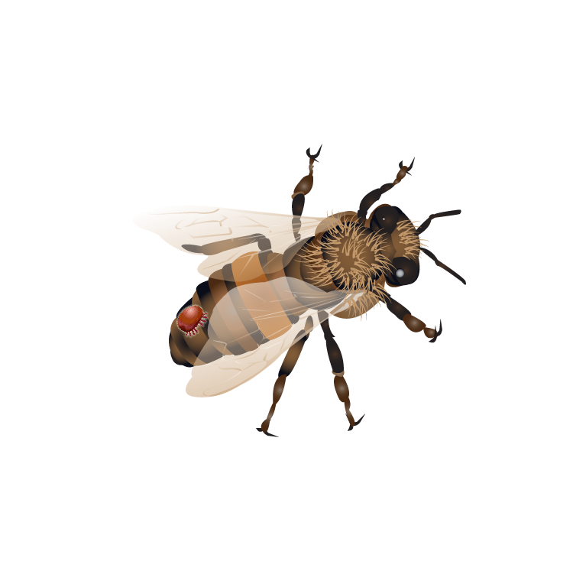
Keep bees alive: understand the damage mites can do when left unmanaged
© 2019 Michigan State University
Graphic design by Anne Turnham, University of Minnesota Bee Lab

Slide 12
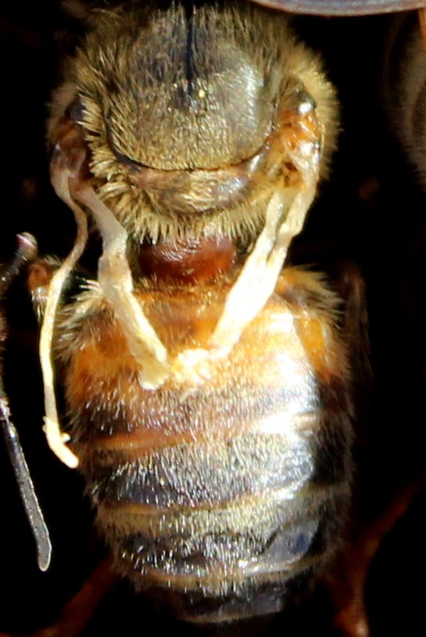
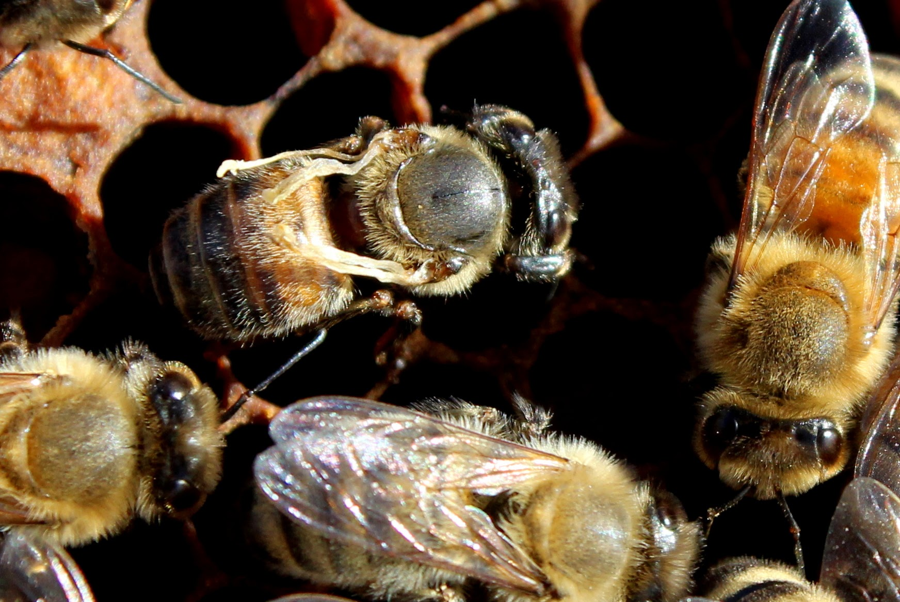
Varroa spread deadly viruses
When mites parasitize pupae, they may spread deformed wing virus
Adult bees may emerge sick and with deformed wings
© Dan Wyns
© Dan Wyns
© 2019 Michigan State University

Slide 13
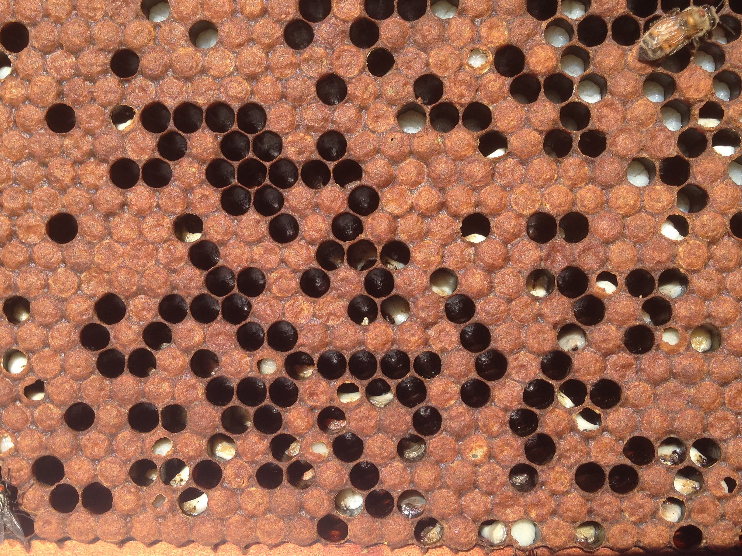
Parasitic mite syndrome
Very high pathogen loads, associated with high mite levels, prevent brood from developing
  © 2019 Michigan State University
© Dan Wyns

Slide 14
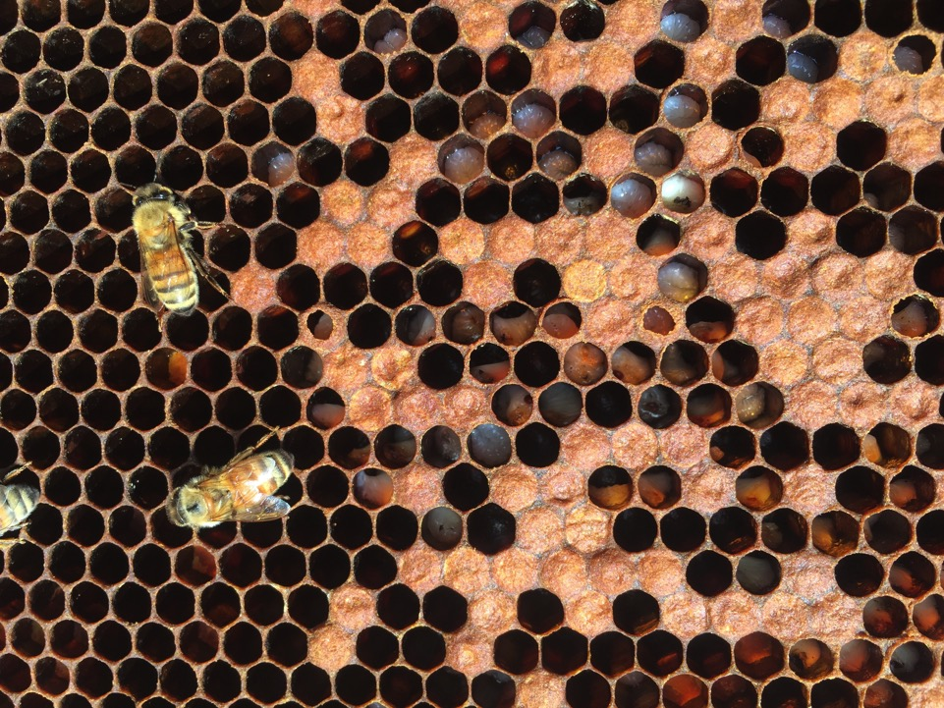
Parasitic mite syndrome
  © 2019 Michigan State University
© Ana Heck

Slide 15
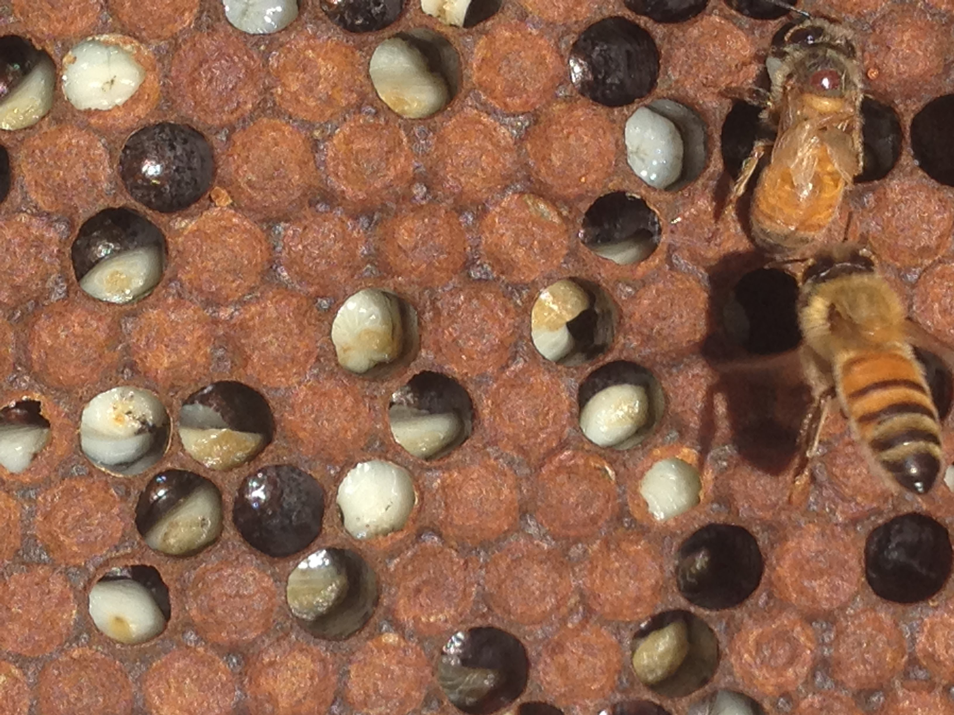
Parasitic mite syndrome
  © 2019 Michigan State University
© Dan Wyns

Slide 16
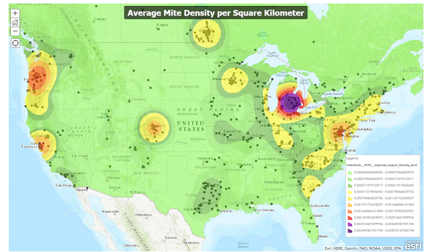
Varroa in Michigan: data from the 2018 Mite-a-thon
This map shows the levels of mites reported during a single week in September from all across the country during a citizen science project
yellow= low mite density, purple = high mite density
https://www.pollinator.org/miteathon
© 2019 Michigan State University

Slide 17
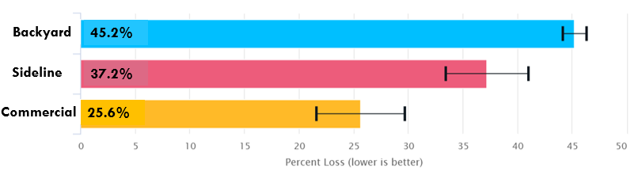
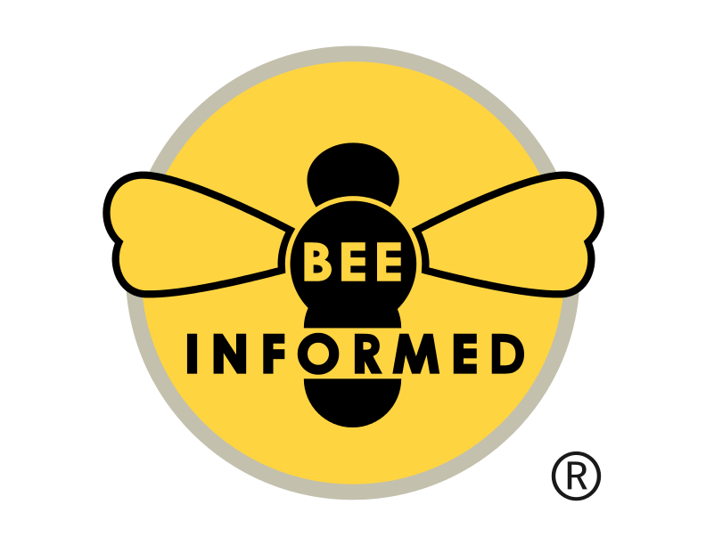
Average winter losses in 2017-2018 by operation size
Backyard (small-scale) beekeepers lose a greater portion of their colonies than other beekeepers
© 2019 Michigan State University

Slide 18
We are in an epidemic of varroa mites
Varroa lead to high colony losses, especially among small-scale beekeepers
Varroa and pathogens vectored are the driving cause of colony losses
© 2019 Michigan State University

Slide 19
We need to be responsible beekeepers
When we lose colonies to varroa, our colonies are lost to a preventable illness – this is not good for our bees
When varroa populations get high, they will spread to other nearby colonies through drift and robbing
  This is not good for other bees and beekeepers
We now know that varroa-associated viruses are found in native bees
  This is not good for our native pollinators
We need to make sure that our beekeeping does not harm other bees
© 2019 Michigan State University

Slide 20
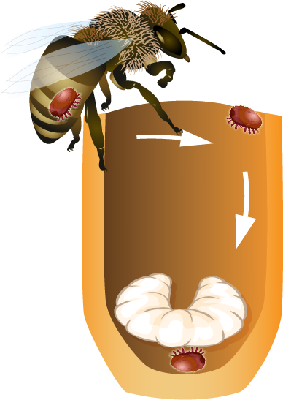

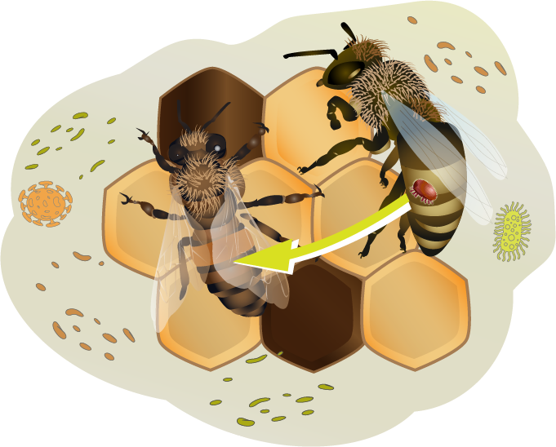
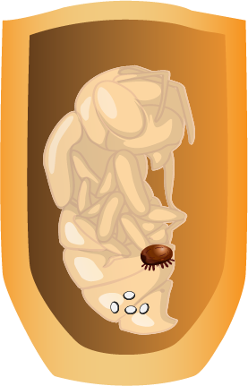
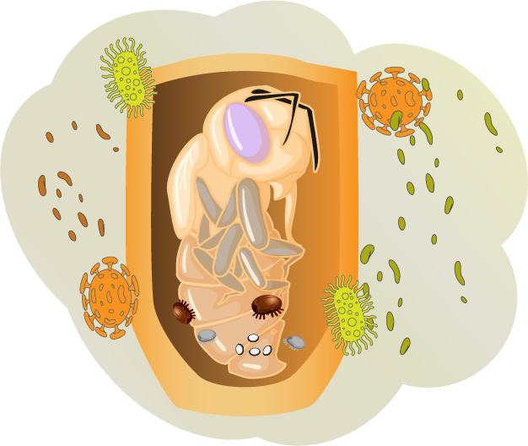
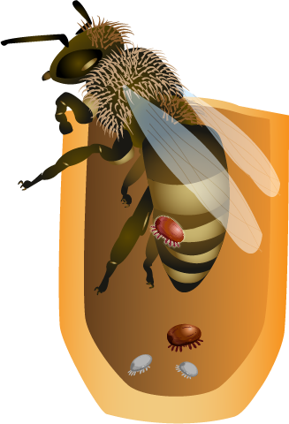
In the next slides, we will learn the life cycle of varroa
© 2019 Michigan State University
Graphic design by Anne Turnham, University of Minnesota Bee Lab

Slide 21
A female enters the cell of a larva just before it is capped
© 2019 Michigan State University
Graphic design by Anne Turnham, University of Minnesota Bee Lab

Slide 22
Seventy hours after capping, the female mite will lay an egg that will become a male
Every 30 hours she will lay another egg, and these eggs will become females
© 2019 Michigan State University
Graphic design by Anne Turnham, University of Minnesota Bee Lab

Slide 23
When the mites feed on the pupa they transmit viruses
They damage the bees during the most delicate phase of development
© 2019 Michigan State University
Graphic design by Anne Turnham, University of Minnesota Bee Lab

Slide 24
When the bee emerges, the original mite emerges, as well as one more daughter
The rest of the mites are not developed enough to survive
In drone cells, two additional mites can emerge with the original female
© 2019 Michigan State University
Graphic design by Anne Turnham, University of Minnesota Bee Lab

Slide 25
The reproductive females will move to other bees. The can continue to reproduce as long as there is brood in the hive
© 2019 Michigan State University
Graphic design by Anne Turnham, University of Minnesota Bee Lab

Slide 26
Mites spread disease and physically injure the bees
Mites spread pathogens when they feed on developing honey bee pupae
Mites spread pathogens when they feed on adult bees
© 2019 Michigan State University
Graphic design by Anne Turnham, University of Minnesota Bee Lab

Slide 27
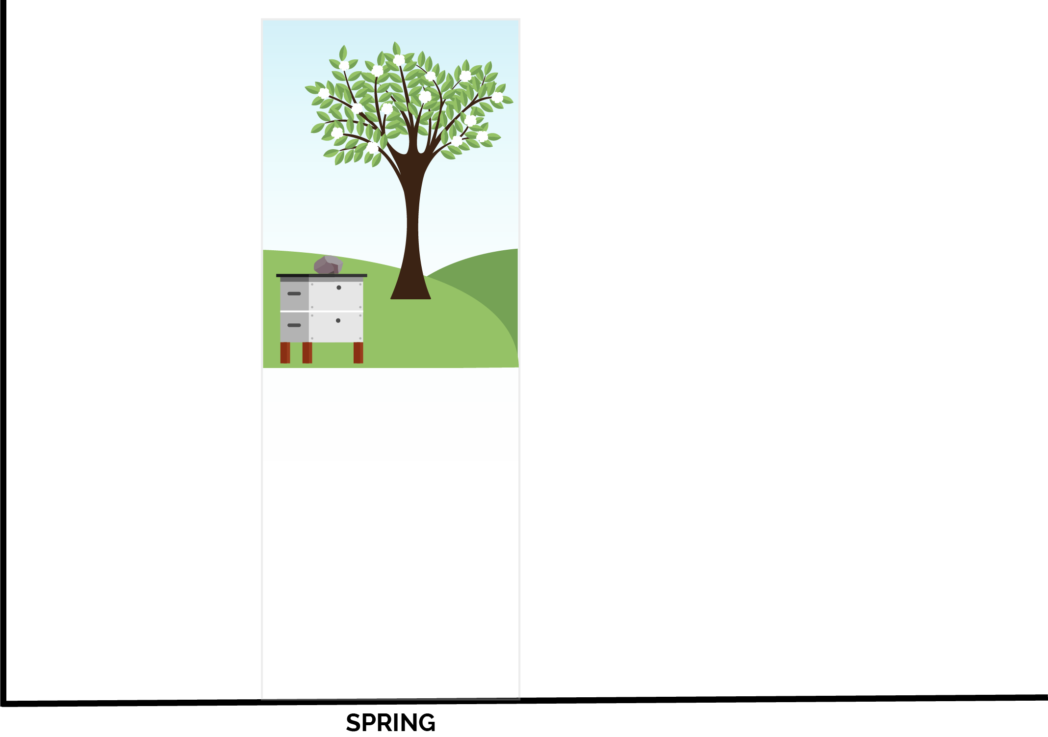
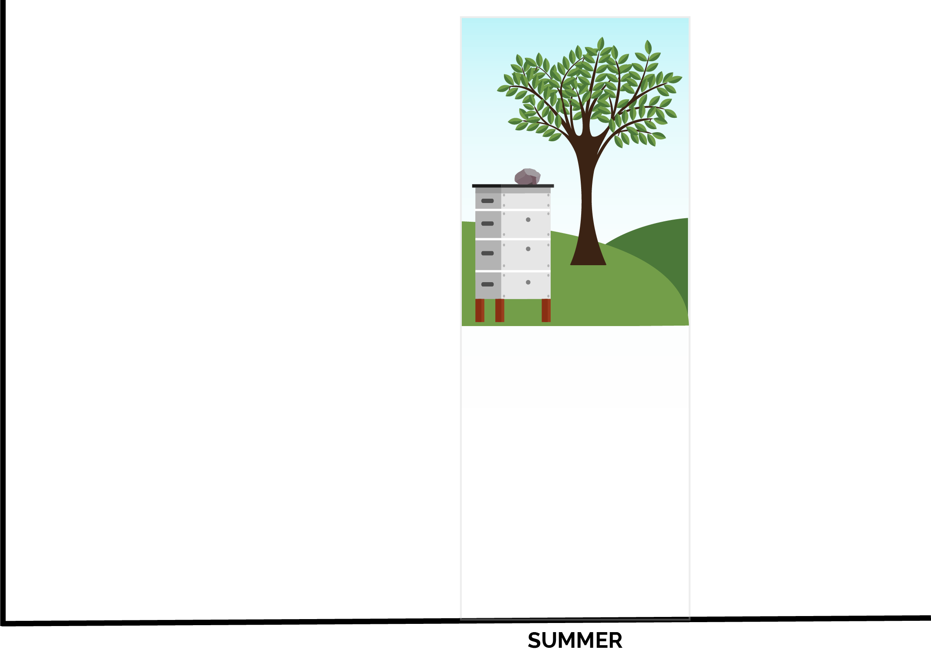
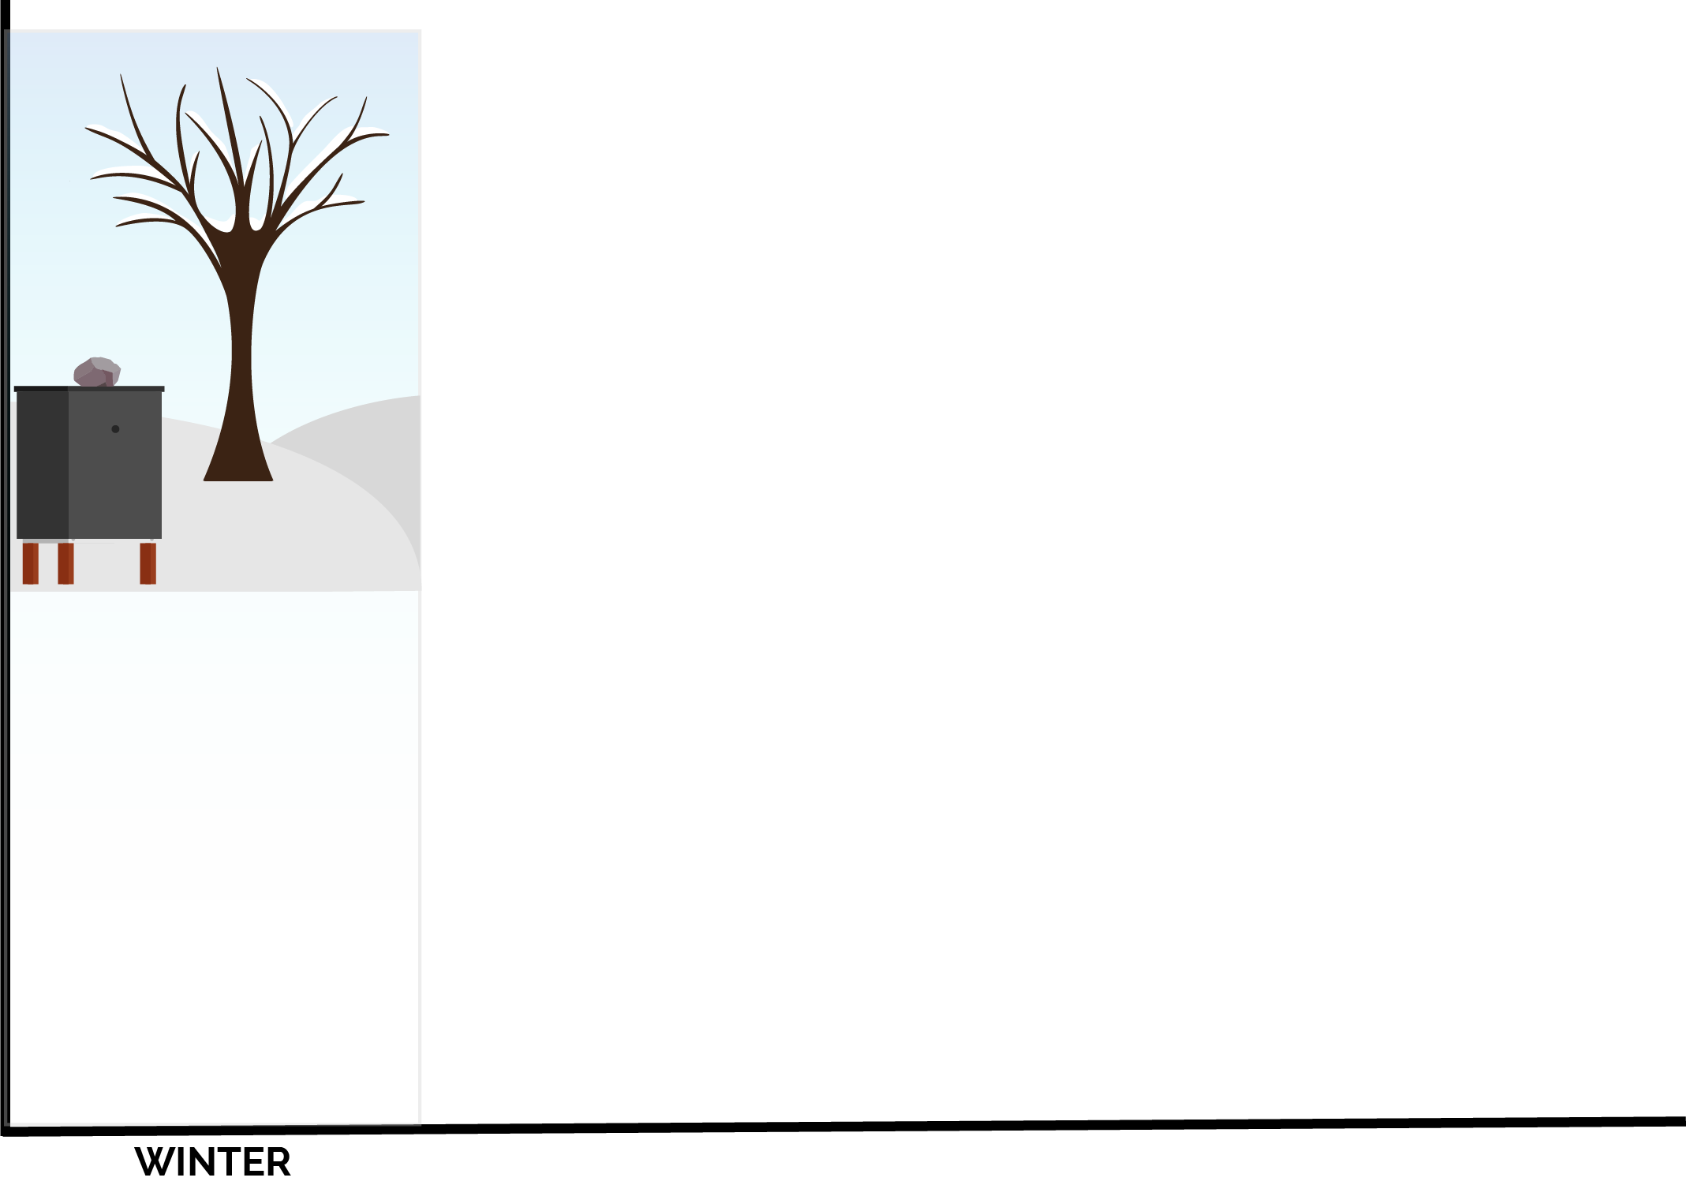
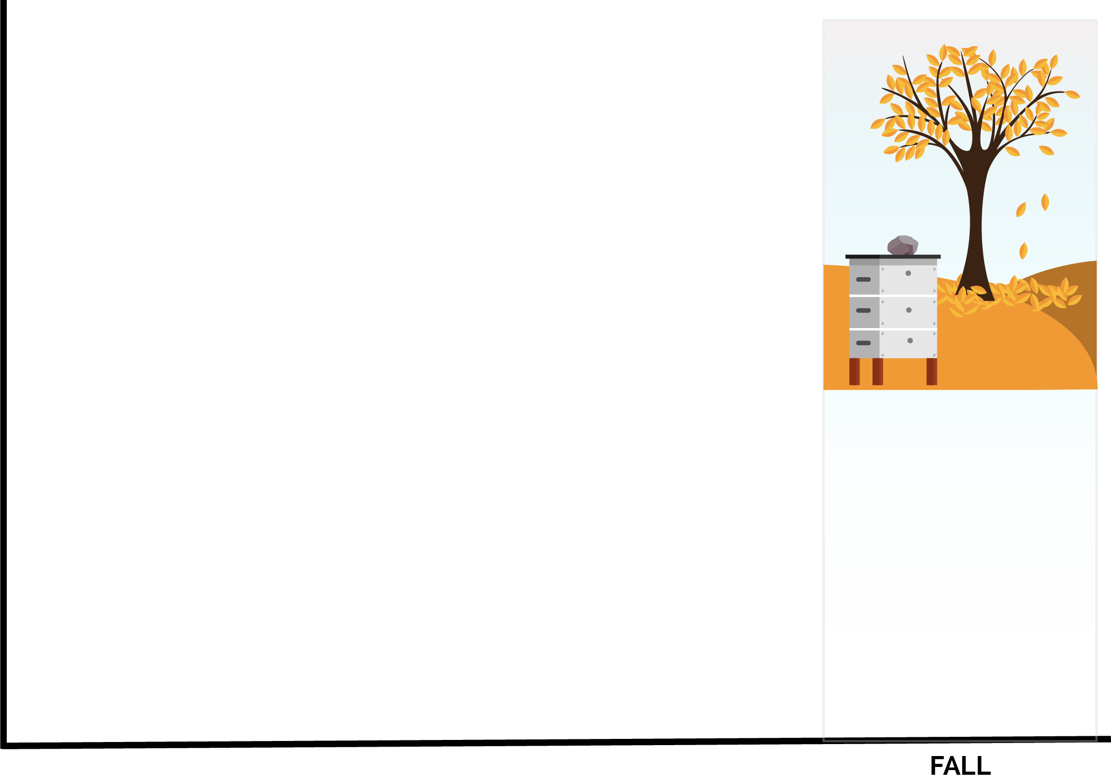
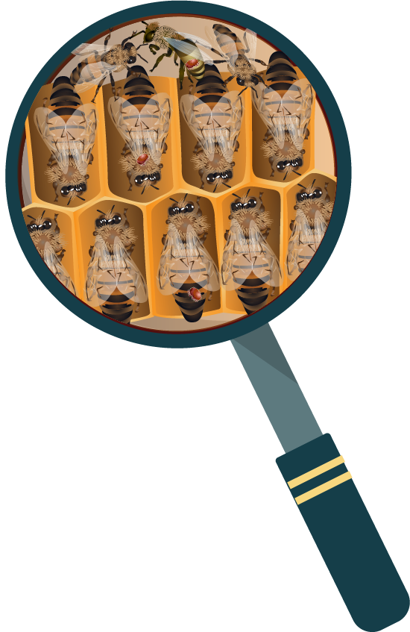
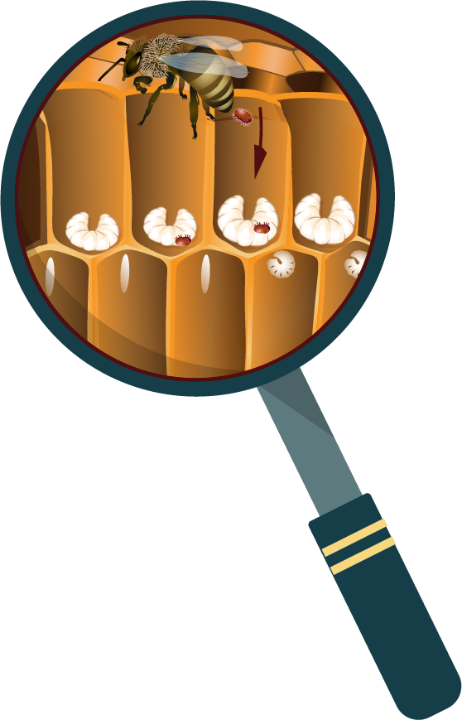
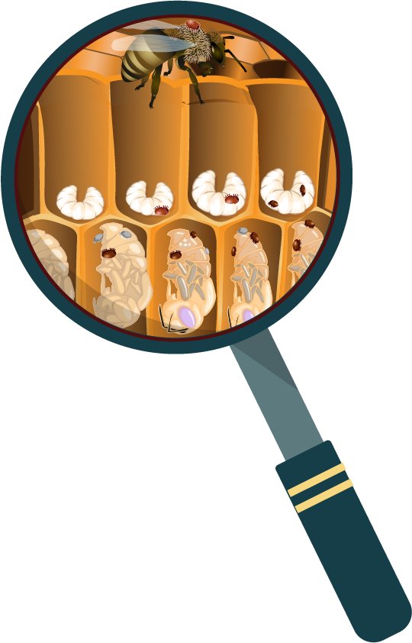

Mite risk is seasonal
© 2019 Michigan State University
Graphic design by Anne Turnham, University of Minnesota Bee Lab

Slide 28
Winter
Varroa don’t reproduce when bees are in cluster, but they feed on the fat bodies of adult bees
© 2019 Michigan State University
Graphic design by Anne Turnham, University of Minnesota Bee Lab

Slide 29
Spring
Varroa that overwintered in the colony begin to reproduce in the first brood
© 2019 Michigan State University
Graphic design by Anne Turnham, University of Minnesota Bee Lab

Slide 30
Summer
In the summer, there is a lot of brood so the mites reproduce heavily
© 2019 Michigan State University
Graphic design by Anne Turnham, University of Minnesota Bee Lab

Slide 31
Fall
In the fall, the brood rearing slows down as winter bees are made
Since mites levels have been growing all summer, there are a lot of mites to infest these few cells
© 2019 Michigan State University
Graphic design by Anne Turnham, University of Minnesota Bee Lab

Slide 32
Mite risk is seasonal
© 2019 Michigan State University
Graphic design by Anne Turnham, University of Minnesota Bee Lab

Slide 33
Mite populations peak right when winter bees are being formed
Mites feed on the fat bodies of the bees
The combination of viruses and damage to the bees cause early death to the winter bees
Your colony may look huge in the fall, because it is filled with summer bees
Once summer bees die, the colony may not have enough winter bees to survive the winter
Varroa harm and kill many colonies by feeding on winter bees
© 2019 Michigan State University

Slide 34
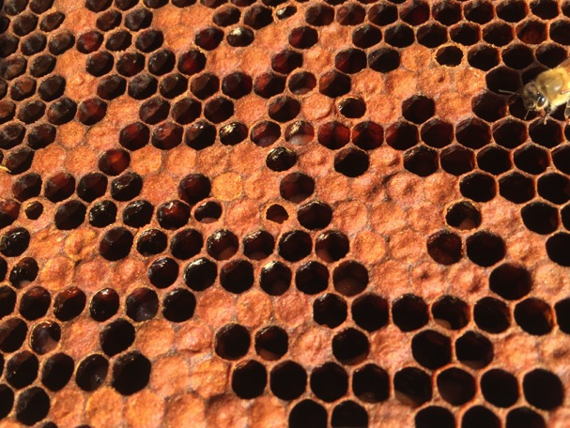
Varroa frass (excrement) on cell ceilings indicating cells that had mites
Would you expect this colony to have enough healthy winter bees to survive a Michigan winter?
  © 2019 Michigan State University
© Ana Heck

Slide 35
Keep bees alive: monitor mite levels
© 2019 Michigan State University
Graphic design by Anne Turnham, University of Minnesota Bee Lab

Slide 36
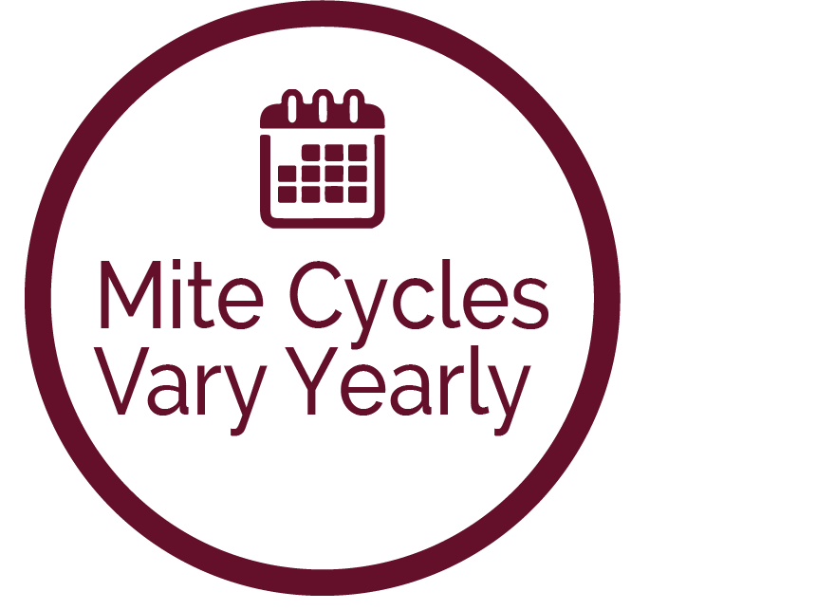
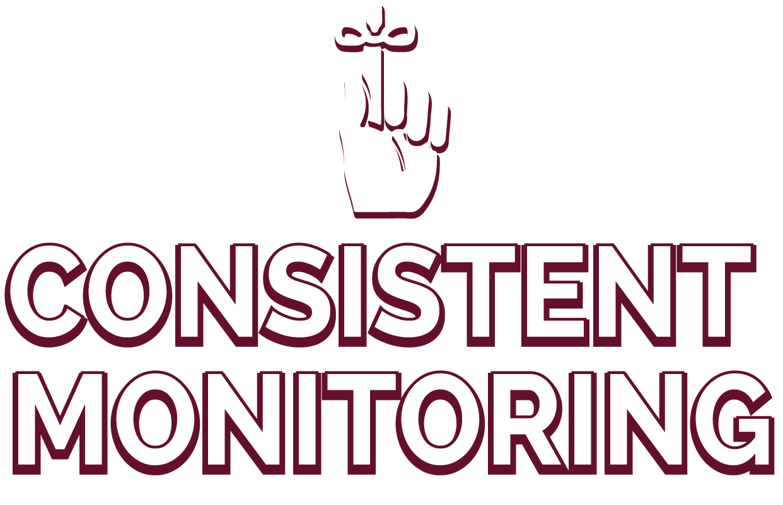
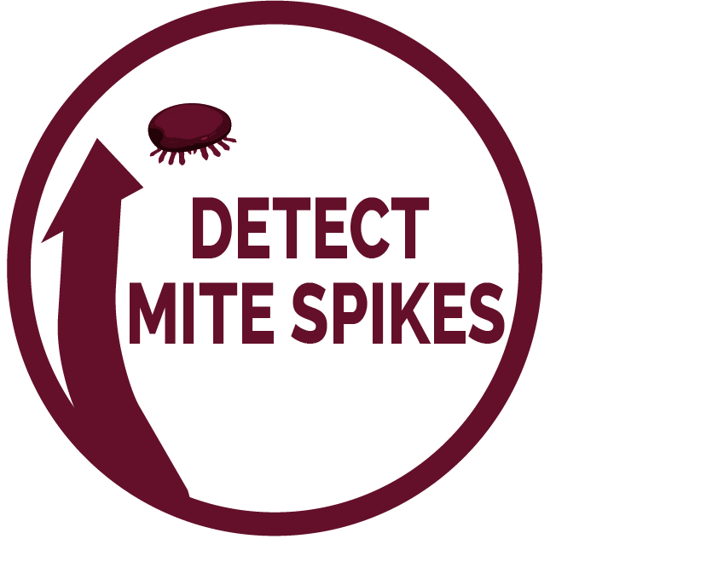


© 2019 Michigan State University
Graphic design by Anne Turnham, University of Minnesota Bee Lab

Slide 37


Visible signs of mites
Varroa are visible to the naked eye, but most mites are on the underside of bee and between segments where they can’t be seen
If you see mites on adult bees, it is likely that your mite levels are already very high
© 2019 Michigan State University
Graphic design by Anne Turnham, University of Minnesota Bee Lab

Slide 38
To keep our bees safe, we need to know that they are not overwhelmed by parasites
We need to use a method that provides a result in
“mites per 100 bees” or “percent infestation”
Powdered sugar roll tests and alcohol wash tests tell you your mite level per 100 bees
© 2019 Michigan State University

Slide 39
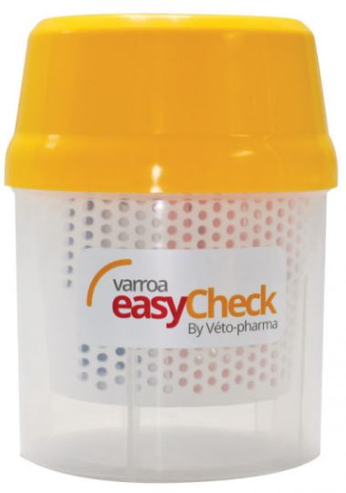
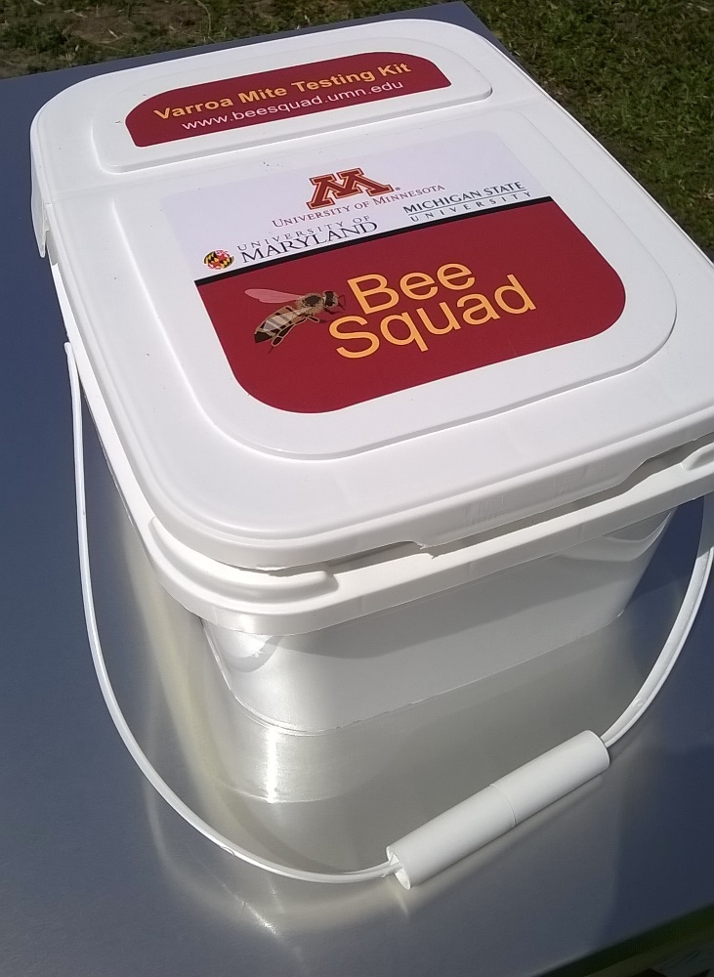
Powdered sugar roll test kit
You can purchase or make your own mite test kit
Alcohol wash test kit
© 2019 Michigan State University

Slide 40
Which test to use?
The alcohol wash test may be slightly more accurate than the powdered sugar roll test, but they are close enough
Both the alcohol wash and sugar roll can be used, and give you a result in mites/ bees
Powdered sugar roll tests are good for beekeepers who can’t stand to watch their bees die
The Honey Bee Health Coalition and the UMN Bee Lab have different instructions on how to sample for mites using a powdered sugar roll
  It is fine to use either method
© 2019 Michigan State University

Slide 41
Common sampling mistakes
Not collecting enough bees in the sample jar
Not monitoring often enough (at least once per month)
Not monitoring late enough in the beekeeping season
Not shaking sample jar hard enough
© 2019 Michigan State University

Slide 42
Common sampling mistakes
In a powdered sugar roll:
Bees get sticky/wet (from the sample jar being left in the sun or from a nectar flow)
  If bees are sticky/wet, the test failed
Not letting bees rest for long enough (2 minutes) before shaking
Using old/exposed powdered sugar
© 2019 Michigan State University

Slide 43
Observations that won’t tell you your mites per 100 bees:
Sticky boards
Looking for mites on bees
  Remember, most mites are on the undersides of bees where they can’t be seen
Looking in drone brood for mites
If you see mites, do a mite test!
© 2019 Michigan State University

Slide 44
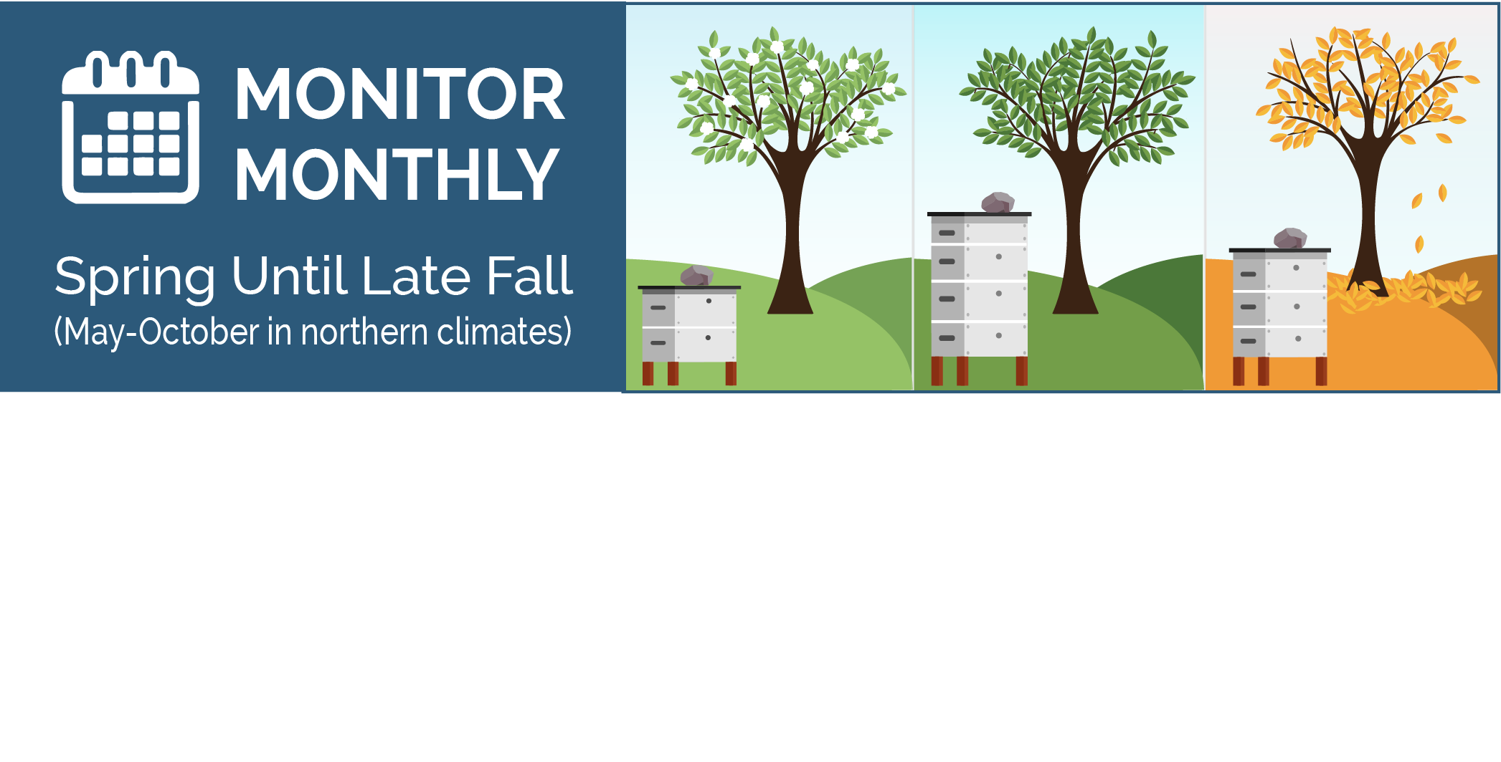
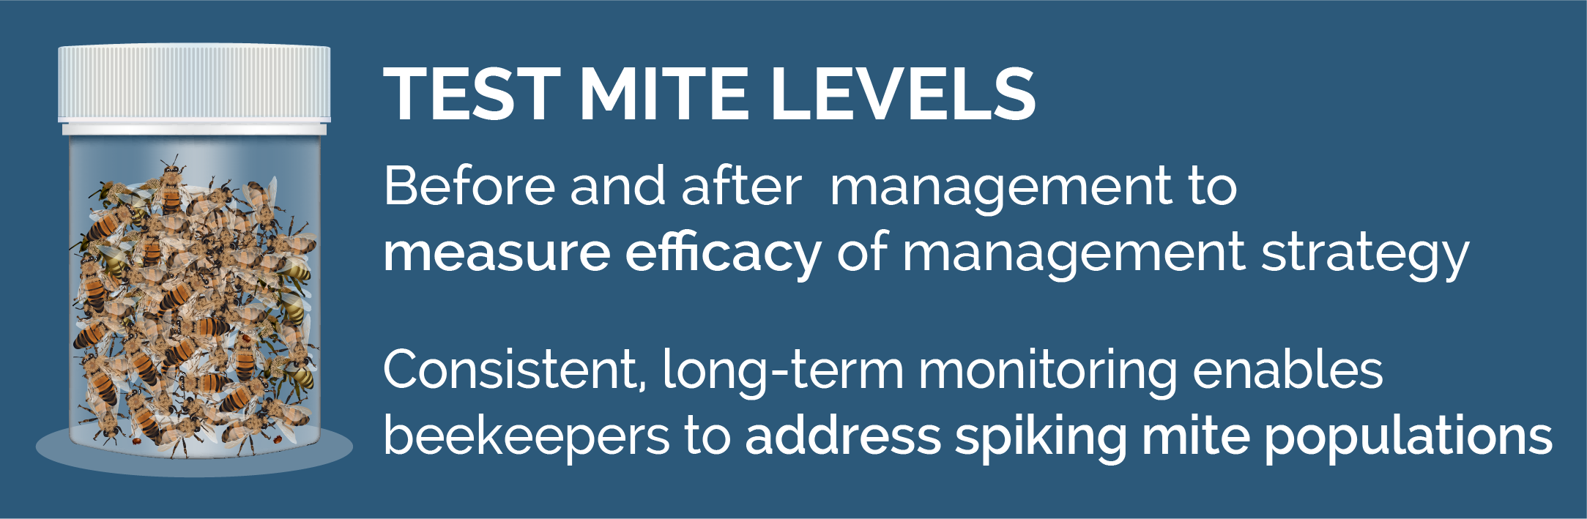
Monitor monthly and after you manage for mites
© 2019 Michigan State University
Graphic design by Anne Turnham, University of Minnesota Bee Lab

Slide 45
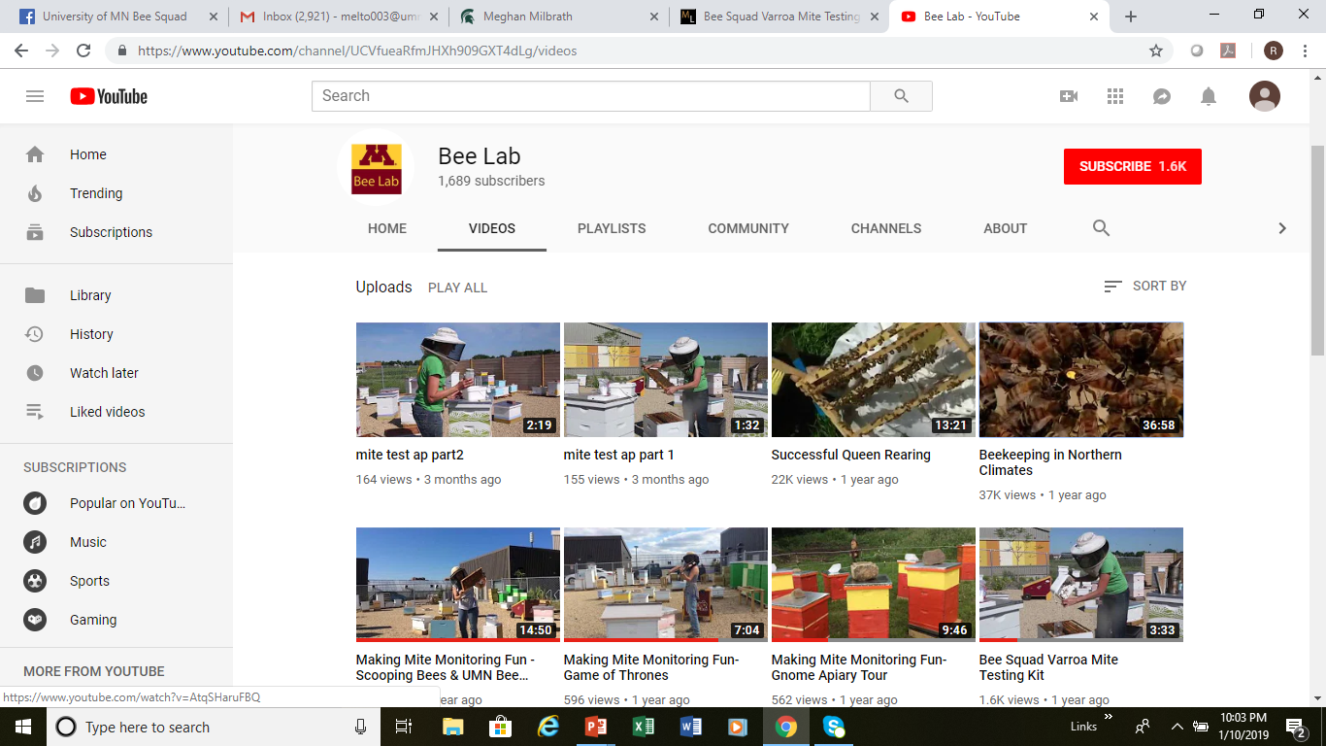
University of Minnesota Bee Lab YouTube channel:
how to do a powdered sugar roll test
© 2019 Michigan State University

Slide 46


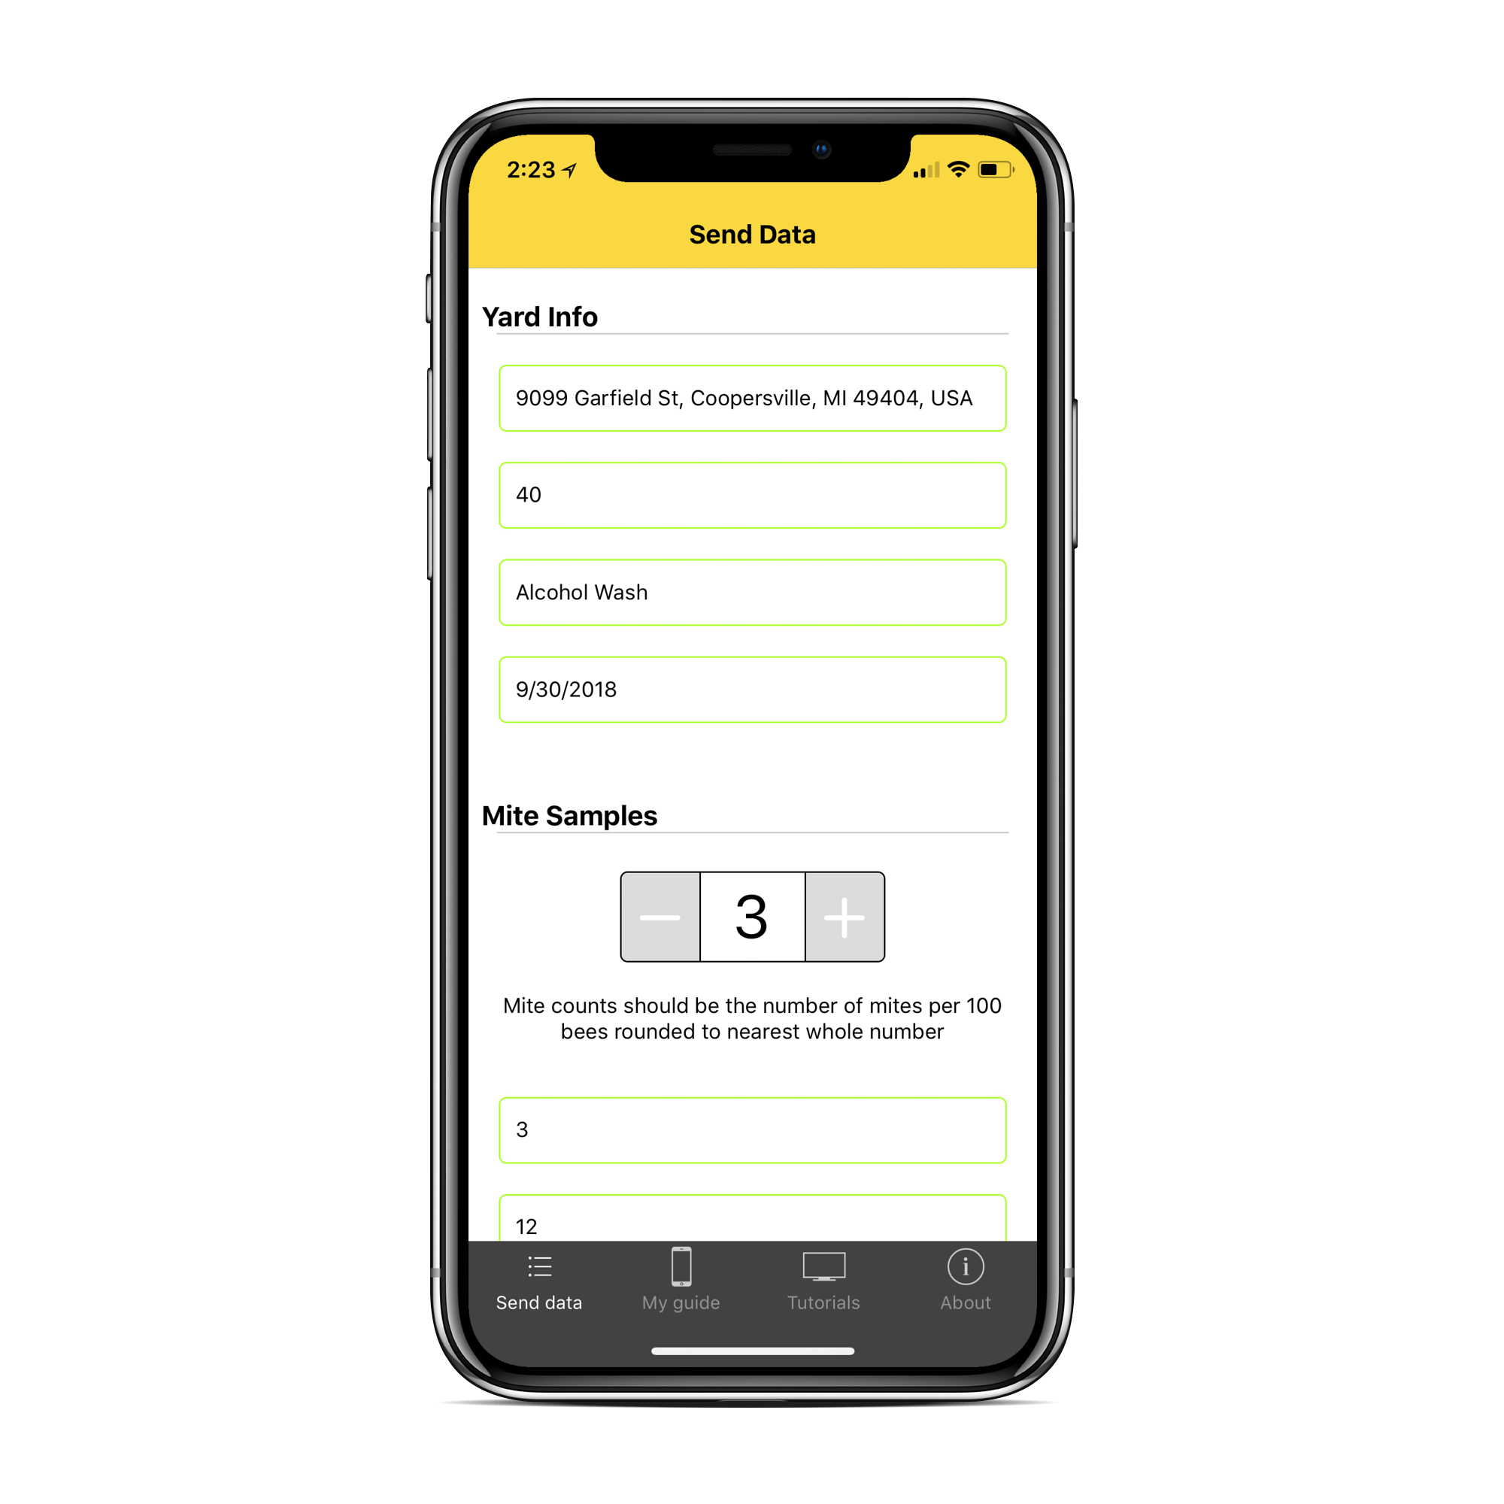
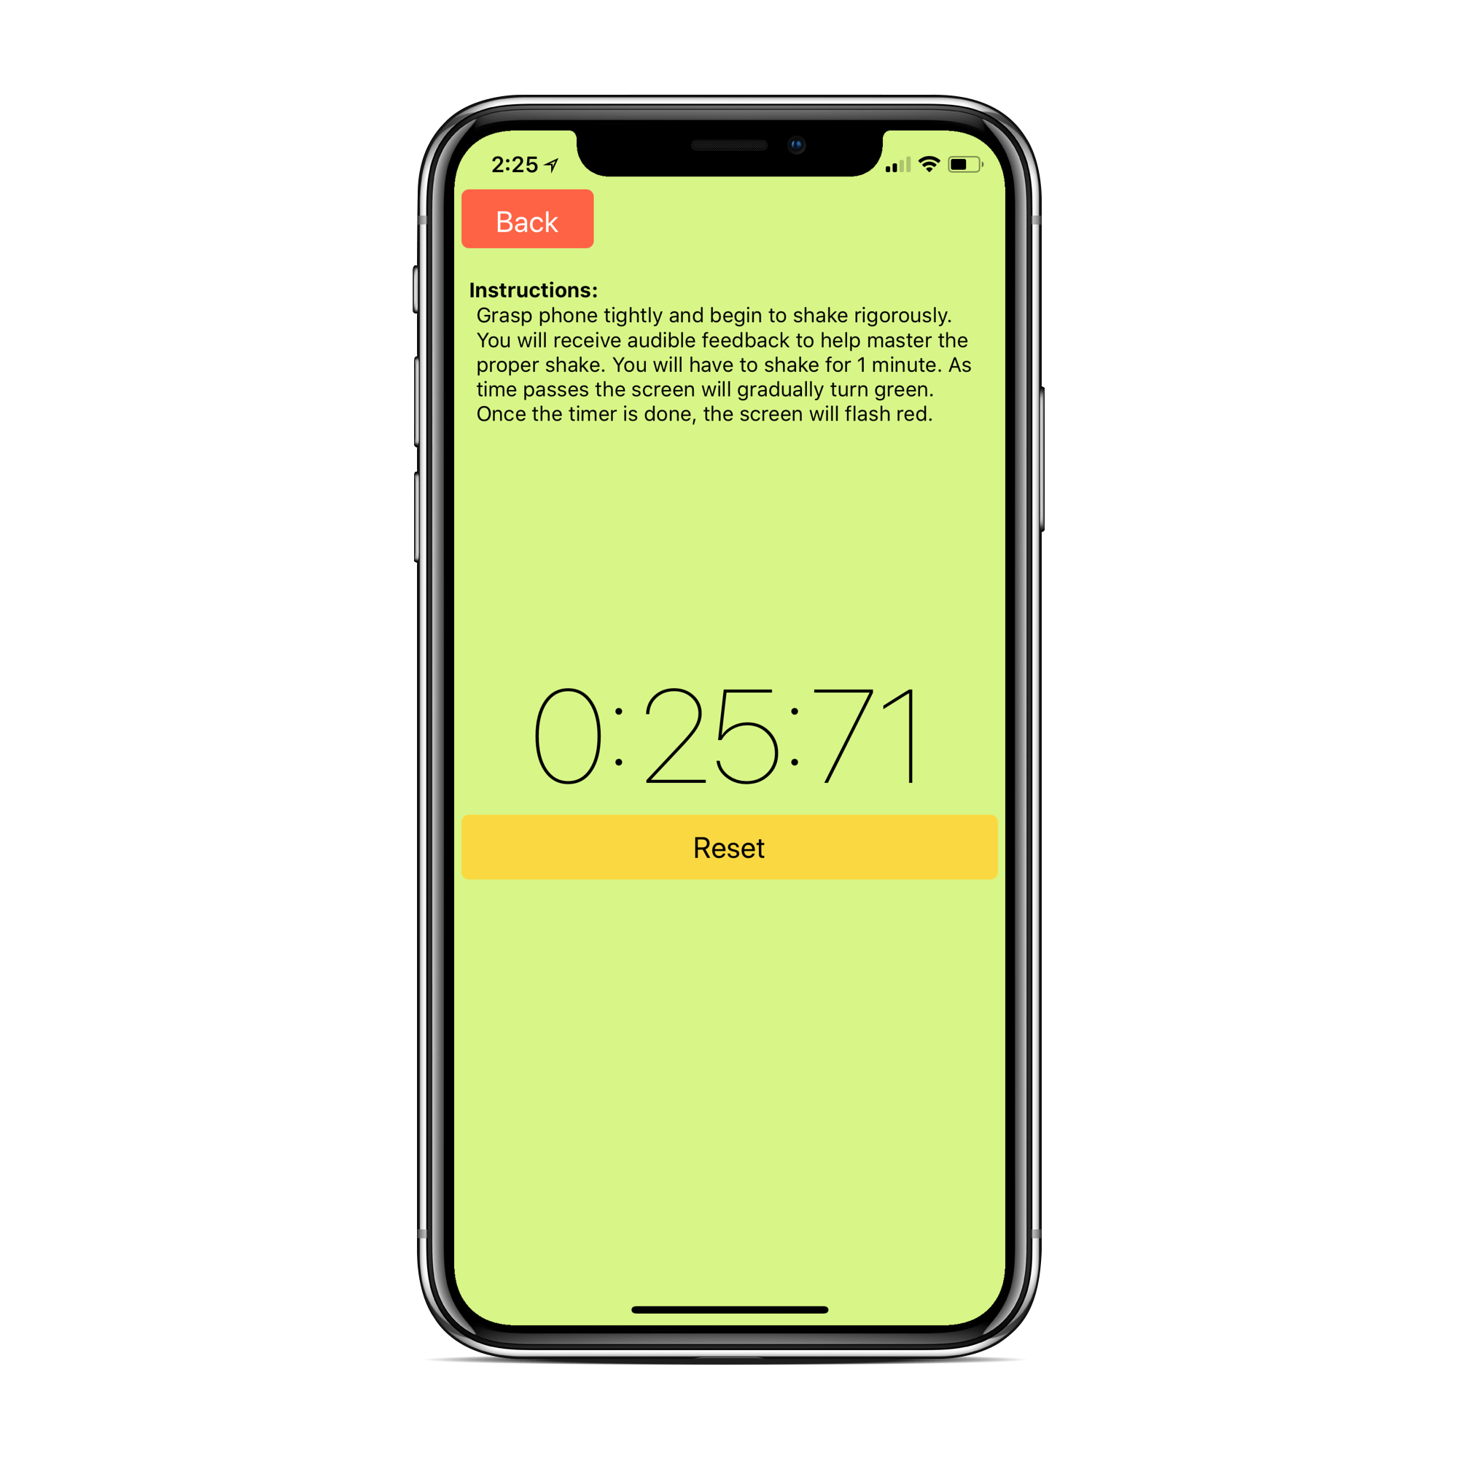
MiteCheck mobile app
Tutorials
Easily report your mite counts
A shake trainer!
© 2019 Michigan State University

Slide 47
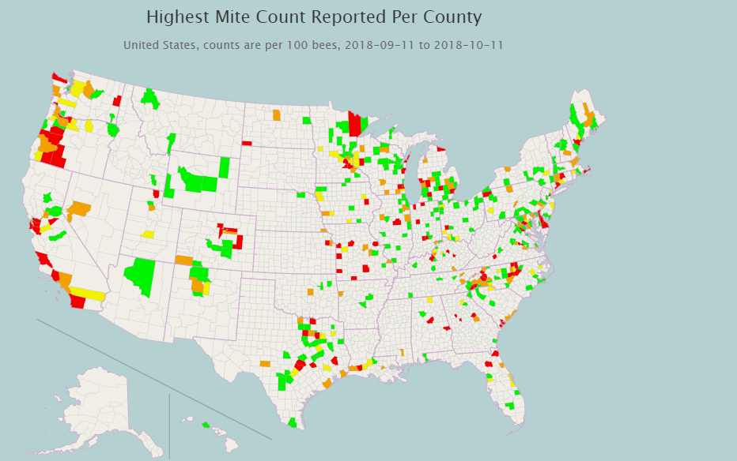

Report your mites to mitecheck.com
Highest Mite Count Reported Per County
2018
© 2019 Michigan State University

Slide 48
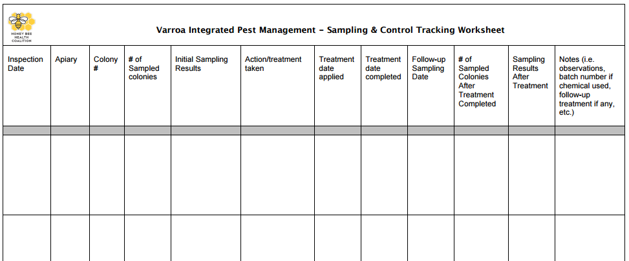
Sampling and control worksheet: keep track of mite monitoring and management
Download the Excel Spreadsheet:
www.honeybeehealthcoalition.org/varroa
© 2019 Michigan State University
Slide modified from the Honey Bee Health Coalition

Slide 49
Keep bees alive: anticipate seasonal mite growth
© 2019 Michigan State University
Graphic design by Anne Turnham, University of Minnesota Bee Lab

Slide 50
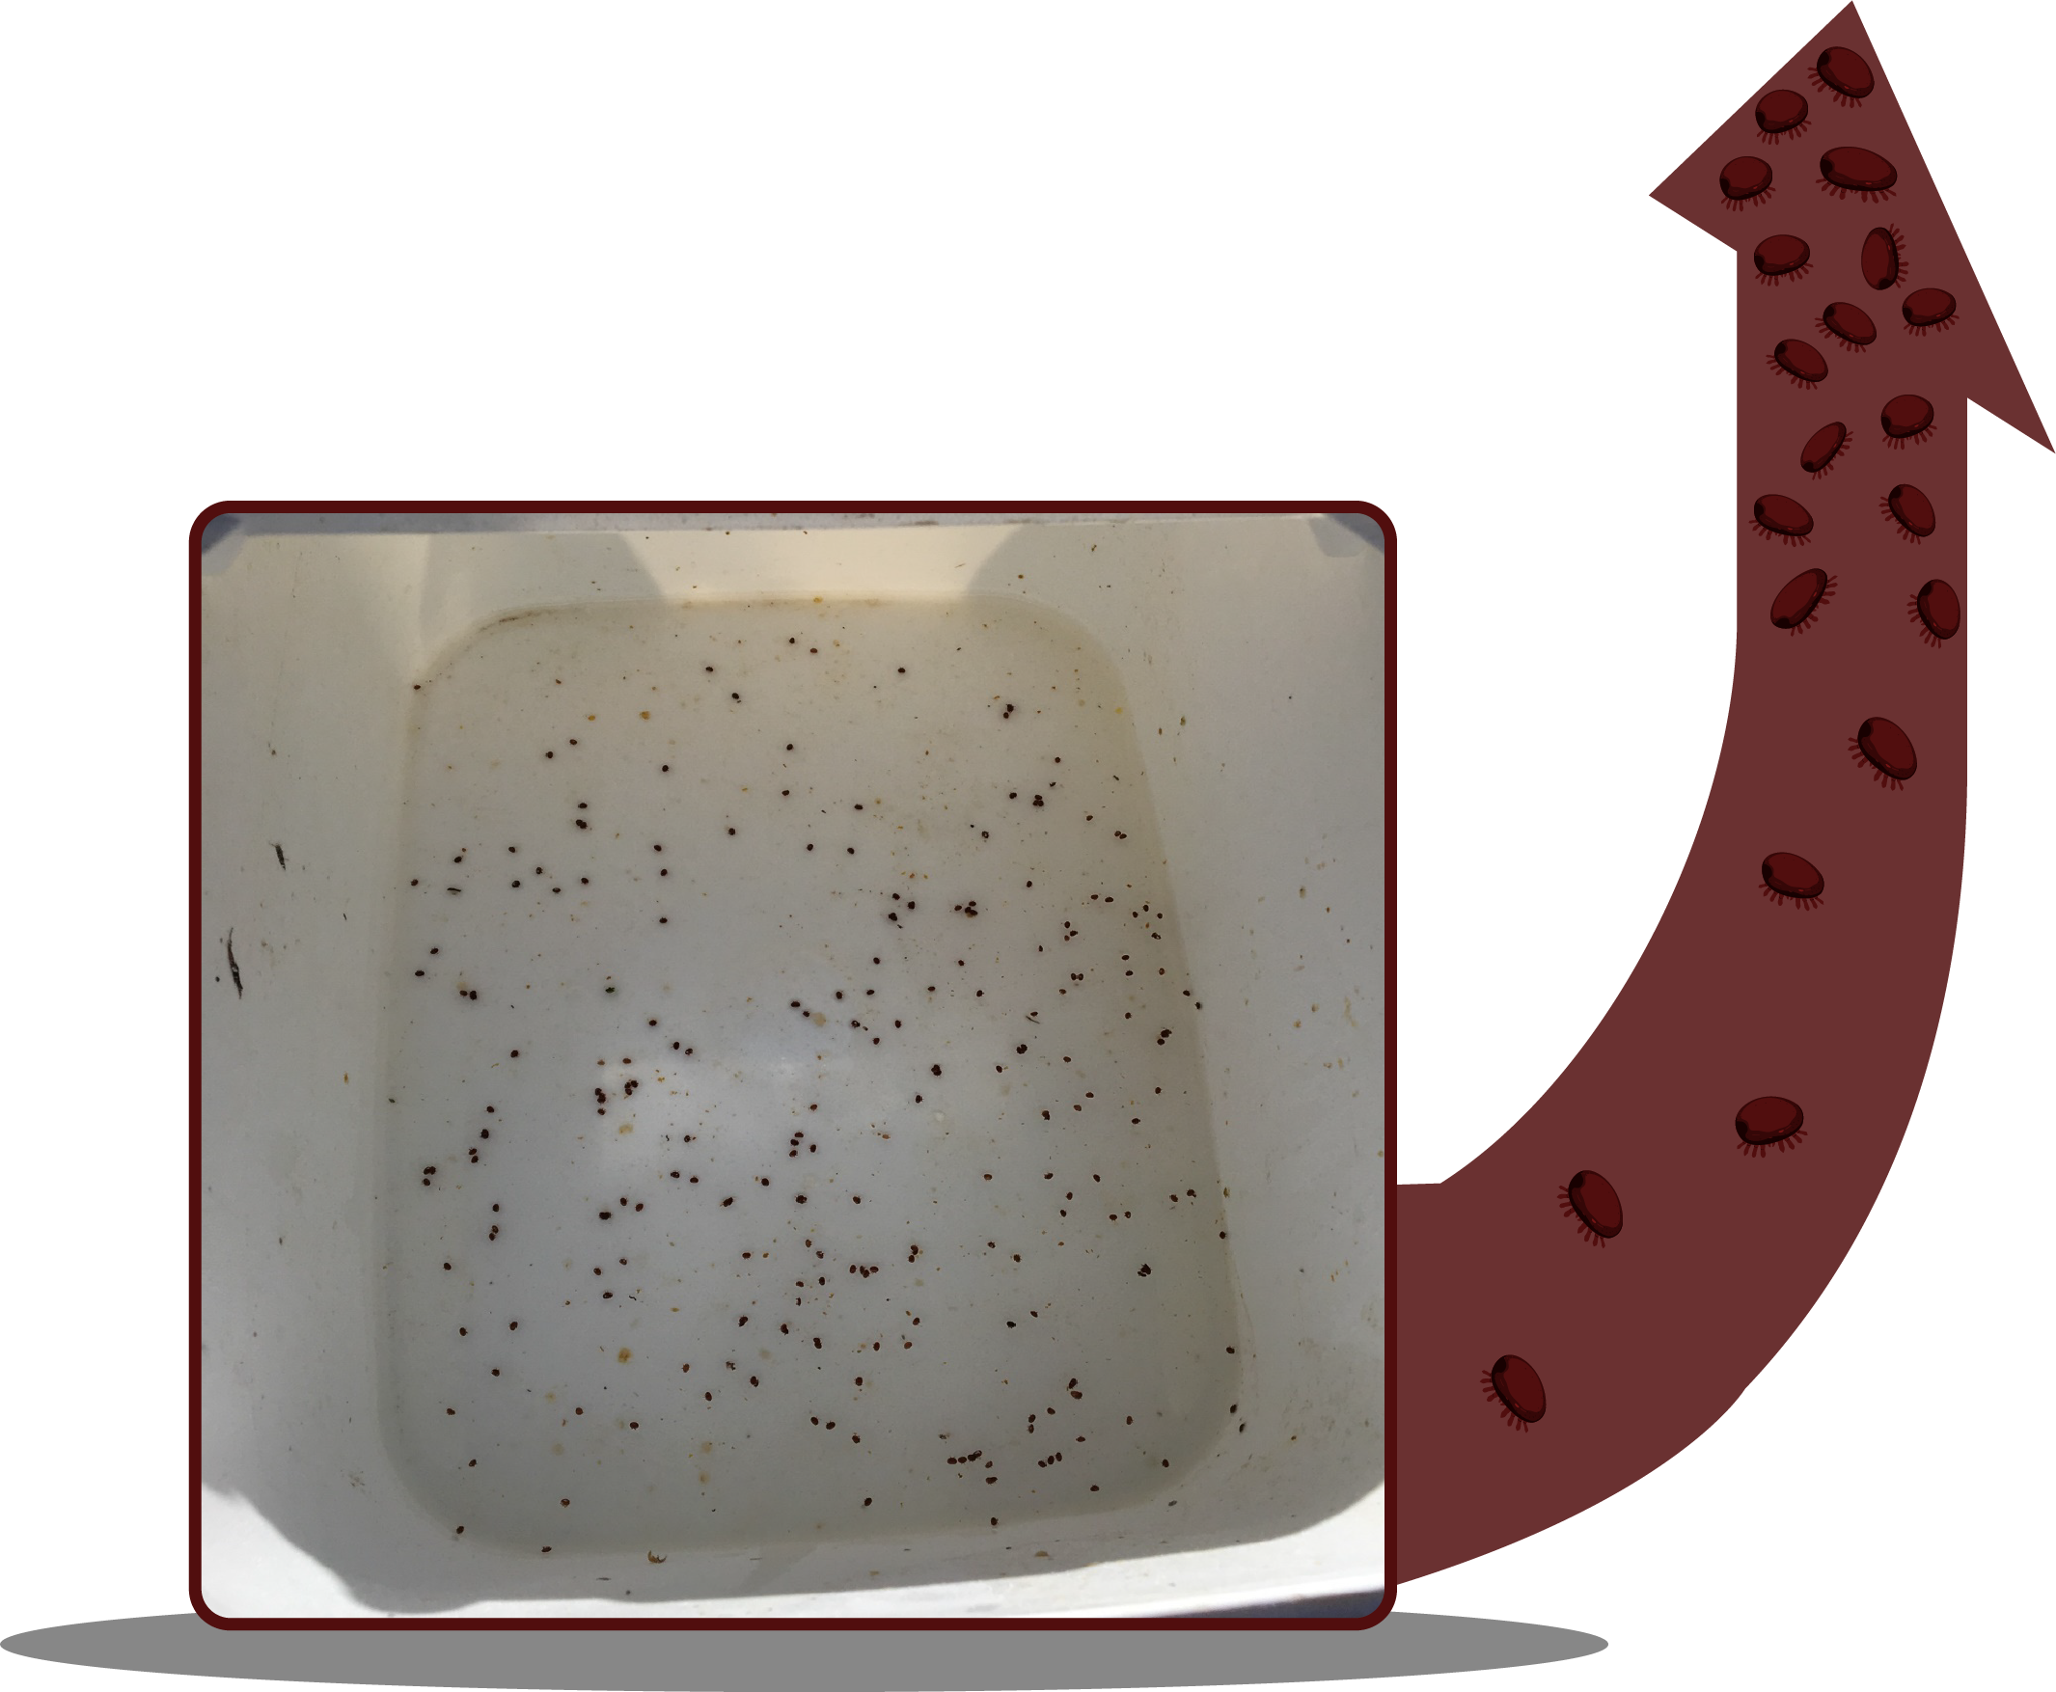
Autumn mite spike
Results from a powdered sugar roll test:
VERY HIGH mite level!
© 2019 Michigan State University
Graphic design by Anne Turnham, University of Minnesota Bee Lab

Slide 51
Did you sample through the end of the beekeeping season?
In the next slide, we will show you an example of high mite levels in autumn
Eight colonies were monitored for mites monthly
Mite levels (mites per 100 bees) samples were analyzed by the Bee Informed Partnership as part of the Sentinel Apiary program (alcohol/saline test)
Yard located in Minnetrista, Minnesota
All colonies were package colonies
All colonies were treated with Formic Pro in August and an oxalic acid dribble in November
Are you ready to see the mite numbers?
© 2019 Michigan State University

Slide 52

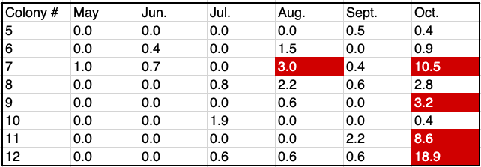
Did you sample through the end of the beekeeping season?
Varroa per 100 bees (2018):
All colonies were treated with Formic Pro in August and an oxalic acid dribble in November
© 2019 Michigan State University

Slide 53
Keep bees alive: help your bees keep mite levels low
© 2019 Michigan State University
Graphic design by Anne Turnham, University of Minnesota Bee Lab

Slide 54
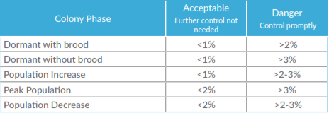
Varroa thresholds
Acceptable: Current mite populations are not an immediate threat.
Danger: Colony loss is likely unless the beekeeper controls varroa immediately.
Post treatment sample percentage should be < 3%
© 2019 Michigan State University
Slide modified from the Honey Bee Health Coalition

Slide 55
Factors that may affect mite levels and action thresholds:
Time of year and colony growth phase
Amount of brood in the colony
Size of colony
Colony density in yard
Proximity of yard to other bee yards
Mite management strategies of beekeeper neighbors
Geographic location and climate
  Virus strains can vary by location
© 2019 Michigan State University

Slide 56
The strategy that you use to manage mites will depend on your risk
The risk of varroa changes every year and changes by location
Some beekeepers will have to do a lot of work, while other beekeepers will not have much risk
What works for other beekeepers may not work in your area
What worked last year may not work this year
© 2019 Michigan State University

Slide 57

Non-chemical varroa management strategies can be used throughout the season to help keep mite populations from exploding
Choose bees less susceptible to mite damage:
  Hygienic behavior (genetic trait)
  Grooming behavior (genetic trait)
Drone comb removal
Create a brood break:
  Create a walk-away divide
Maintain small (nucleus) colonies
Sticky boards under screened bottom boards
© 2019 Michigan State University
Graphic Design by Anne Turnham, University of Minnesota Bee Lab

Slide 58
In many places, non-chemical strategies are not sufficient to keep mite populations from harming your bees
Many non-chemical strategies require an understanding of beekeeping biology and management, and may be overwhelming or impossible for beginning beekeepers
Try to learn to incorporate strategies like brood breaks into your management plans, but make sure you are monitoring to make sure they are working
© 2019 Michigan State University

Slide 59
Keep bees alive: know your treatment options
© 2019 Michigan State University
Graphic design by Anne Turnham, University of Minnesota Bee Lab

Slide 60
Varroa treatments
Acid based treatments
  Formic Acid
    Mite Away Quick Strips (MAQS)
    Formic Pro
  HopGuard II
  Oxalic acid
Thyme oil-based treatments
  Apiguard
  ApiLife Var
Synthetic treatment
  Apivar (Apistan)
© 2019 Michigan State University
Graphic design by Anne Turnham, University of Minnesota Bee Lab

Slide 61
Varroa keep killing Michigan bees
Some beekeepers treat their bees, but don’t have an effective management strategy
For example, some beekeepers:
Treat once per season and believe that is enough
  Some colonies may need multiple treatments throughout the season
Only treat with oxalic acid (which doesn’t kill mites under the brood cappings)
© 2019 Michigan State University

Slide 62
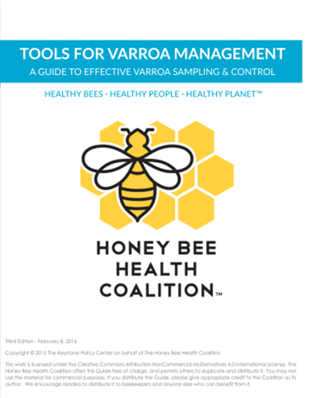
Honey Bee Health Coalition’s Tools for Varroa Management guide:
learn about treatment options
Download the Guide:
www.honeybeehealthcoalition.org/varroa
© 2019 Michigan State University
Slide modified from the Honey Bee Health Coalition

Slide 63
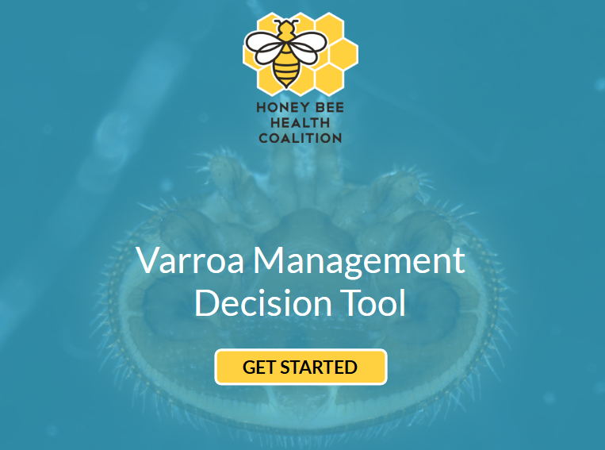
Honey Bee Health Coalition’s varroa management decision tool:
find your treatment options
honeybeehealthcoalition.org/VarroaTool
© 2019 Michigan State University
Slide modified from the Honey Bee Health Coalition

Slide 64
Honey Bee Health Coalition’s
varroa management decision tool:
Answer questions to learn which treatments are available for you to use:
Do your varroa mite levels exceed threshold?
Are you open to synthetic & naturally-derived treatments or just naturally-derived treatments?
Is brood present?
Do you have honey supers on?
Is your colony’s population increasing, at peak, decreasing, or dormant?
honeybeehealthcoalition.org/VarroaTool
© 2019 Michigan State University
Slide modified from the Honey Bee Health Coalition

Slide 65
If I’m treatment-free, will I select for varroa-resistant bees?
Even colonies that have a genetic tendency to tolerate varroa loads can die from horizontal transmission
  Breeding is generally stepwise – you often lose colonies that are useful in working towards better bees
You may breed bees with other undesirable traits – varroa are not our only issue
Can you control the drone sources? Can you artificially inseminate queens, or are you on an isolated island?
Do you have dozens/hundreds of colonies with good stock that you can evaluate and choose from?
Is withholding treatment an ethical way to breed for bees?
© 2019 Michigan State University

Slide 66
If I’m treatment-free, will I select for varroa-resistant bees?
Remember, honey bees aren’t native to the Americas
Very few areas of the United States are known to have healthy feral populations
Honey bee colonies need beekeepers to control pests and diseases so that they don’t die
  Just like dogs need tick collars or flea medication
© 2019 Michigan State University

Slide 67
Keep bees alive: apply treatments correctly
© 2019 Michigan State University
Graphic design by Anne Turnham, University of Minnesota Bee Lab

Slide 68
Treatments
Anything used to kill mites is a pesticide – even if it is natural or homemade
Pesticides are covered by law
  Legally, treatments must be approved and applied according to the label
Improper application may harm humans and bees
Do not instruct beekeepers on how to apply a treatment unless you are very familiar with the label
© 2019 Michigan State University
Graphic design by Anne Turnham, University of Minnesota Bee Lab

Slide 69
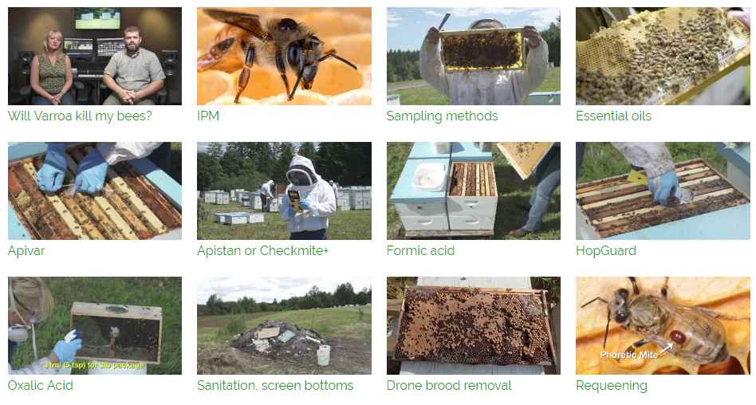
Honey Bee Health Coalition’s YouTube channel: how to correctly apply treatments
Watch the Video Series: Search YouTube for “Tools for Varroa Management Honey Bee Health Coalition”
© 2019 Michigan State University
Graphic design by Anne Turnham, University of Minnesota Bee Lab

Slide 70
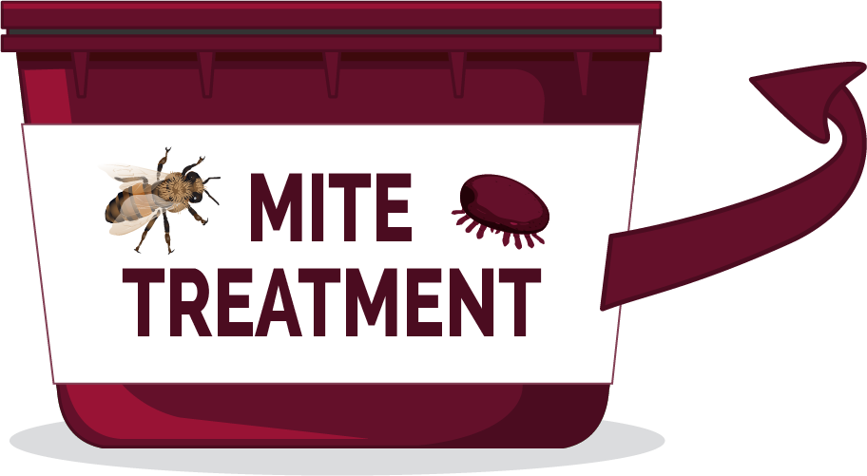
Follow the label
Some treatments restrict use based on:
  Temperature
  Brood in colony
  Honey supers
LABEL
It is important for the
beekeeper to wear
correct personal
protective equipment (PPE)
© 2019 Michigan State University
Graphic design by Anne Turnham, University of Minnesota Bee Lab

Slide 71
Keep bees alive: be a good beekeeper neighbor!
© 2019 Michigan State University
Graphic design by Anne Turnham, University of Minnesota Bee Lab

Slide 72
While mite densities may vary across colonies, all* colonies in an apiary should be treated at the same time with the same chemical or non-chemical technique
True or false?
© 2019 Michigan State University
Slide modified from the Honey Bee Health Coalition

Slide 73
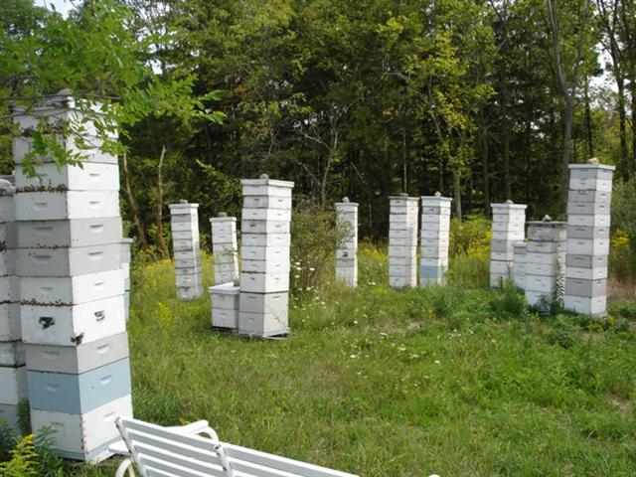

True
While mite densities may vary across colonies, all colonies in an apiary should be treated at the same time with the same chemical or non-chemical technique (if allowed by the label)
*Follow the label: some small/nucleus colonies may be too small for some treatments
Colonies with high mite numbers act as “mite bombs”
© Mike Risk
© 2019 Michigan State University
Slide modified from the Honey Bee Health Coalition

Slide 74
Keep bees alive: educate yourself about bees and mites
© 2019 Michigan State University
Slide modified from the Honey Bee Health Coalition

Slide 75
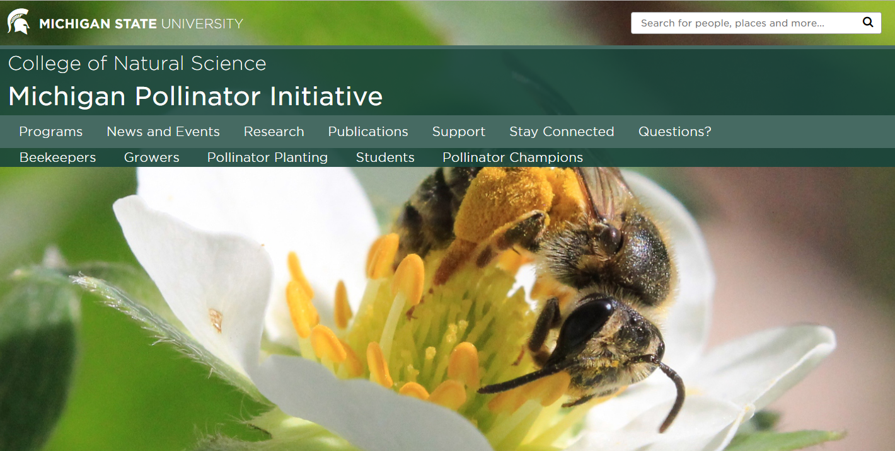
Michigan Pollinator Initiative
pollinators.msu.edu
© 2019 Michigan State University

Slide 76
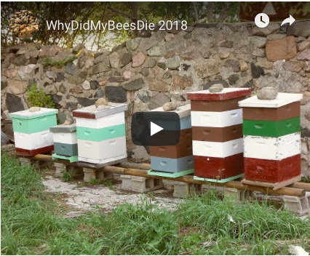
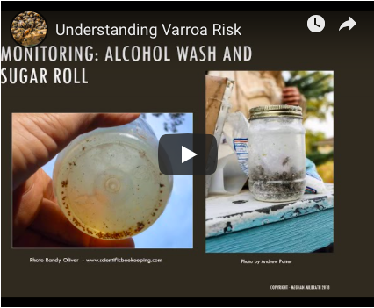
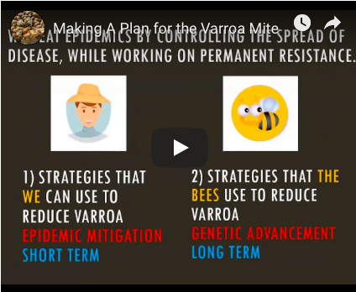
MSU’s keepbeesalive.org
Links to resources mentioned in this presentation
Download this PowerPoint presentation
Videos and handouts
Why did my bees die?
Understanding Varroa Risk
Making a Plan for Varroa
© 2019 Michigan State University

Slide 77
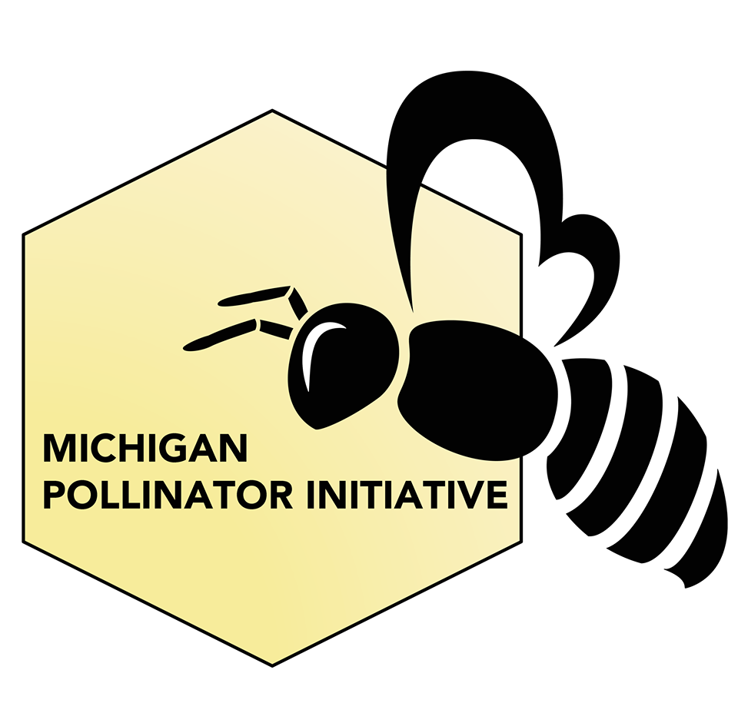

MSU’s Michigan Pollinator Initiative on Facebook:
@MichiganPollinatorInitiative
© 2019 Michigan State University

Slide 78


Pollinator Champions is a free, self-paced online course offered by MSU
Packed full of videos, articles, and fun activities to guide you through the amazing world of pollinators and pollination
The course is free, but for a small contribution you can receive a certificate and materials to help you give presentations about pollinators
Help us spread the word as an MSU Certified Pollinator Champion!
To register for Pollinator Champions, go to:
www.pollinators.msu.edu/programs/pollinator-champions/
© 2019 Michigan State University

Slide 79





University of Minnesota Bee Lab Social Media
University of MN
Bee Lab
University of MN
Bee Squad
www.beelab.umn.edu
www.beesquad.umn.edu
Bee Lab
UMNBeeSquad
@UMNBeeLab_Squad
© 2019 Michigan State University

Slide 80

The Honey Bee Health Coalition:
Treatment Information honeybeehealthcoalition.org
© 2019 Michigan State University

Slide 81
The Bee Informed Partnership: colony loss survey data beeinformed.org
© 2019 Michigan State University

Slide 82

  MSU Michigan Pollinator Initiative contacts:
  Ana Heck: heckanar@msu.edu, 517-884-7976
  Meghan Milbrath: mpi@msu.edu, 517-884-9518
  pollinators.msu.edu
  © 2019 Michigan State University
© Ana Heck
© Ana Heck

Slide 83
Summary
Virtually all colonies have or will have mites
A large percentage of colonies will not survive if the mite population exceeds 3%
High varroa populations (mite bombs) often result in virus epidemics that weaken or kill colonies
Some resistant stocks are helpful but temporary fixes are still needed to keep mite populations lower
Consult MSU’s keepbeesalive.org for varroa information and resources
© 2019 Michigan State University
Slide modified from the Honey Bee Health Coalition

Slide 84







This work is supported by a NIFA CARE grant "Mite Check: A national strategy to reduce honey bee colony loss from the varroa mite“ [grant no. 2017-08680] from the USDA National Institute of Food and Agriculture.
Content and graphic design for many slides was supported by an NCR-SARE PDP grant "Training an Influential Network of Farming, Beekeeping and Extension Experts to Promote Bee Health“ [grant no. ENC17-160] from the USDA National Institute of Food and Agriculture.
© 2019 Michigan State University

