Slide 1
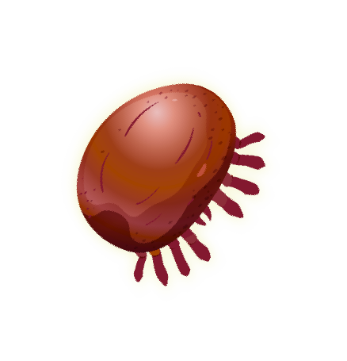
Keep Bees Alive
Information and resources for keeping your bees healthy in the era of varroa
© 2021 Michigan State University
Graphic design by Anne Turnham, University of Minnesota Bee Squad for NCR-SARE PDP grant "Training an Influential Network of Farming, Beekeeping and Extension Experts to Promote Bee Health“ [grant no. ENC17-160] from the USDA National Institute of Food and Agriculture.

Slide 2
We lose high numbers of honey bee colonies every year
Honey bee researchers and experts agree that bees are dying because of multiple, interacting factors including poor nutrition, pesticides, and pathogens.
While pesticides and poor nutrition can weaken a colony, most of the winter deaths are due to disease spread by varroa mites.
© 2021 Michigan State University
Graphic design by Anne Turnham, University of Minnesota Bee Squad for NCR-SARE PDP grant "Training an Influential Network of Farming, Beekeeping and Extension Experts to Promote Bee Health“ [grant no. ENC17-160] from the USDA National Institute of Food and Agriculture.

Slide 3
If we want to protect our bees, we need to manage harmful pests.
We often can’t control the pesticide exposure and the poor landscape around our hives.
While varroa aren’t the only problem for bees, they are a serious problem that we can control.
We can control the parasite loads in our hives.
© 2021 Michigan State University

Slide 4
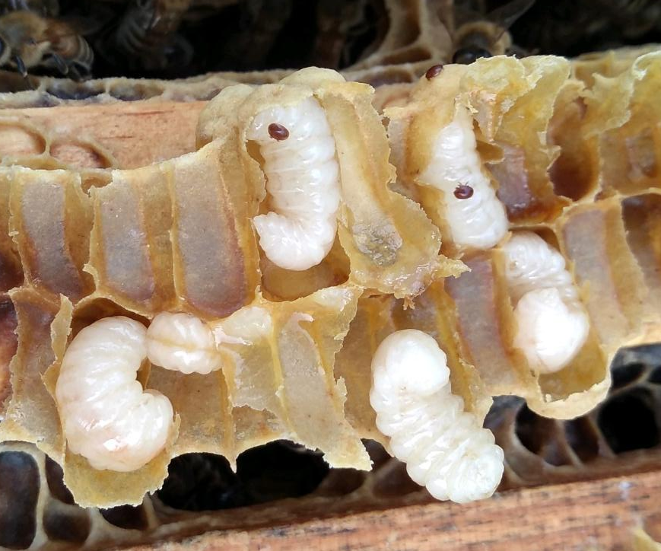
What is a varroa mite?
Scientific name → Varroa destructor
Originally a pest of Asian honey bee
Introduced to United States in 1987
In all beekeeping countries except Australia
Parasitizes pupa and adult bees
Vector for multiple viruses
© 2021 Michigan State University
Photo: © Dan Wyns
Slide modified from the Honey Bee Health Coalition

Slide 5
True or false?
Every honey bee colony in the continental United States and Canada either has Varroa mites today or will have them within several months.
© 2021 Michigan State University

Slide 6
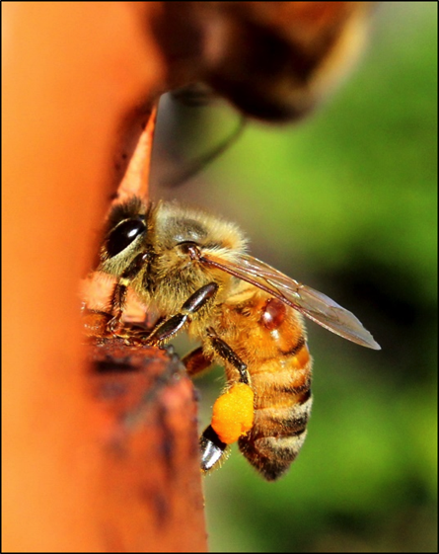
True
Every honey bee colony in the continental United States and Canada either has varroa mites today or will have them within several months.
Photo: © Dan Wyns
© 2021 Michigan State University

Slide 7
Just because your colony will have varroa doesn’t mean that your colony has to die from varroa
The mites will enter our hives throughout the season on the backs of foragers and robbers
We can take actions to make sure that the populations of mites never reach dangerous levels
Photo: © Dan Wyns
© 2021 Michigan State University

Slide 8
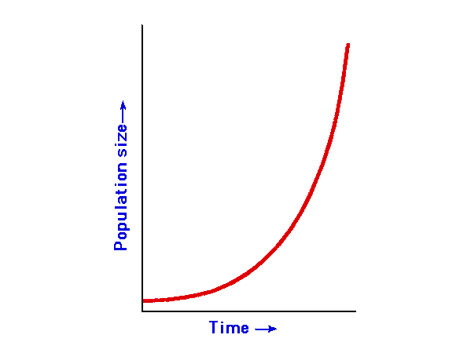
Varroa mite populations have an exponential growth curve
This means that the mite population starts off slow, and then explodes.
10%
5%
Mite Infestation
0%
0 1 2 3 4 5
Months
© 2021 Michigan State University
Slide modified from the Honey Bee Health Coalition

Slide 9
Varroa mite populations have an exponential growth curve
Our job as beekeepers is to prevent this population explosion – to keep mites below dangerous levels.
10%
5%
Mite Infestation
0%
0 1 2 3 4 5
Months
© 2021 Michigan State University
Slide modified from the Honey Bee Health Coalition

Slide 10
Varroa Transmission
Mites can be transferred between hives, yards, and operations.
In areas densely populated with bees and beekeepers, your varroa and virus problems can become everyone’s problem within 1+ mile of you
© 2021 Michigan State University
Graphic design by Anne Turnham, University of Minnesota Bee Squad for NCR-SARE PDP grant "Training an Influential Network of Farming, Beekeeping and Extension Experts to Promote Bee Health“ [grant no. ENC17-160] from the USDA National Institute of Food and Agriculture.

Slide 11
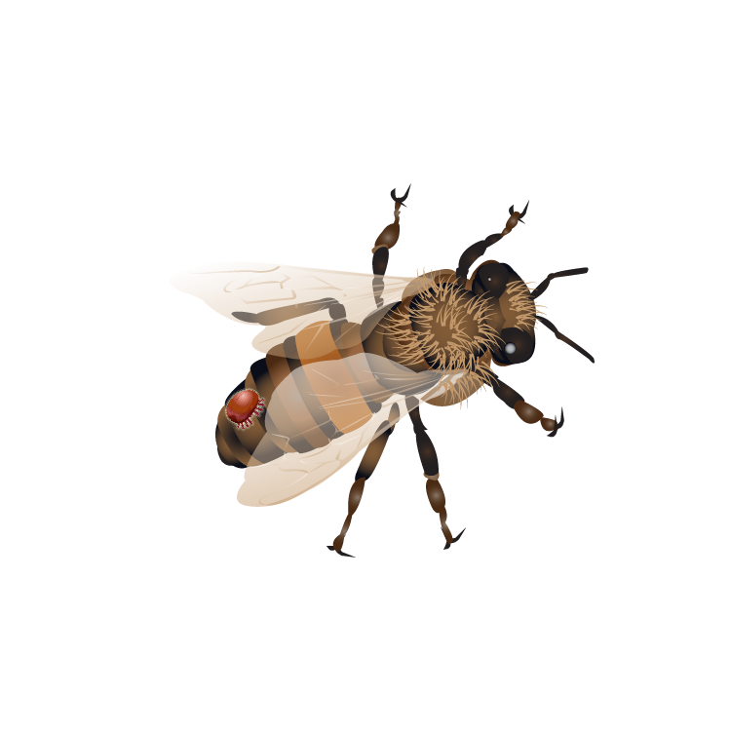
Keep bees alive:
Understand the harm caused by mites
© 2021 Michigan State University
Graphic design by Anne Turnham, University of Minnesota Bee Squad for NCR-SARE PDP grant "Training an Influential Network of Farming, Beekeeping and Extension Experts to Promote Bee Health“ [grant no. ENC17-160] from the USDA National Institute of Food and Agriculture.

Slide 12
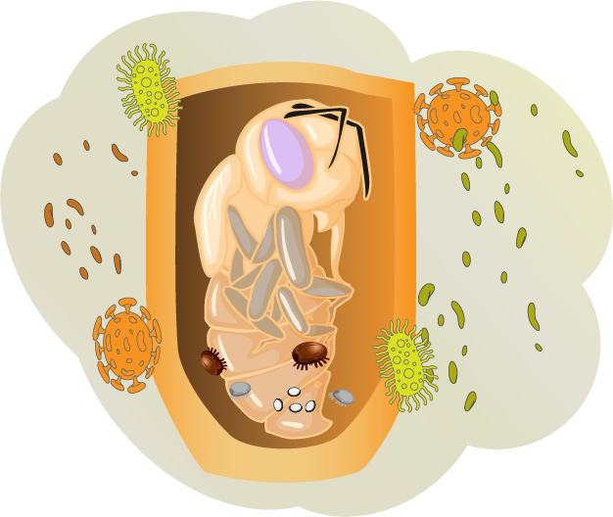
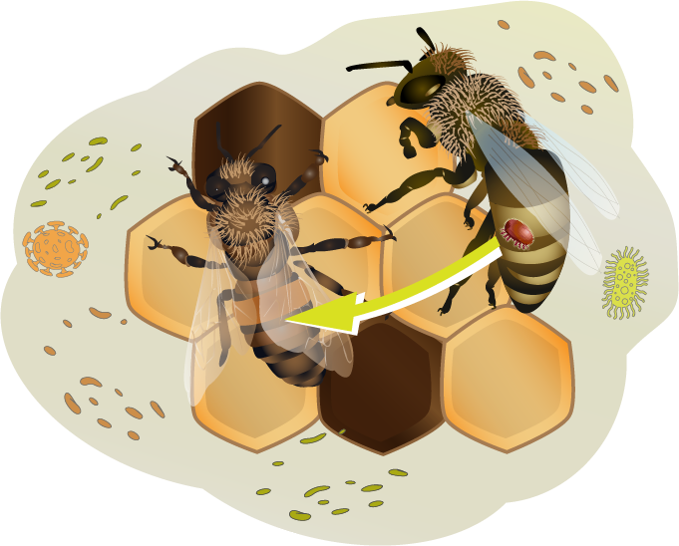
Mites spread disease and physically injure the bees.
Mites spread pathogens when they feed on developing honey bee pupae.
Mites spread pathogens when they feed on adult bees.
© 2021 Michigan State University
Graphic design by Anne Turnham, University of Minnesota Bee Squad for NCR-SARE PDP grant "Training an Influential Network of Farming, Beekeeping and Extension Experts to Promote Bee Health“ [grant no. ENC17-160] from the USDA National Institute of Food and Agriculture.

Slide 13
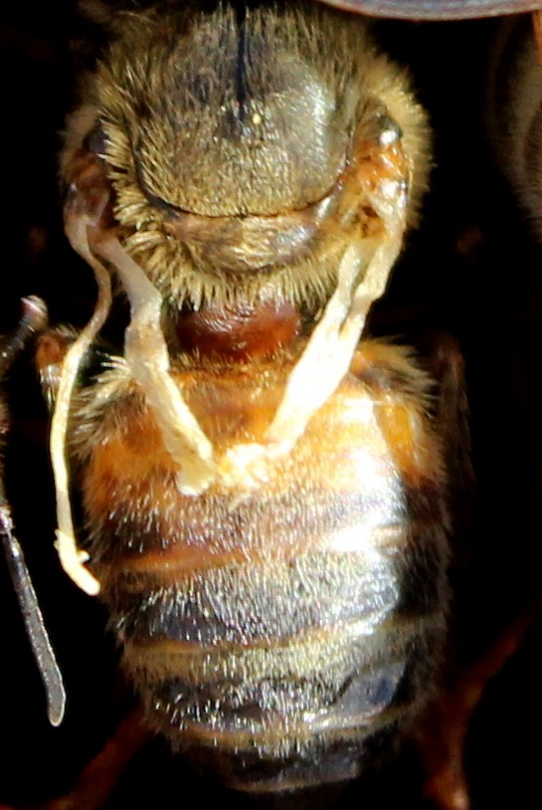
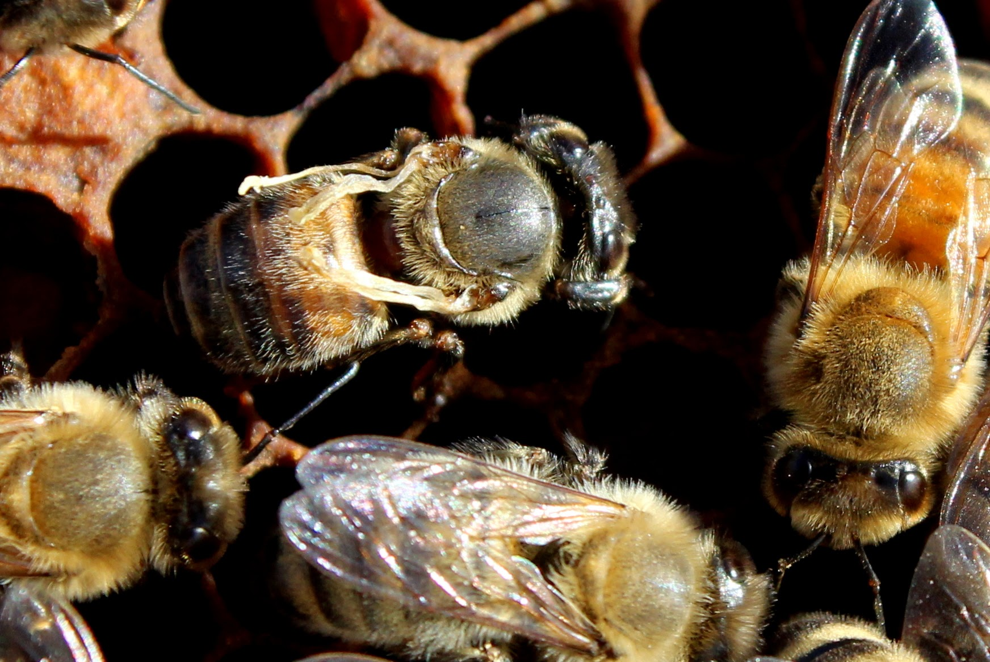
Varroa spread deadly viruses
When mites parasitize pupae, they often spread deformed wing virus (DWV).
Adult bees may emerge sick and with deformed wings.
Photo: © Dan Wyns
Photo: © Dan Wyns
© 2021 Michigan State University

Slide 14
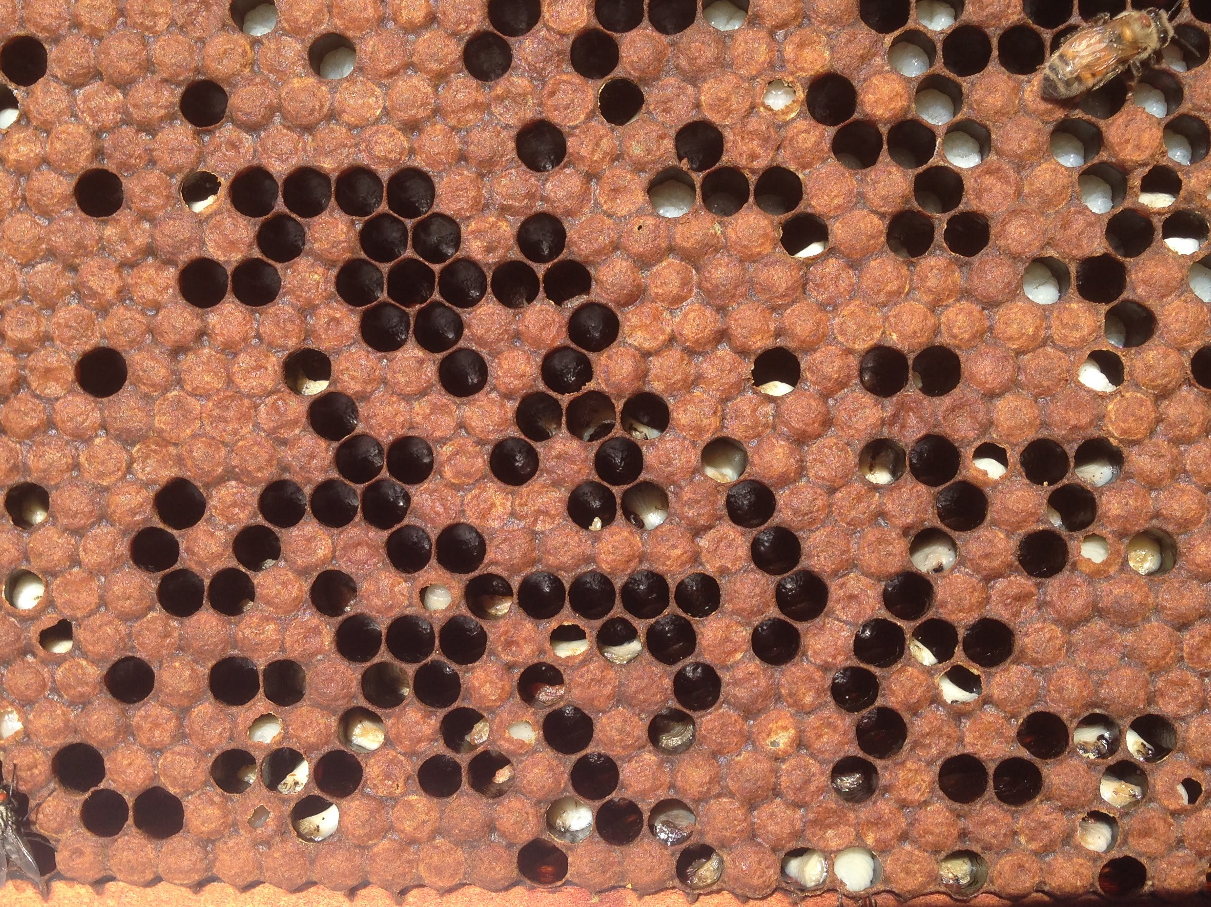
Parasitic mite syndrome
Very high pathogen loads, associated with high mite levels, prevent brood from developing
  © 2021 Michigan State University
Photo: © Dan Wyns

Slide 15
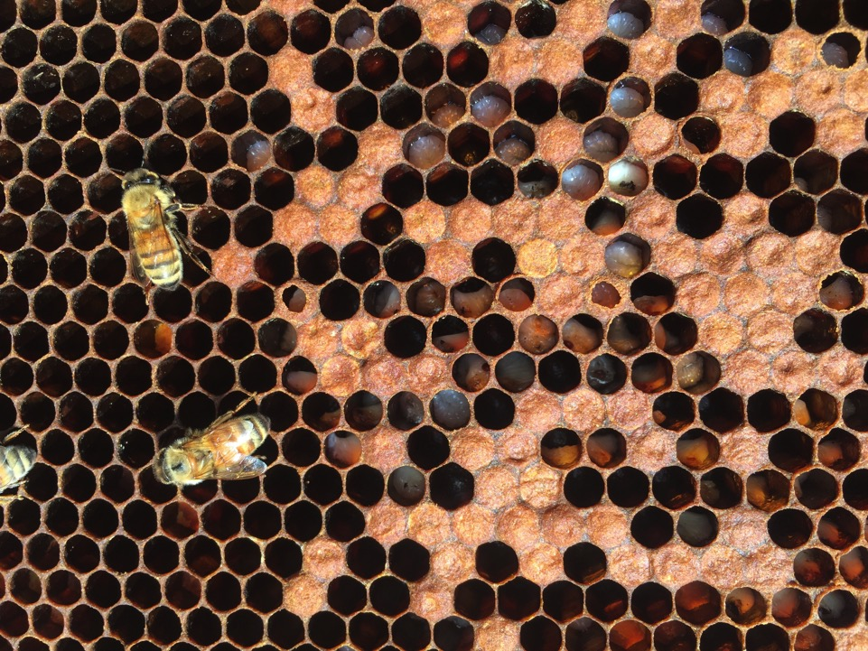
Parasitic mite syndrome
  © 2021 Michigan State University
© Ana Heck

Slide 16
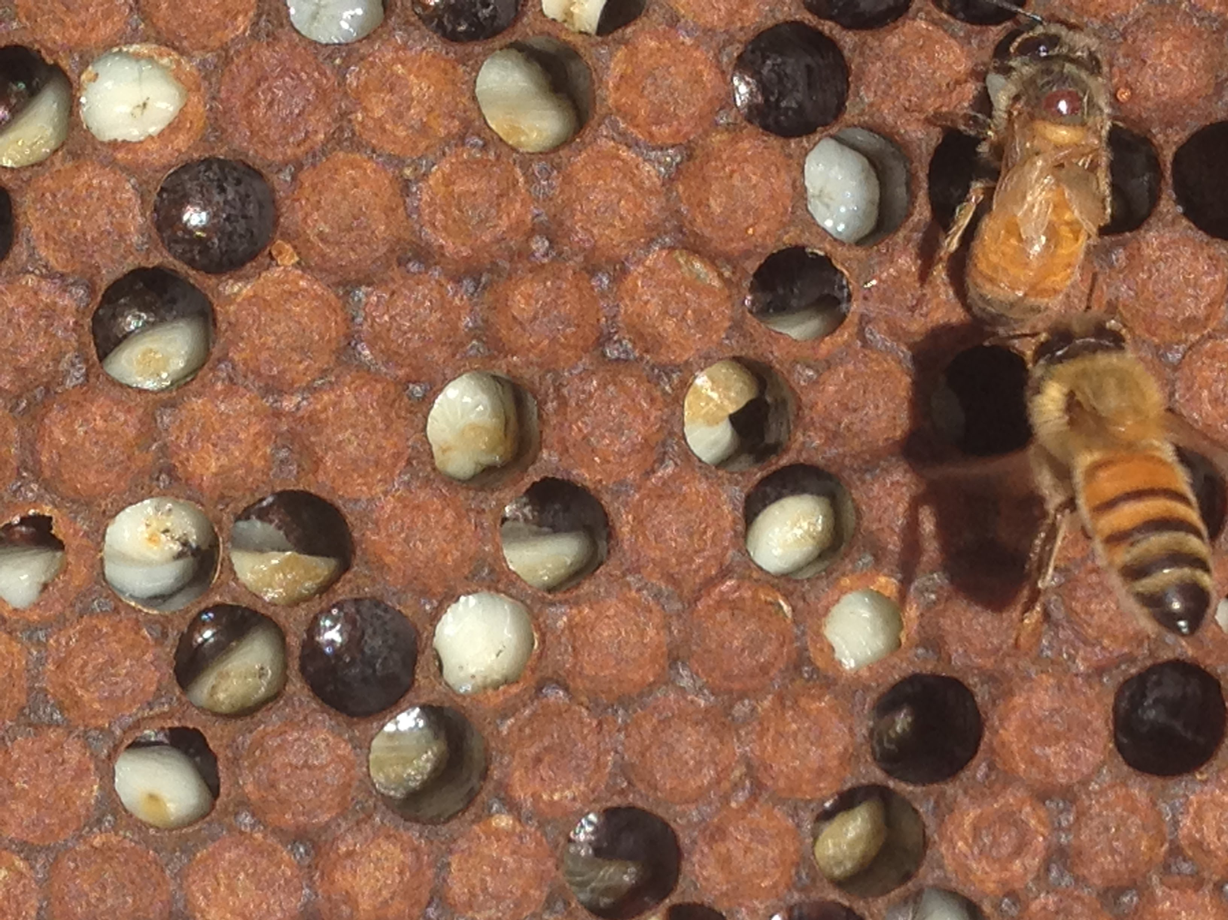
Parasitic mite syndrome
  © 2021 Michigan State University
Photo: © Dan Wyns

Slide 17
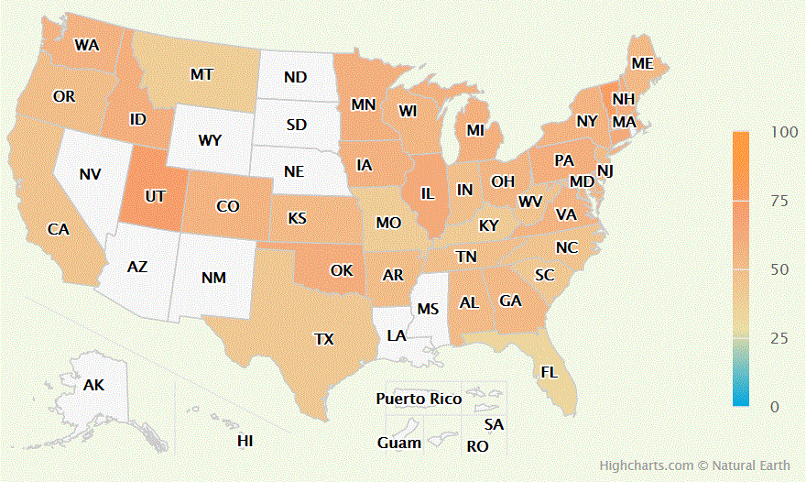
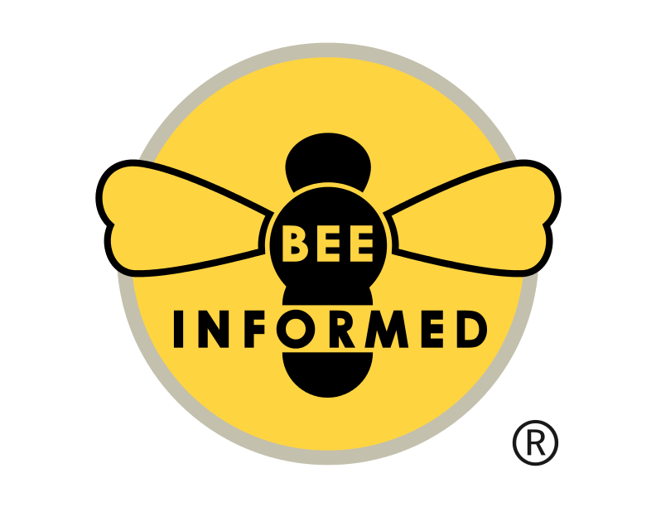
Average colony loss in Michigan in 2020-2021 = 53.32%
According to survey data: 126 beekeepers surveyed, representing 5,404 colonies
Source: Bee Informed Partnership, United States Honey Bee Colony Losses 2020-2021: Preliminary Results https://beeinformed.org/wp-content/uploads/2021/06/BIP_2020_21_Losses_Abstract_2021.06.14_FINAL_R1.pdf

Slide 18
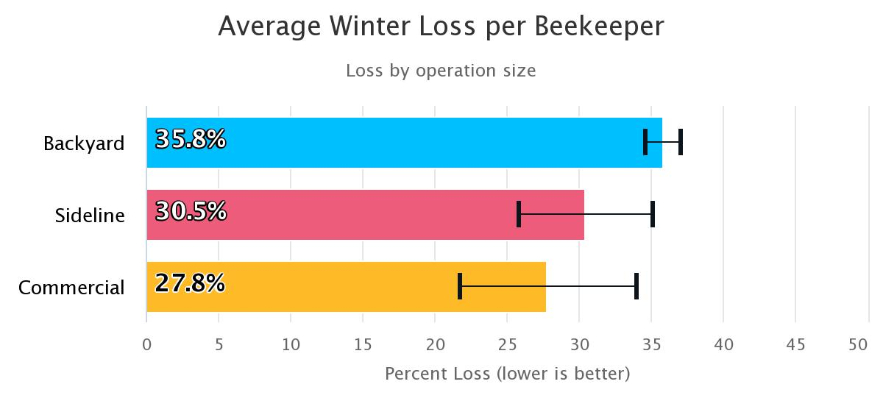
Backyard (small-scale) beekeepers lose a greater portion of their colonies than other beekeepers
Source: Bee Informed Partnership, United States Honey Bee Colony Losses 2020-2021: Preliminary Results https://beeinformed.org/wp-content/uploads/2021/06/BIP_2020_21_Losses_Abstract_2021.06.14_FINAL_R1.pdf
© 2021 Michigan State University

Slide 19
We are in an epidemic of varroa mites
Varroa lead to high colony losses, especially among small-scale beekeepers.
Varroa and the pathogens that they vector are the driving cause of colony losses.
© 2021 Michigan State University

Slide 20
We need to be responsible beekeepers!
When we lose colonies to varroa, our colonies are lost to a preventable illness – this is not good for our bees.
When varroa populations get high, they will spread to other nearby colonies through drifting and robbing.
  This is not good for other bees and beekeepers.
We now know that varroa-associated viruses are found in native bees.
  This is not good for our native pollinators.
We need to make sure that our beekeeping does not harm other bees
© 2021 Michigan State University

Slide 21
Keep bees alive:
Understand the mite life cycle
© 2021 Michigan State University
Graphic design by Anne Turnham, University of Minnesota Bee Squad for NCR-SARE PDP grant "Training an Influential Network of Farming, Beekeeping and Extension Experts to Promote Bee Health“ [grant no. ENC17-160] from the USDA National Institute of Food and Agriculture.

Slide 22
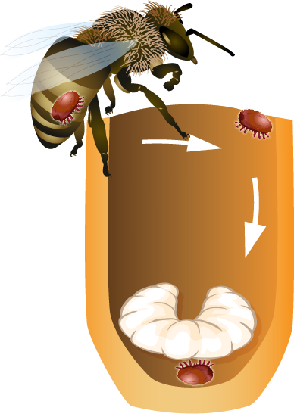

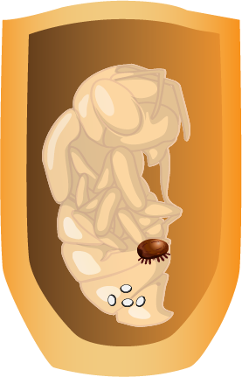
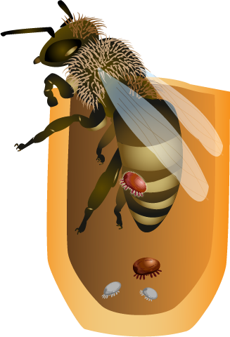
In the next slides, we will learn the life cycle of varroa.
© 2021 Michigan State University
Graphic design by Anne Turnham, University of Minnesota Bee Squad for NCR-SARE PDP grant "Training an Influential Network of Farming, Beekeeping and Extension Experts to Promote Bee Health“ [grant no. ENC17-160] from the USDA National Institute of Food and Agriculture.

Slide 23
Female varroa mites enter a cell containing an older larva (just before it is capped).
© 2021 Michigan State University
Graphic design by Anne Turnham, University of Minnesota Bee Squad for NCR-SARE PDP grant "Training an Influential Network of Farming, Beekeeping and Extension Experts to Promote Bee Health“ [grant no. ENC17-160] from the USDA National Institute of Food and Agriculture.

Slide 24
About 70 hours after capping, the female mite will lay an egg. This first egg will become a male.
Every 30 hours after this, she will lay another egg, and these eggs will become females.
© 2021 Michigan State University
Graphic design by Anne Turnham, University of Minnesota Bee Squad for NCR-SARE PDP grant "Training an Influential Network of Farming, Beekeeping and Extension Experts to Promote Bee Health“ [grant no. ENC17-160] from the USDA National Institute of Food and Agriculture.

Slide 25
The adult female and developing mites will bite the pupa to feed, and can pick up and transmit viruses.
They compromise the bee immune system shortening the life of the bee.
© 2021 Michigan State University
Graphic design by Anne Turnham, University of Minnesota Bee Squad for NCR-SARE PDP grant "Training an Influential Network of Farming, Beekeeping and Extension Experts to Promote Bee Health“ [grant no. ENC17-160] from the USDA National Institute of Food and Agriculture.

Slide 26
If the bee emerges, the original female mite emerges as well, along with one or sometimes two more daughters.
The rest of the mites are not developed enough to survive.
In drone cells, two additional mites can emerge with the original female (because of the extra time).
© 2021 Michigan State University
Graphic design by Anne Turnham, University of Minnesota Bee Squad for NCR-SARE PDP grant "Training an Influential Network of Farming, Beekeeping and Extension Experts to Promote Bee Health“ [grant no. ENC17-160] from the USDA National Institute of Food and Agriculture.

Slide 27
The reproductive females will move to other bees.
They can continue to feed, reproduce, and transmit bee viruses, as long as there is brood in the hive.
© 2021 Michigan State University
Graphic design by Anne Turnham, University of Minnesota Bee Squad for NCR-SARE PDP grant "Training an Influential Network of Farming, Beekeeping and Extension Experts to Promote Bee Health“ [grant no. ENC17-160] from the USDA National Institute of Food and Agriculture.

Slide 28
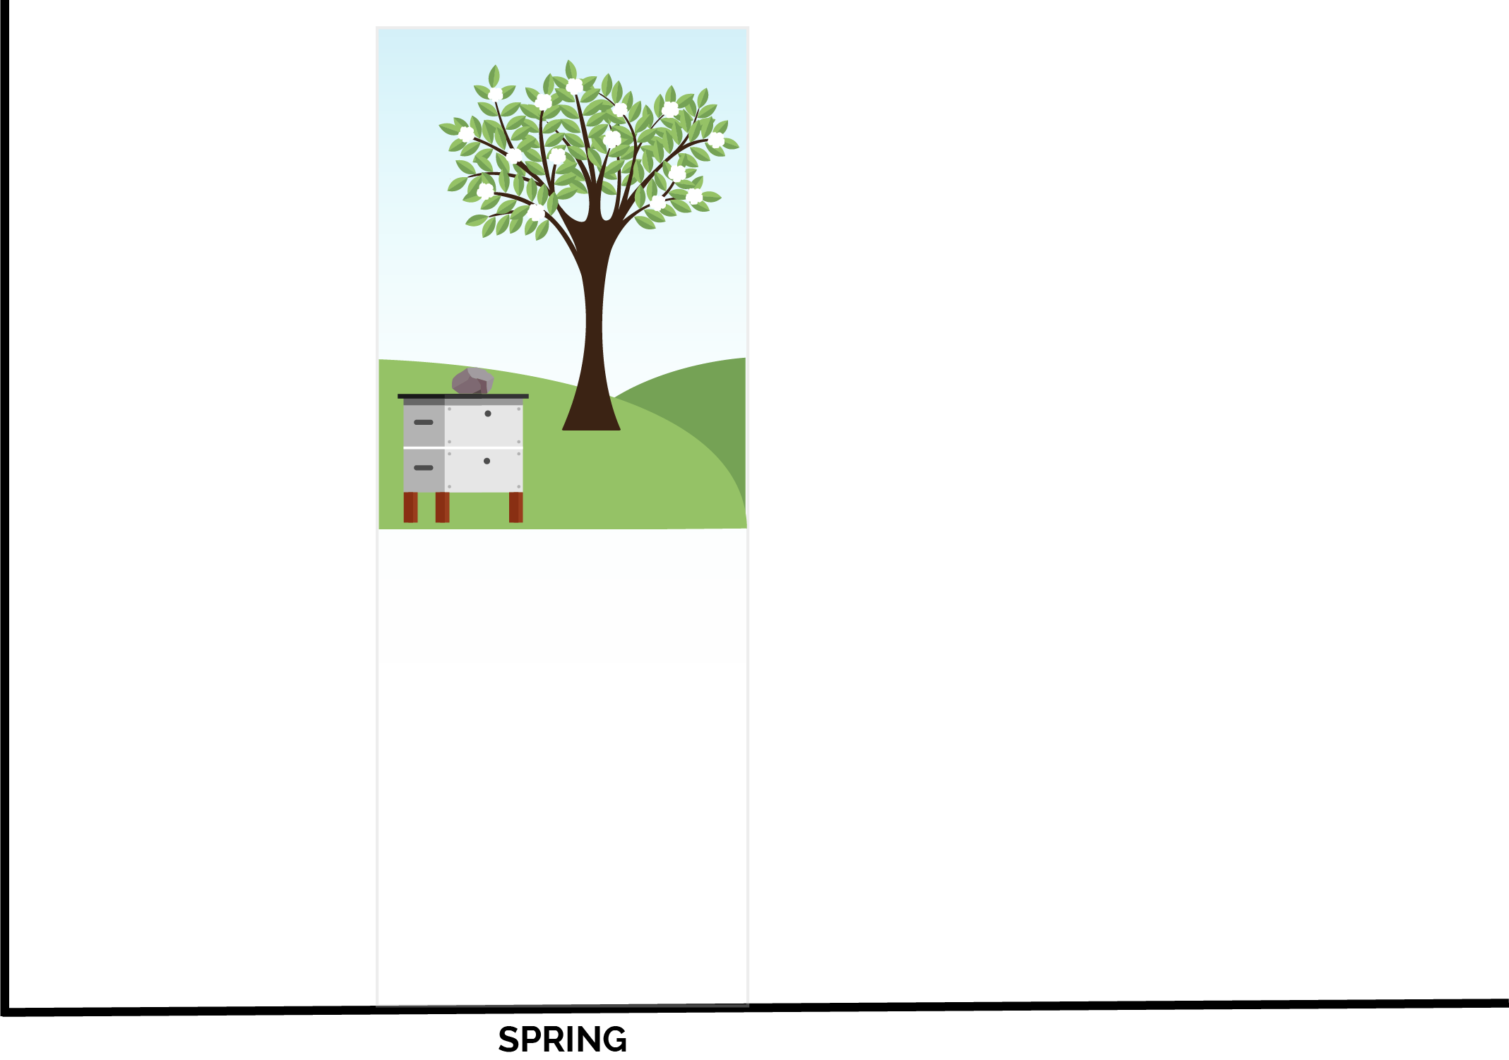
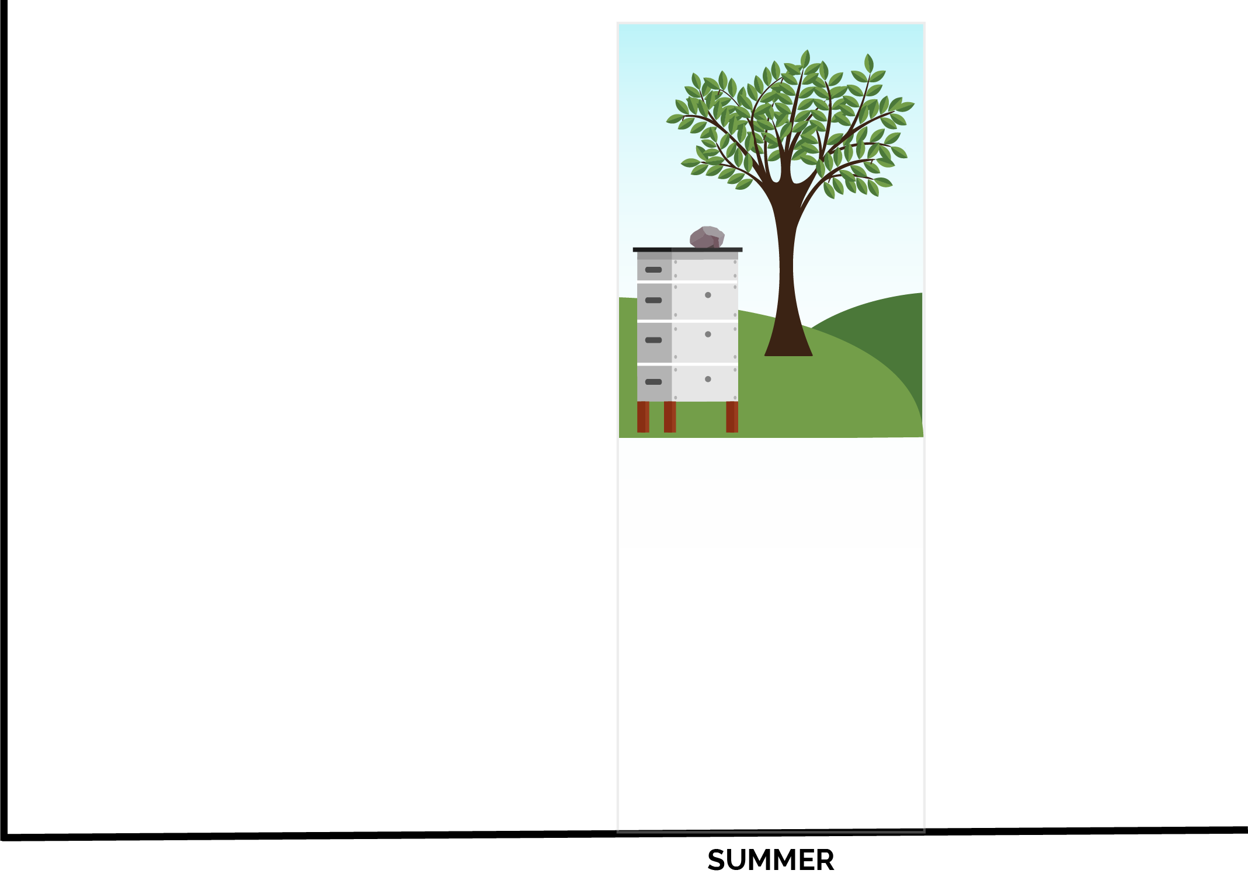
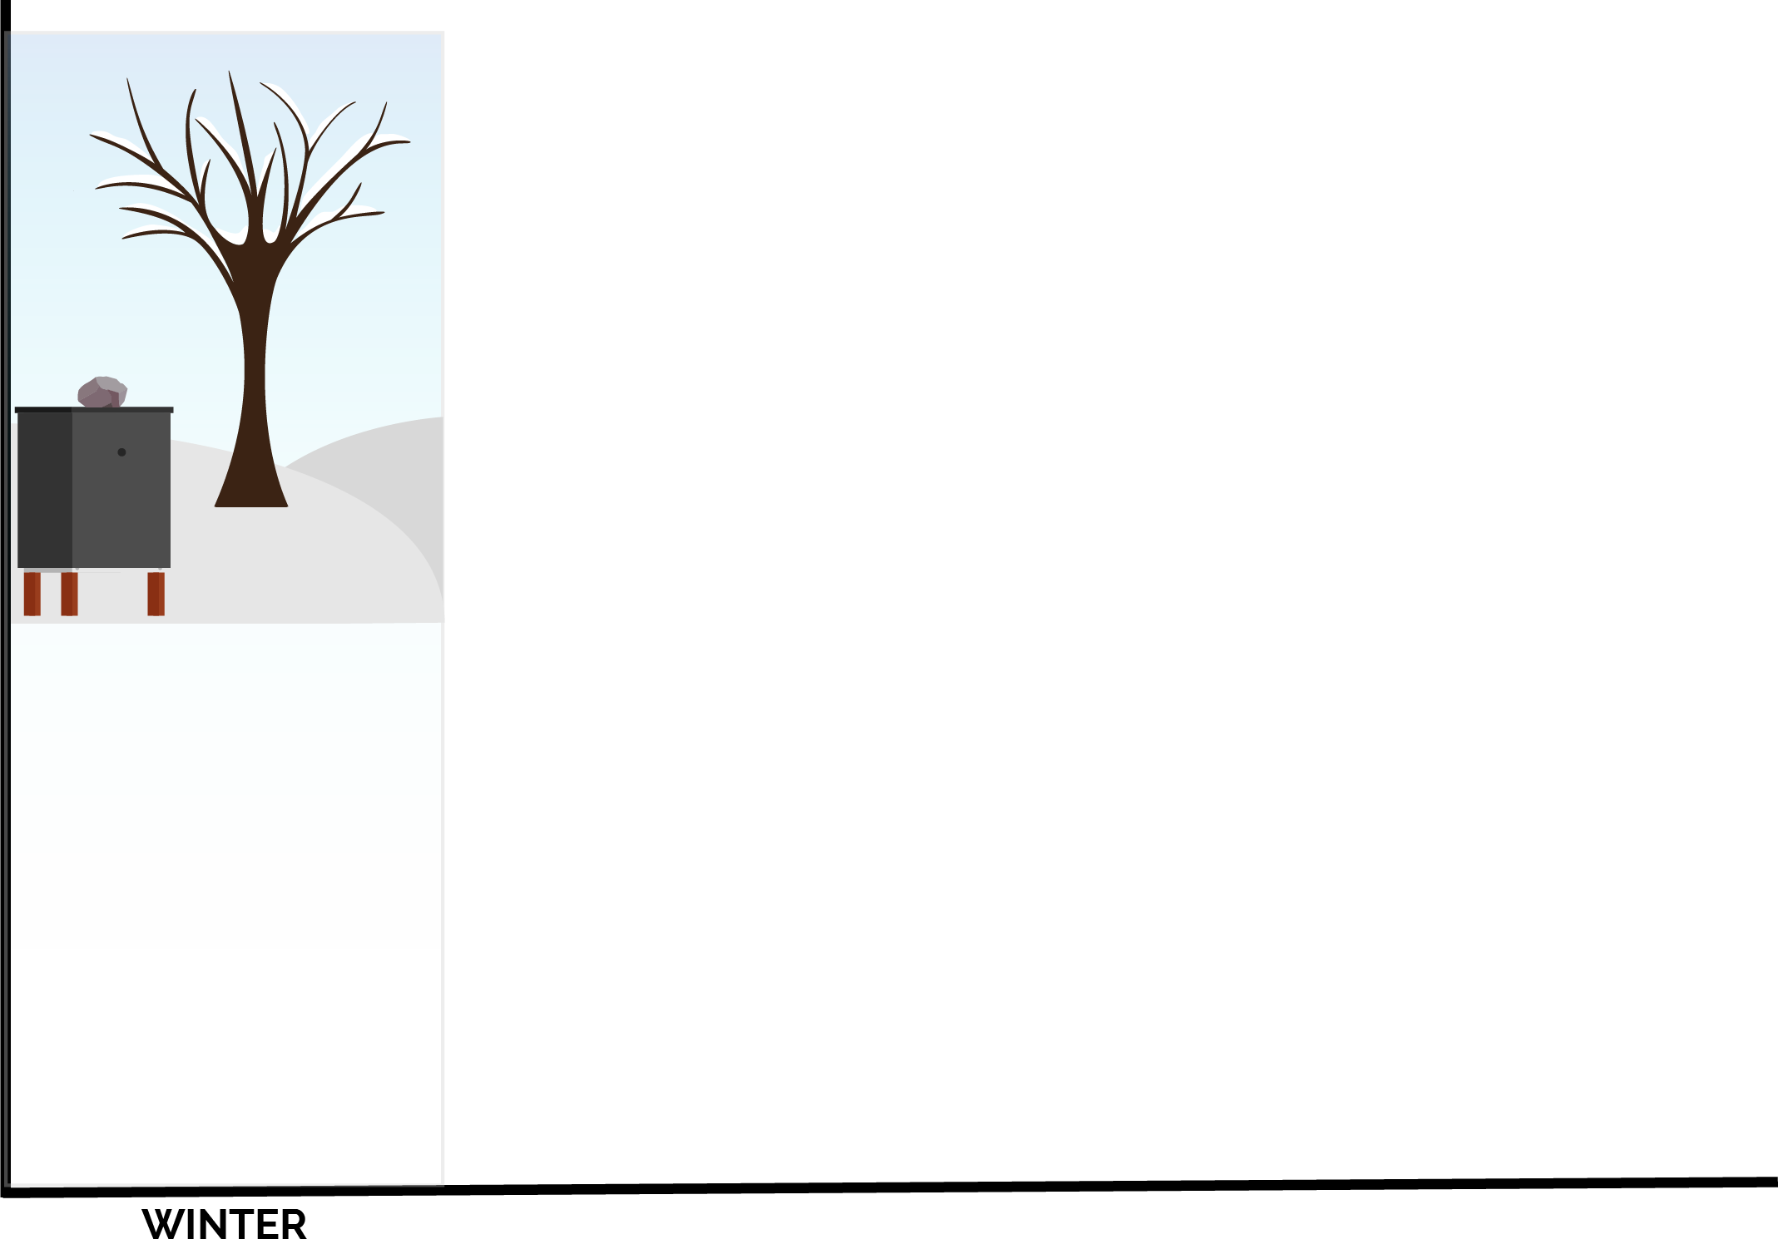
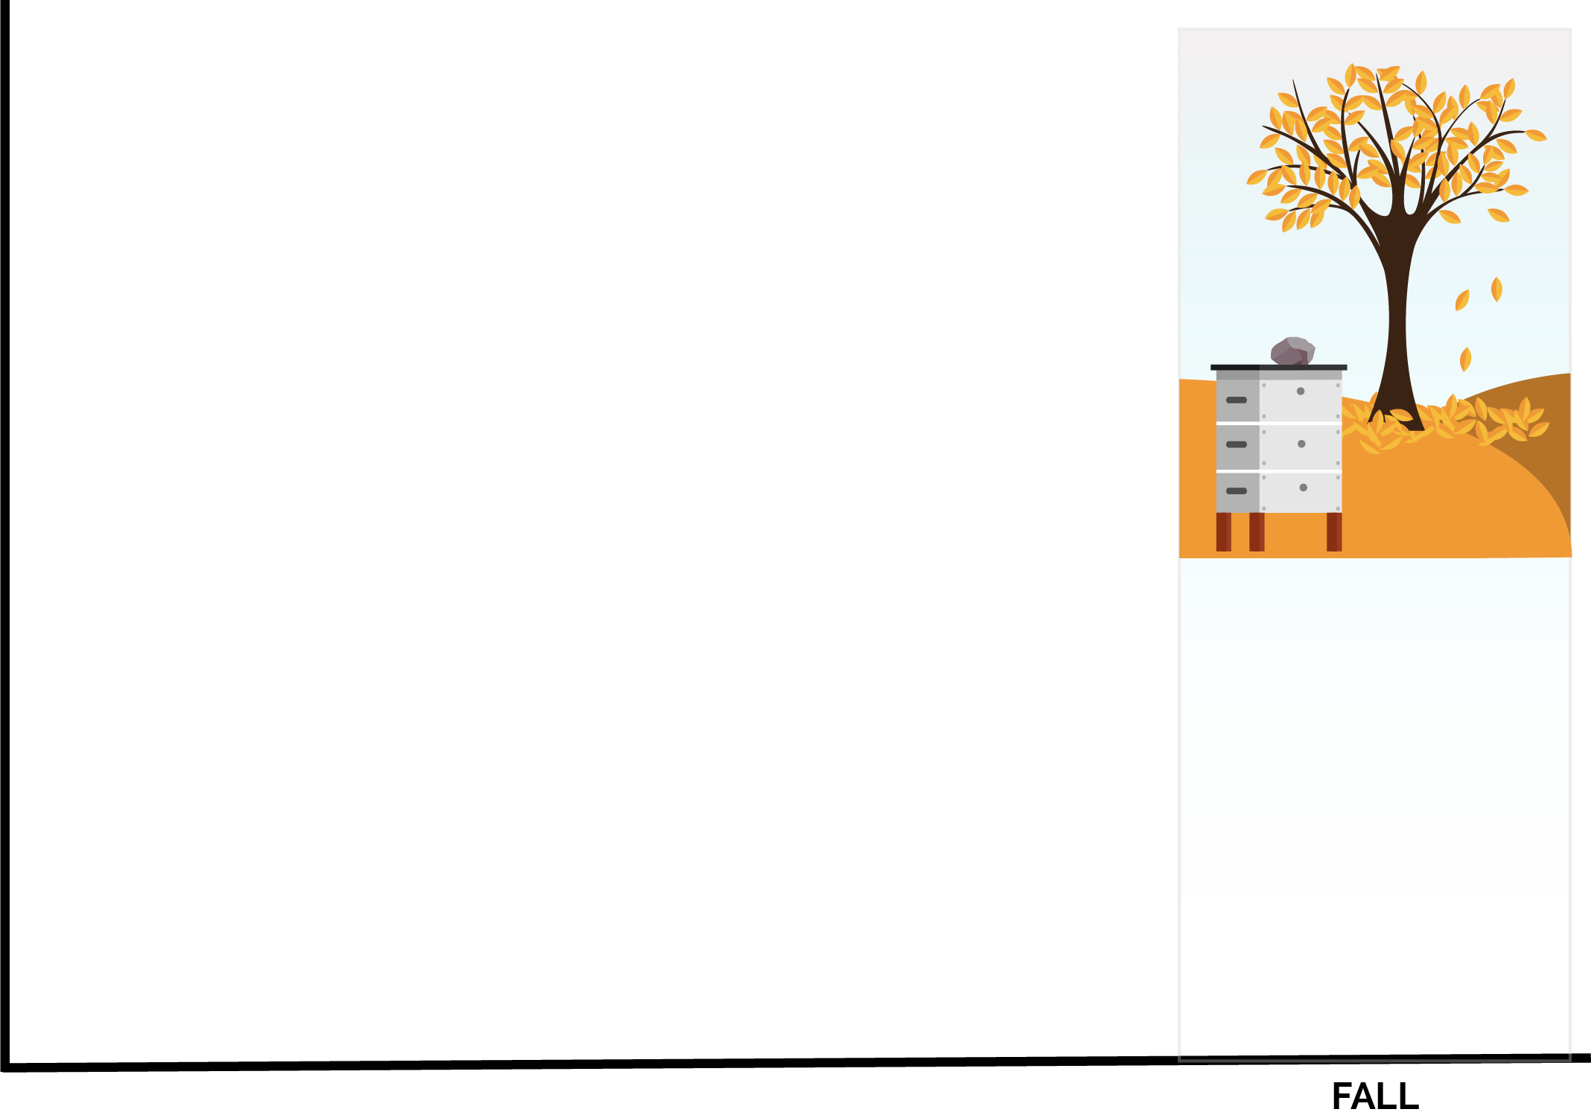
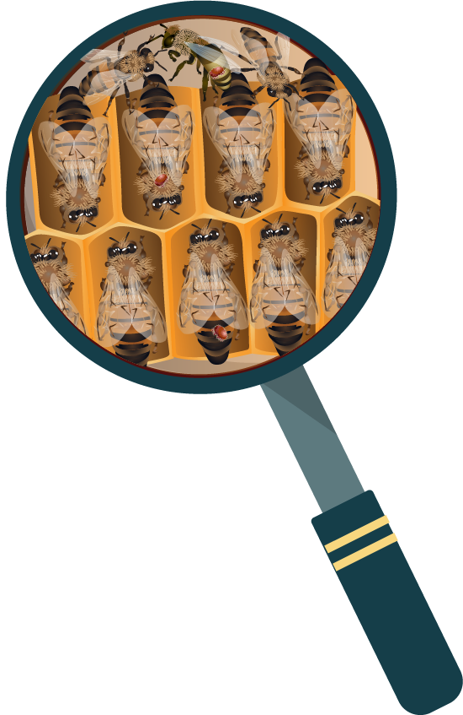
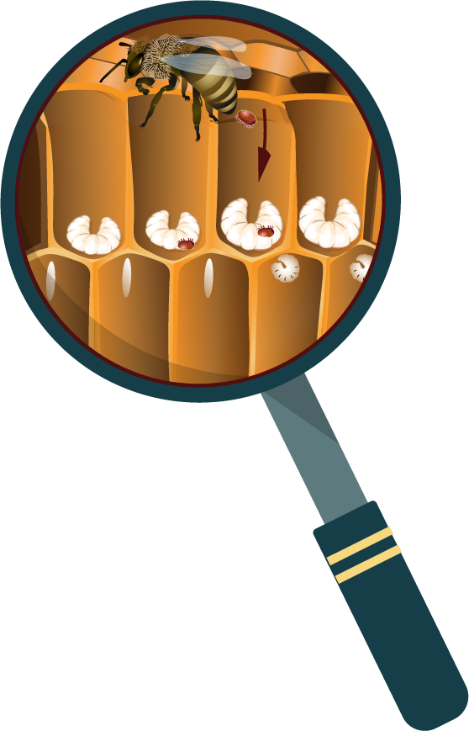
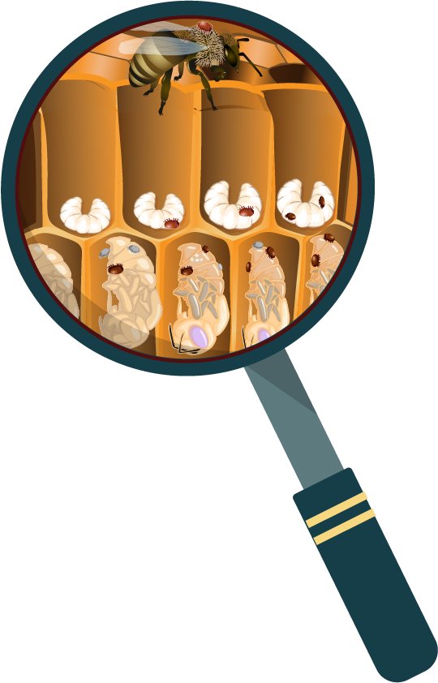

Mite populations are seasonal.
© 2021 Michigan State University
Graphic design by Anne Turnham, University of Minnesota Bee Squad for NCR-SARE PDP grant "Training an Influential Network of Farming, Beekeeping and Extension Experts to Promote Bee Health“ [grant no. ENC17-160] from the USDA National Institute of Food and Agriculture.

Slide 29
Winter
Varroa don’t reproduce when bees are in cluster, but they feed on the fat bodies of adult bees.
© 2021 Michigan State University
Graphic design by Anne Turnham, University of Minnesota Bee Squad for NCR-SARE PDP grant "Training an Influential Network of Farming, Beekeeping and Extension Experts to Promote Bee Health“ [grant no. ENC17-160] from the USDA National Institute of Food and Agriculture.

Slide 30
Spring
In spring, Varroa that overwintered in the colony begin to reproduce in the first brood.
© 2021 Michigan State University
Graphic design by Anne Turnham, University of Minnesota Bee Squad for NCR-SARE PDP grant "Training an Influential Network of Farming, Beekeeping and Extension Experts to Promote Bee Health“ [grant no. ENC17-160] from the USDA National Institute of Food and Agriculture.

Slide 31
Summer
In the summer, there is a lot of brood for reproduction, so the mite populations rise quickly.
© 2021 Michigan State University
Graphic design by Anne Turnham, University of Minnesota Bee Squad for NCR-SARE PDP grant "Training an Influential Network of Farming, Beekeeping and Extension Experts to Promote Bee Health“ [grant no. ENC17-160] from the USDA National Institute of Food and Agriculture.

Slide 32
Fall
In the fall, the brood rearing slows down as winter bees are made.
Since mite levels have been growing all summer, there are a lot of mites to infest these few cells.
© 2021 Michigan State University
Graphic design by Anne Turnham, University of Minnesota Bee Squad for NCR-SARE PDP grant "Training an Influential Network of Farming, Beekeeping and Extension Experts to Promote Bee Health“ [grant no. ENC17-160] from the USDA National Institute of Food and Agriculture.

Slide 33
Mite risk is seasonal.
© 2021 Michigan State University
Graphic design by Anne Turnham, University of Minnesota Bee Squad for NCR-SARE PDP grant "Training an Influential Network of Farming, Beekeeping and Extension Experts to Promote Bee Health“ [grant no. ENC17-160] from the USDA National Institute of Food and Agriculture.

Slide 34
Mite populations peak right when winter bees are being formed.
Mites feed on the fat bodies of the bees.
The combination of viruses and damage to the bees cause early death to the winter bees.
Your colony may look huge in the fall, because it is filled with summer bees.
Once summer bees die, the colony may not have enough winter bees to survive the winter.
Varroa harm and kill many colonies by feeding on winter bees.
© 2021 Michigan State University

Slide 35
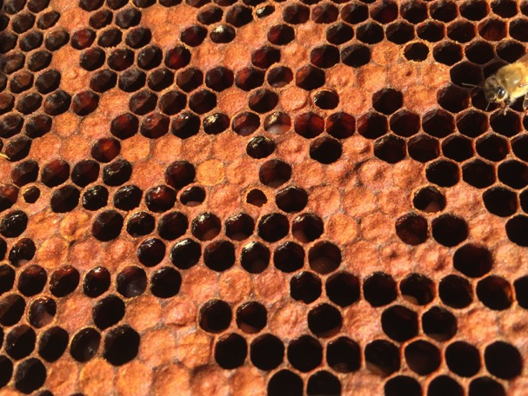
Varroa frass (excrement) on cell ceilings indicate cells that had mites.
Would you expect this colony to have enough healthy winter bees to survive winter?
  © 2021 Michigan State University
© Ana Heck

Slide 36
Keep bees alive: monitor mite levels
© 2021 Michigan State University
Graphic design by Anne Turnham, University of Minnesota Bee Squad for NCR-SARE PDP grant "Training an Influential Network of Farming, Beekeeping and Extension Experts to Promote Bee Health“ [grant no. ENC17-160] from the USDA National Institute of Food and Agriculture.

Slide 37


Visible signs of mites
Varroa are visible to the naked eye, but most mites are on the underside of bee and between segments where they can’t be seen.
If you see mites on adult bees, it is likely that your mite levels are already very high.
© 2021 Michigan State University
Graphic design by Anne Turnham, University of Minnesota Bee Squad for NCR-SARE PDP grant "Training an Influential Network of Farming, Beekeeping and Extension Experts to Promote Bee Health“ [grant no. ENC17-160] from the USDA National Institute of Food and Agriculture.

Slide 38
To keep our bees safe, we need to know that they are not overwhelmed by parasites
We need to use a method that provides a result in
“mites per 100 bees” or “percent infestation.”
Alcohol wash tests and powdered sugar roll tests can give you this number.
© 2021 Michigan State University
Graphic design by Anne Turnham, University of Minnesota Bee Squad for NCR-SARE PDP grant "Training an Influential Network of Farming, Beekeeping and Extension Experts to Promote Bee Health“ [grant no. ENC17-160] from the USDA National Institute of Food and Agriculture.

Slide 39
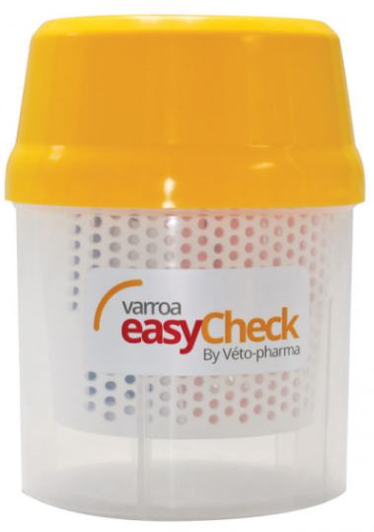
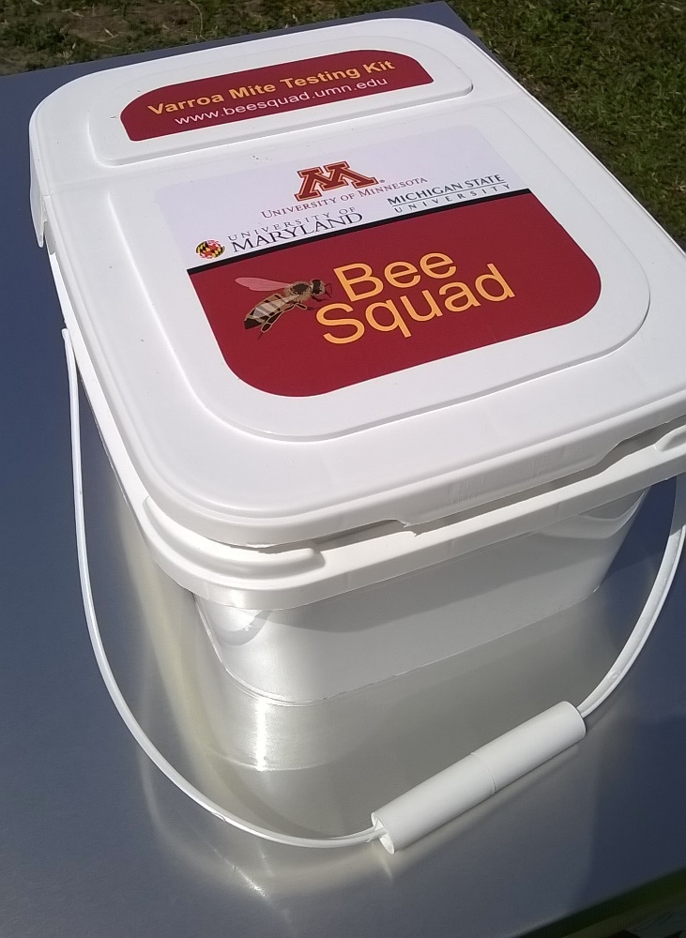
Powdered sugar roll test kit
You can purchase or make your own mite test kit.
Alcohol wash test kit
© 2021 Michigan State University

Slide 40
Which test to use?
The alcohol wash test may be slightly more accurate than the powdered sugar roll test, but they are close enough.
Both the alcohol wash and sugar roll can be used, and give you a result in mites/ bees.
Powdered sugar roll tests are good for beekeepers who can’t stand to watch their bees die.
The Honey Bee Health Coalition and the UMN Bee Lab have different instructions on how to sample for mites using a powdered sugar roll.
  The most important thing is that you are monitoring.
© 2021 Michigan State University

Slide 41
Common sampling mistakes
Not collecting enough bees in the sample jar!
Not monitoring often enough (at least once per month)
Not monitoring late enough in the beekeeping season
Not shaking sample jar hard enough
© 2021 Michigan State University

Slide 42
Common sampling mistakes
In a powdered sugar roll:
Bees get sticky/wet (from the sample jar being left in the sun or from a nectar flow)
  If bees are sticky/wet, the test failed
Not letting bees rest for long enough (2 minutes) before shaking
Using old/exposed powdered sugar
© 2021 Michigan State University

Slide 43
Observations that won’t tell you your mites per 100 bees:
Sticky boards
Looking for mites on bees
  Remember, most mites are on the undersides of bees where they can’t be seen
Looking in drone brood for mites
If you see mites, do a mite test!
© 2021 Michigan State University

Slide 44
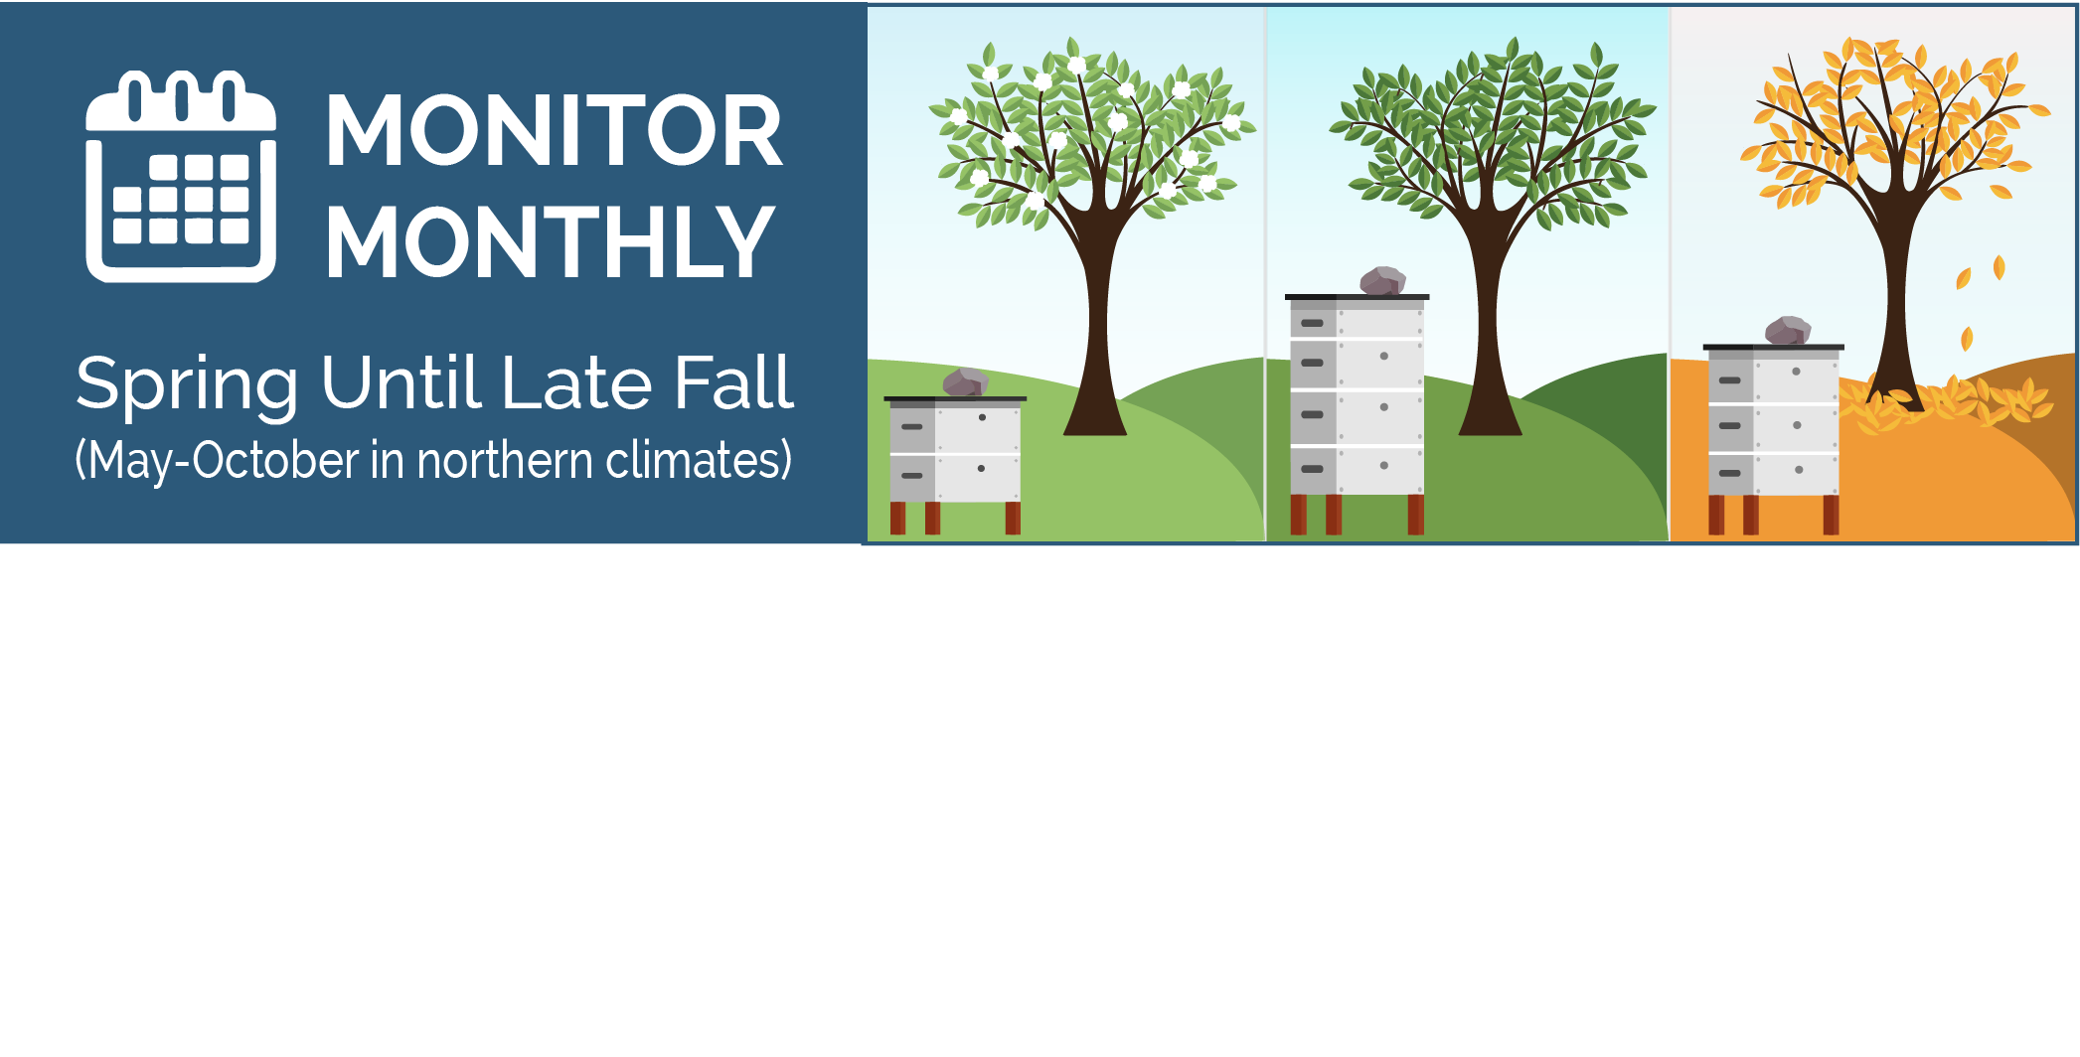
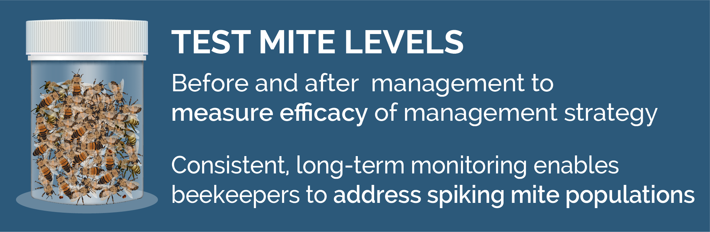
Monitor monthly and after you manage for mites
© 2021 Michigan State University
Graphic design by Anne Turnham, University of Minnesota Bee Squad for NCR-SARE PDP grant "Training an Influential Network of Farming, Beekeeping and Extension Experts to Promote Bee Health“ [grant no. ENC17-160] from the USDA National Institute of Food and Agriculture.

Slide 45
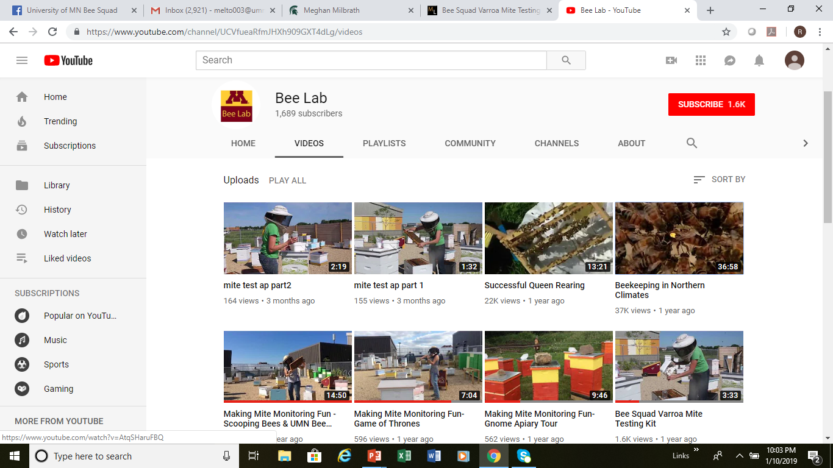
University of Minnesota Bee Lab YouTube channel:
how to do a powdered sugar roll test
© 2021 Michigan State University

Slide 46


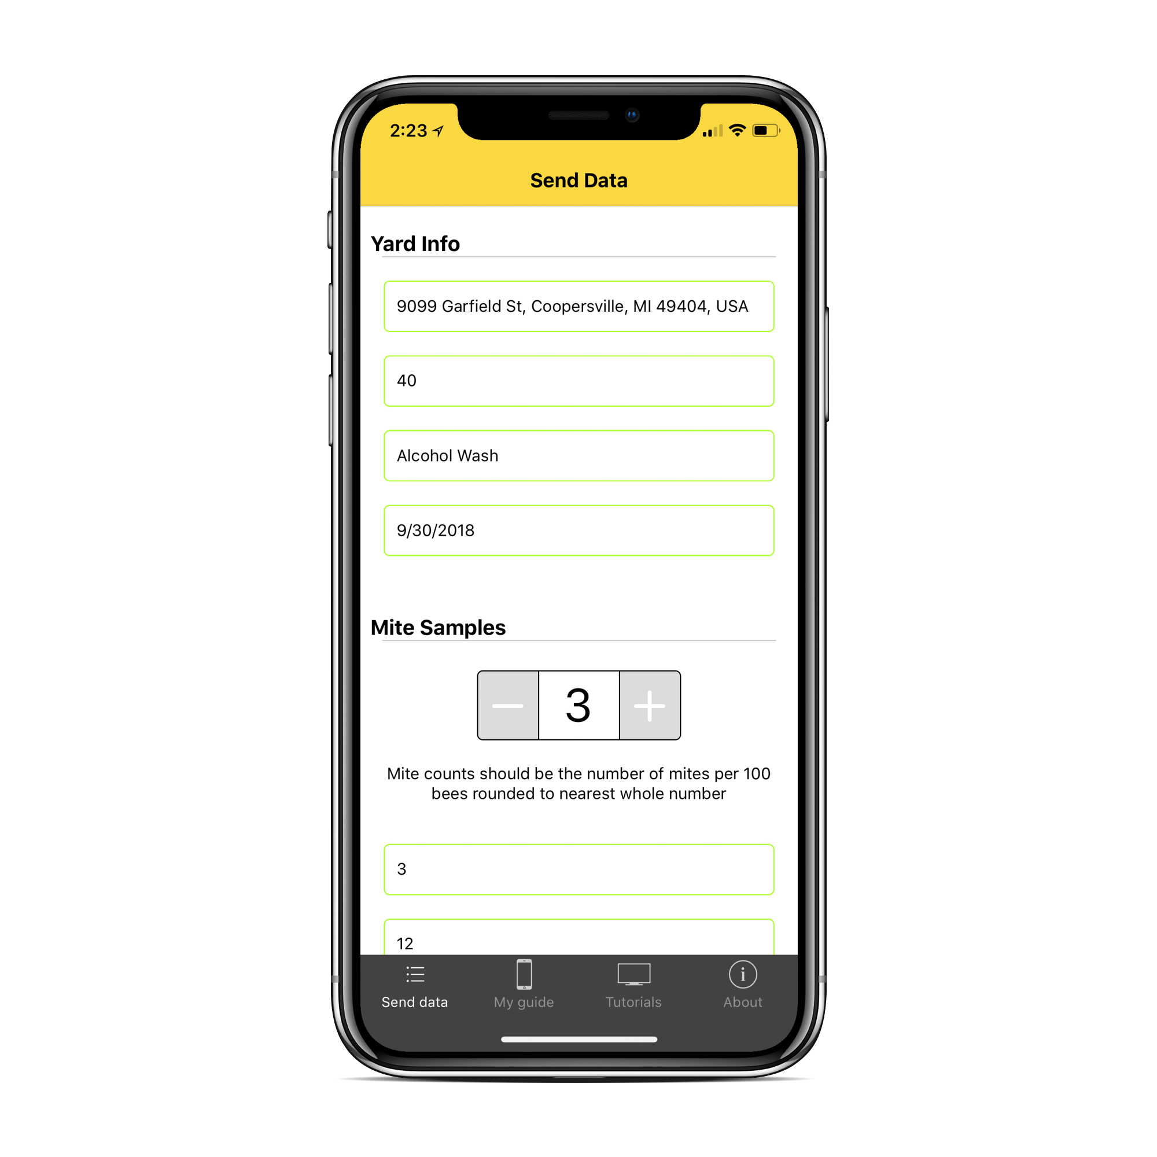

MITECHECK MOBILE APP
Tutorials
Easily report your mite counts
Mite management resources

Slide 47
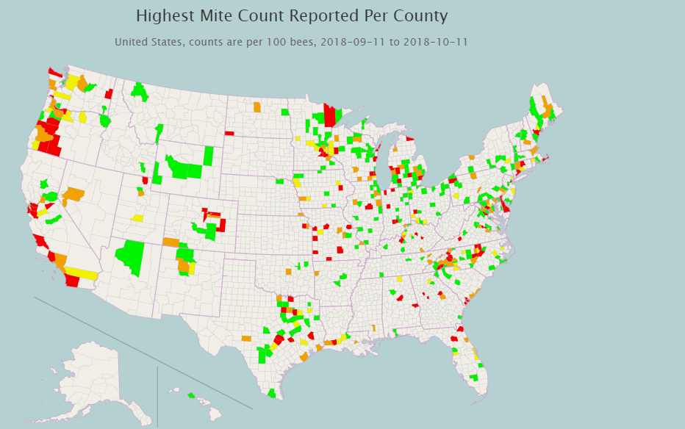

Report your mites to mitecheck.com
Highest Mite Count Reported Per County
2018
© 2021 Michigan State University

Slide 48
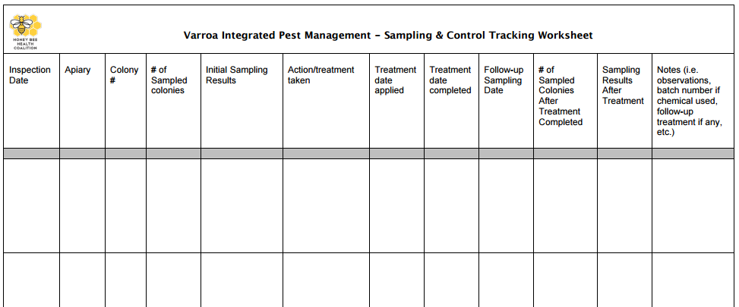
Sampling and control worksheet: keep track of mite monitoring and management
Download the Excel Spreadsheet:
www.honeybeehealthcoalition.org/varroa
© 2021 Michigan State University
Slide modified from the Honey Bee Health Coalition

Slide 49
Keep bees alive: anticipate seasonal mite growth
© 2021 Michigan State University
Graphic design by Anne Turnham, University of Minnesota Bee Squad for NCR-SARE PDP grant "Training an Influential Network of Farming, Beekeeping and Extension Experts to Promote Bee Health“ [grant no. ENC17-160] from the USDA National Institute of Food and Agriculture.

Slide 50
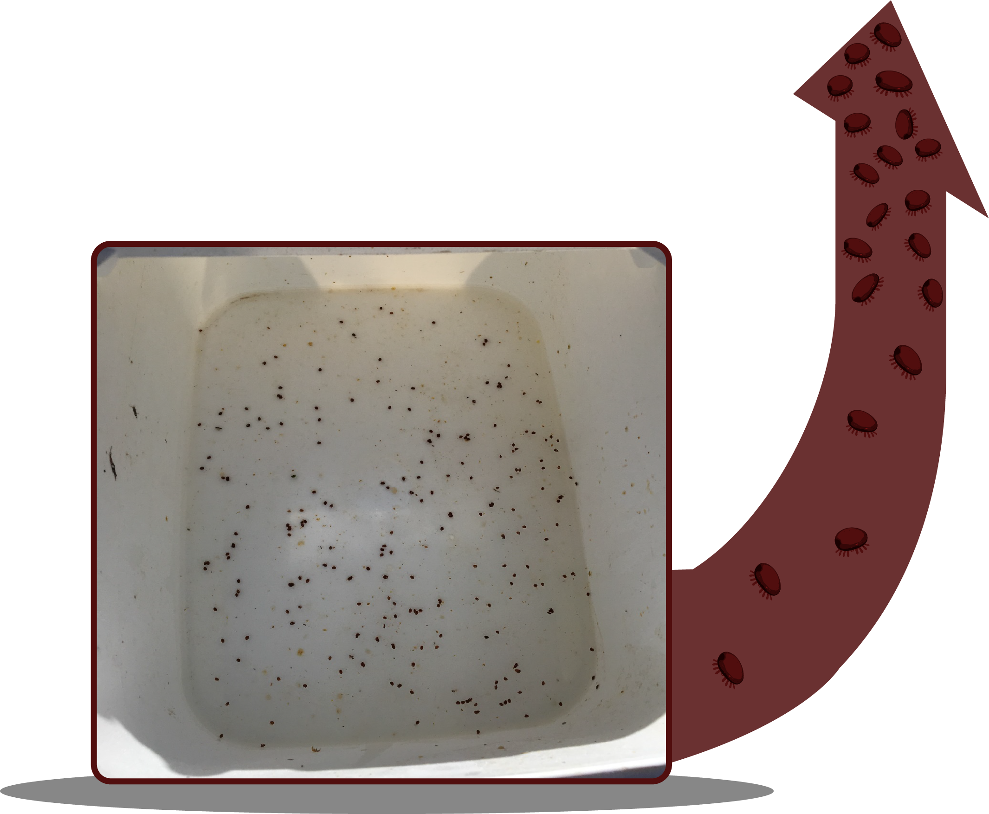
Autumn mite spike
Results from a powdered sugar roll test:
VERY HIGH mite level!
© 2021 Michigan State University
Graphic design by Anne Turnham, University of Minnesota Bee Squad for NCR-SARE PDP grant "Training an Influential Network of Farming, Beekeeping and Extension Experts to Promote Bee Health“ [grant no. ENC17-160] from the USDA National Institute of Food and Agriculture.

Slide 51
Did you sample through the end of the beekeeping season?
In the next slide, we will show you an example of high mite levels in autumn
Eight colonies were monitored for mites monthly
Mite levels (mites per 100 bees) samples were analyzed by the Bee Informed Partnership as part of the Sentinel Apiary program (alcohol/saline test)
Yard located in Minnetrista, Minnesota
All colonies were package colonies
All colonies were treated with Formic Pro in August and an oxalic acid dribble in November
Are you ready to see the mite numbers?
© 2021 Michigan State University

Slide 52

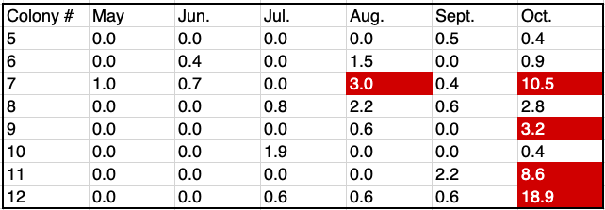
Did you sample through the end of the beekeeping season?
Varroa per 100 bees (2018):
All colonies were treated with Formic Pro in August and an oxalic acid dribble in November.
© 2021 Michigan State University

Slide 53
Keep bees alive: help your bees keep mite levels low
© 2021 Michigan State University
Graphic design by Anne Turnham, University of Minnesota Bee Squad for NCR-SARE PDP grant "Training an Influential Network of Farming, Beekeeping and Extension Experts to Promote Bee Health“ [grant no. ENC17-160] from the USDA National Institute of Food and Agriculture.

Slide 54
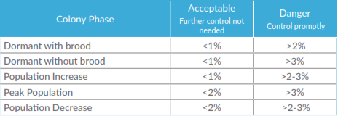
Keep varroa levels low throughout the season!
Acceptable: Current mite populations are not an immediate threat.
Danger: Colony loss is likely unless the beekeeper controls varroa immediately.
Slide modified from the Honey Bee Health Coalition, Tools for Varroa Management –
https://honeybeehealthcoalition.org/wp-content/uploads/2018/06/HBHC-Guide_Varroa_Interactive_7thEdition_June2018.pdf
© 2021 Michigan State University

Slide 55
Factors that may affect mite levels and action thresholds:
Time of year and colony growth phase
Amount of brood in the colony
Size of colony
Colony density in yard
Proximity of yard to other bee yards
Mite management strategies of beekeeper neighbors
Geographic location and climate
  Virus strains can vary by location
© 2021 Michigan State University

Slide 56
The strategy that you use to manage mites will depend on your risk
The risk of varroa changes every year and changes by location.
Some beekeepers will have to do a lot of work, while other beekeepers will not have much risk.
What works for other beekeepers may not work in your area.
What worked last year may not work this year.
© 2021 Michigan State University

Slide 57

Non-chemical varroa management strategies can be used throughout the season to help keep mite populations from exploding.
Choose bees less susceptible to mite damage:
  Hygienic behavior (genetic trait)
  Grooming behavior (genetic trait)
Drone comb removal
Create a brood break:
  Create a walk-away divide
Maintain small (nucleus) colonies
Sticky boards under screened bottom boards
© 2021 Michigan State University
Graphic design by Anne Turnham, University of Minnesota Bee Squad for NCR-SARE PDP grant "Training an Influential Network of Farming, Beekeeping and Extension Experts to Promote Bee Health“ [grant no. ENC17-160] from the USDA National Institute of Food and Agriculture.

Slide 58
In many places, non-chemical strategies are not sufficient to keep mite populations from harming your bees
Many non-chemical strategies require an understanding of beekeeping biology and management, and may be overwhelming or impossible for beginning beekeepers.
Try to learn to incorporate strategies like brood breaks into your management plans, but make sure you are monitoring to make sure they are working.
© 2021 Michigan State University

Slide 59
Keep bees alive:
Know your treatment options
© 2021 Michigan State University
Graphic design by Anne Turnham, University of Minnesota Bee Squad for NCR-SARE PDP grant "Training an Influential Network of Farming, Beekeeping and Extension Experts to Promote Bee Health“ [grant no. ENC17-160] from the USDA National Institute of Food and Agriculture.

Slide 60
Varroa treatments
Acid based treatments
  Formic Acid
    Mite Away Quick Strips (MAQS)
    Formic Pro
  Potassium Salts of Hops Beta Acids
    HopGuard II
    HopGuard III
  Oxalic acid
    ApiBioxal
Thyme oil-based treatments
  Apiguard
  ApiLife Var
Synthetic treatment
  Apivar (amitraz)
  Apistan (fluvalinate): not recommended
  CheckMite+ (coumaphos): not recommended
© 2021 Michigan State University
Graphic design by Anne Turnham, University of Minnesota Bee Squad for NCR-SARE PDP grant "Training an Influential Network of Farming, Beekeeping and Extension Experts to Promote Bee Health“ [grant no. ENC17-160] from the USDA National Institute of Food and Agriculture.

Slide 61
Oxalic acid update -2021
On February 23, 2021, the FDA finalized a ruling that establishes an exemption from the requirement of a tolerance for residues of oxalic acid in honey and honeycomb.
This ruling does not change the way you use oxalic acid (OA) in your hives—it does not mean you can use OA with honey supers on.
In 2021, Oxalic acid also became approved as an organic treatment
https://beeinformed.org/2021/03/10/what-does-the-new-ruling-on-oxalic-acid-in-honey-mean/
© 2021 Michigan State University

Slide 62
Varroa keep killing Michigan bees
Some beekeepers treat their bees, but don’t have an effective management strategy
For example, some beekeepers:
Treat once per season, hoping it is sufficient.
  Some colonies may need multiple treatments throughout the season.
Only treat with oxalic acid
  Oxalic acid does not work under the cappings, and is not good to use when there is brood.
Treat too late
  Some beekeepers wait until after mite levels and disease are too high, or it is too late in the season, and the winter bees are already damaged.
© 2021 Michigan State University

Slide 63
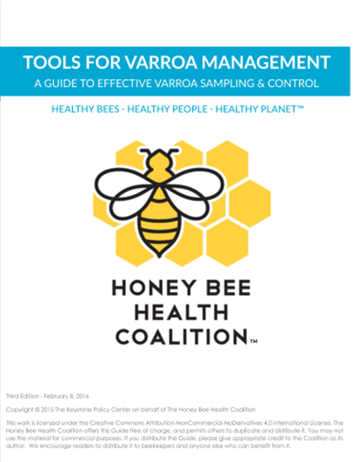
Honey Bee Health Coalition’s Tools for Varroa Management guide:
learn about treatment options
Download the Guide:
www.honeybeehealthcoalition.org/varroa
© 2021 Michigan State University
Slide modified from the Honey Bee Health Coalition
© 2021 Michigan State University

Slide 64
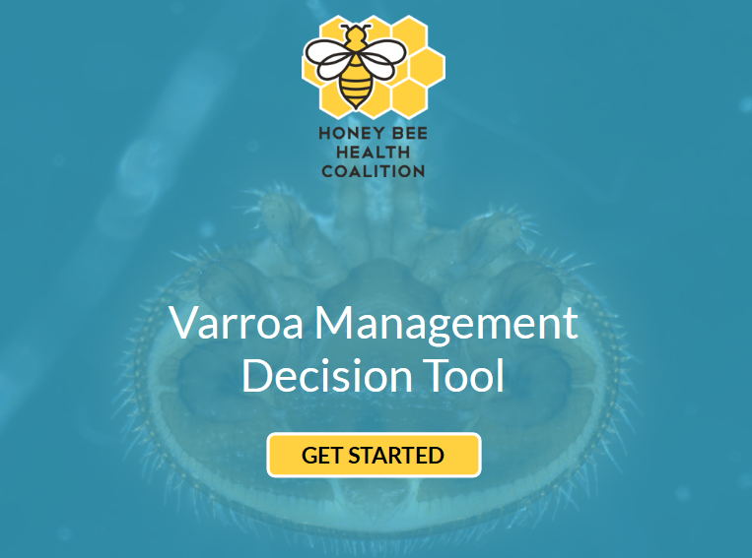
Honey Bee Health Coalition’s varroa management decision tool:
find your treatment options
honeybeehealthcoalition.org/VarroaTool
© 2021 Michigan State University
Slide modified from the Honey Bee Health Coalition

Slide 65
Honey Bee Health Coalition’s
varroa management decision tool:
Answer questions to learn which treatments are available for you to use:
Do your varroa mite levels exceed threshold?
Are you open to synthetic & naturally-derived treatments or just naturally-derived treatments?
Is brood present?
Do you have honey supers on?
Is your colony’s population increasing, at peak, decreasing, or dormant?
honeybeehealthcoalition.org/VarroaTool
© 2021 Michigan State University
Slide modified from the Honey Bee Health Coalition

Slide 66
If I’m treatment-free, will I select for varroa-resistant bees?
Even colonies that have a genetic tendency to tolerate varroa loads can die from high levels of mites.
  Breeding is generally stepwise – you often lose colonies that are useful in working towards better bees.
You may breed bees with other undesirable traits – varroa are not our only issue.
Can you control the drone sources? Can you artificially inseminate queens, or are you on an isolated island?
Do you have dozens/hundreds of colonies with good stock that you can evaluate and choose from?
Is withholding treatment an ethical way to breed for bees?
© 2021 Michigan State University

Slide 67
If I’m treatment-free, will I select for varroa-resistant bees?
Remember, honey bees aren’t native to the Americas.
Very few areas of the United States are known to have healthy feral populations.
Honey bee colonies need beekeepers to control pests and diseases so that they don’t die.
  Just like dogs need tick collars or flea medication.
© 2021 Michigan State University

Slide 68
Keep bees alive: apply treatments correctly
© 2021 Michigan State University
Graphic design by Anne Turnham, University of Minnesota Bee Squad for NCR-SARE PDP grant "Training an Influential Network of Farming, Beekeeping and Extension Experts to Promote Bee Health“ [grant no. ENC17-160] from the USDA National Institute of Food and Agriculture.

Slide 69
Treatments
Anything used to kill mites is a pesticide – even if it is natural or homemade
Pesticides are covered by law
  Legally, treatments must be approved and applied according to the label
Improper application may harm humans and bees
Do not instruct beekeepers on how to apply a treatment unless you are very familiar with the label
© 2021 Michigan State University
Graphic design by Anne Turnham, University of Minnesota Bee Squad for NCR-SARE PDP grant "Training an Influential Network of Farming, Beekeeping and Extension Experts to Promote Bee Health“ [grant no. ENC17-160] from the USDA National Institute of Food and Agriculture.

Slide 70
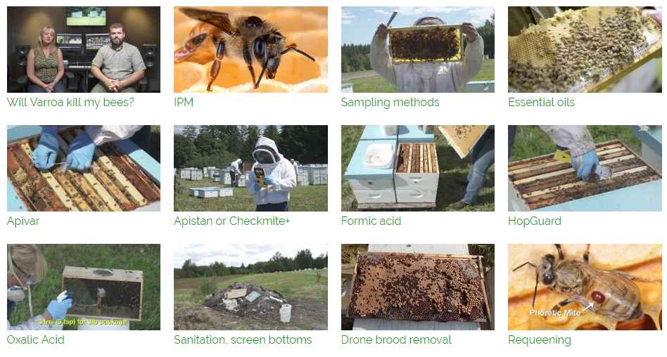
Honey Bee Health Coalition’s YouTube channel: how to correctly apply treatments
Watch the Video Series: Search YouTube for “Tools for Varroa Management Honey Bee Health Coalition”
© 2021 Michigan State University

Slide 71
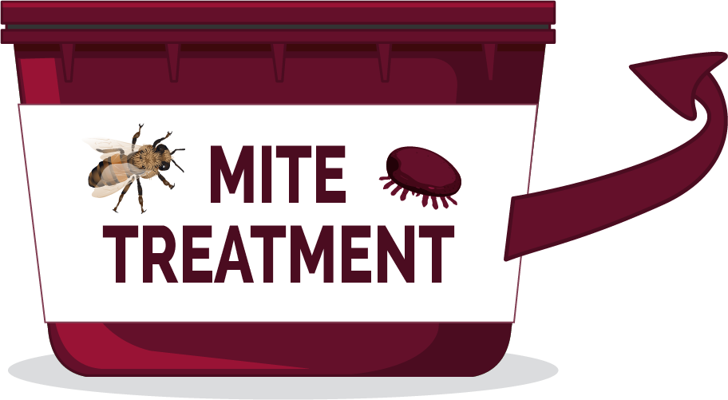
Follow the label
Some treatments restrict use based on
  Temperature
  Brood in colony
  Honey supers
LABEL
It is important for the
beekeeper to wear
correct personal
protective equipment (PPE).
© 2021 Michigan State University
Graphic design by Anne Turnham, University of Minnesota Bee Squad for NCR-SARE PDP grant "Training an Influential Network of Farming, Beekeeping and Extension Experts to Promote Bee Health“ [grant no. ENC17-160] from the USDA National Institute of Food and Agriculture.

Slide 72
Keep bees alive: be a good beekeeper neighbor!
© 2021 Michigan State University
Graphic design by Anne Turnham, University of Minnesota Bee Squad for NCR-SARE PDP grant "Training an Influential Network of Farming, Beekeeping and Extension Experts to Promote Bee Health“ [grant no. ENC17-160] from the USDA National Institute of Food and Agriculture.

Slide 73
While mite densities may vary across colonies, all* colonies in an apiary should be treated at the same time with the same chemical or non-chemical technique.
True or false?
© 2021 Michigan State University

Slide 74
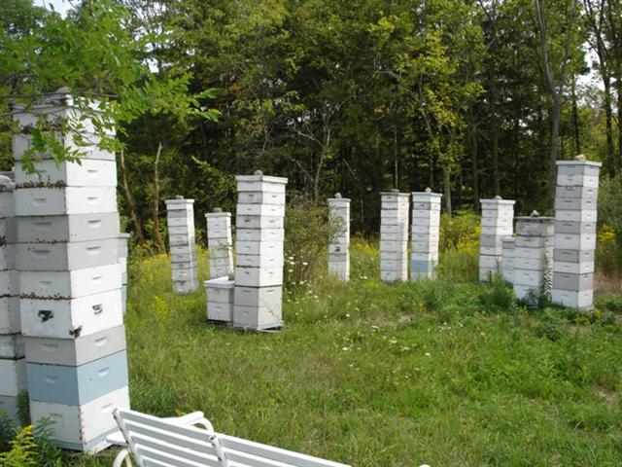
True
While mite densities may vary across colonies, all colonies in an apiary should be treated at the same time with the same chemical or non-chemical technique (if allowed by the label)
*Follow the label: some small/nucleus colonies may be too small for some treatments
Horizontal transmission: varroa mites can spread between colonies
© Mike Risk
© 2021 Michigan State University

Slide 75
Keep bees alive: educate yourself about bees and mites
© 2021 Michigan State University
Graphic design by Anne Turnham, University of Minnesota Bee Squad for NCR-SARE PDP grant "Training an Influential Network of Farming, Beekeeping and Extension Experts to Promote Bee Health“ [grant no. ENC17-160] from the USDA National Institute of Food and Agriculture.

Slide 76
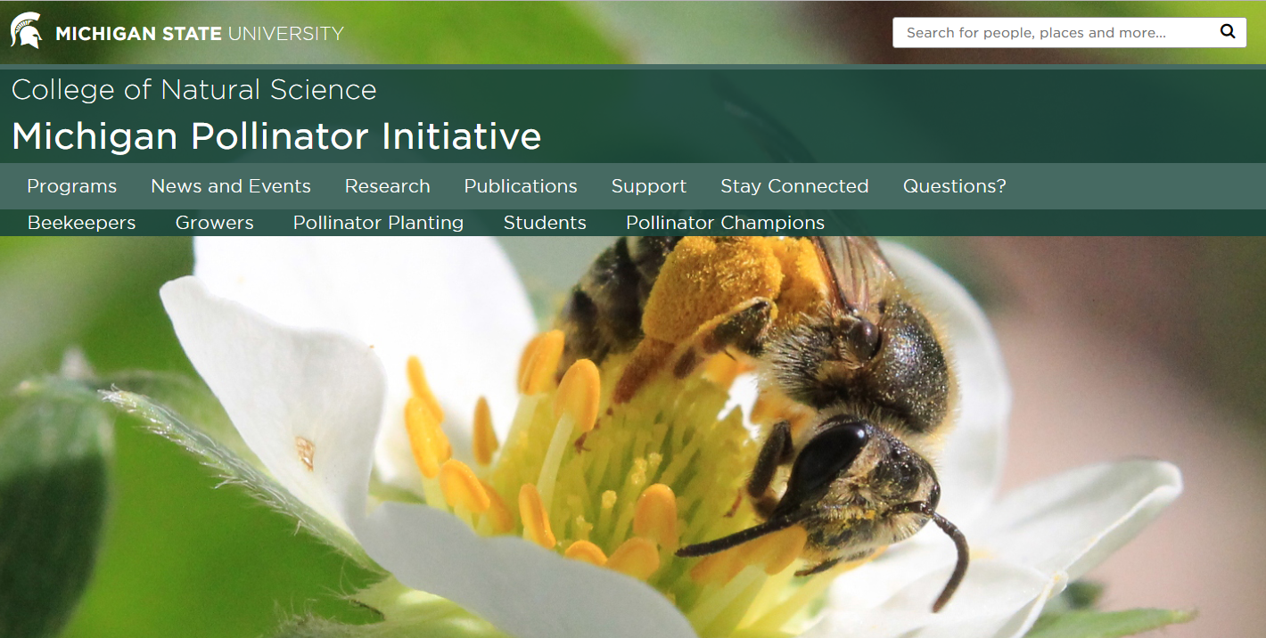
Michigan Pollinator Initiative
pollinators.msu.edu
© 2021 Michigan State University

Slide 77
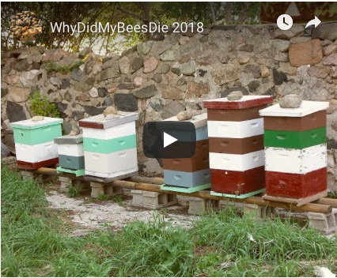
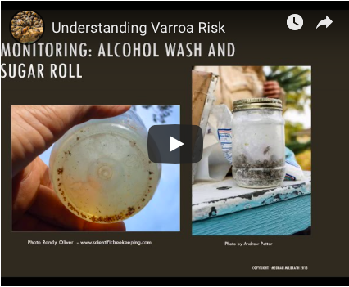
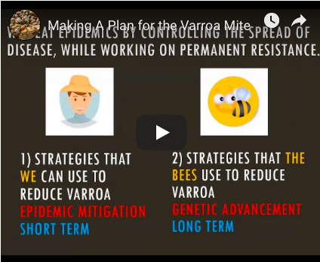
KeepBeesAlive.org
Links to resources mentioned in this presentation
Download this PowerPoint presentation
Videos and handouts
Why did my bees die?
Understanding Varroa Risk
Making a Plan for Varroa
© 2021 Michigan State University

Slide 78
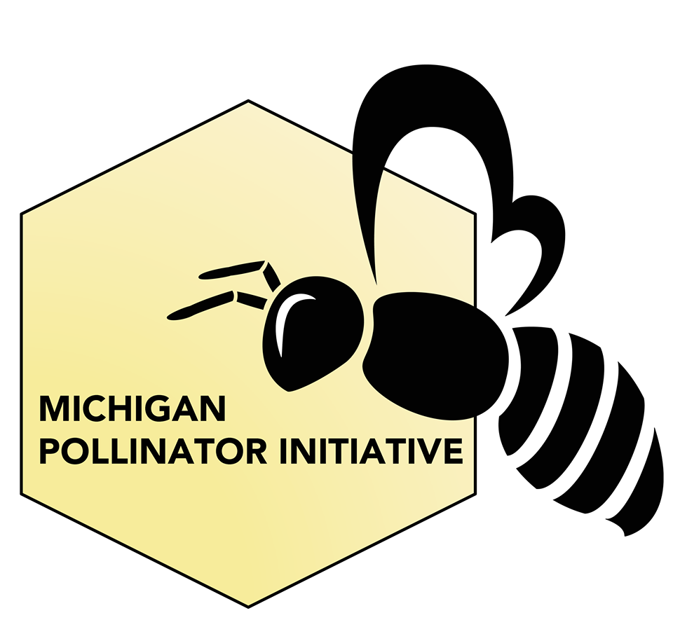

MSU on Facebook:
@MichiganPollinatorInitiative
@MSUHoneyBees
© 2021 Michigan State University

Slide 79
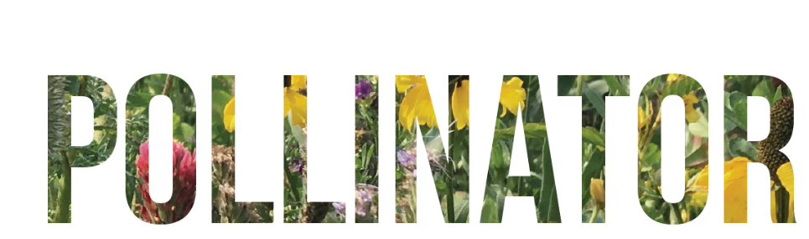

Pollinator Champions is a free, self-paced online course offered by MSU
Packed full of videos, articles, and fun activities to guide you through the amazing world of pollinators and pollination
The course is free, but for a small contribution you can receive a certificate and materials to help you give presentations about pollinators
Help us spread the word as an MSU Certified Pollinator Champion!
To register for Pollinator Champions, go to:
www.pollinators.msu.edu/programs/pollinator-champions/
© 2021 Michigan State University

Slide 80
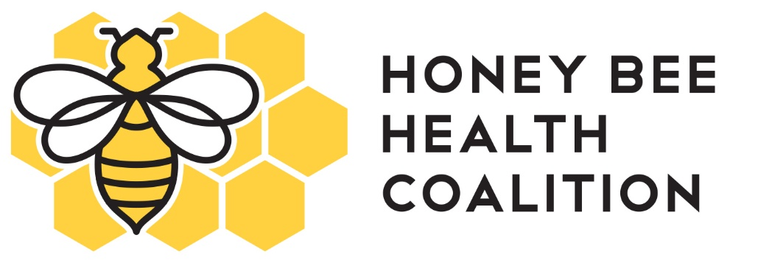
The Honey Bee Health Coalition:
Treatment Information honeybeehealthcoalition.org
© 2021 Michigan State University

Slide 81
The Bee Informed Partnership: colony loss survey data beeinformed.org
© 2021 Michigan State University

Slide 82
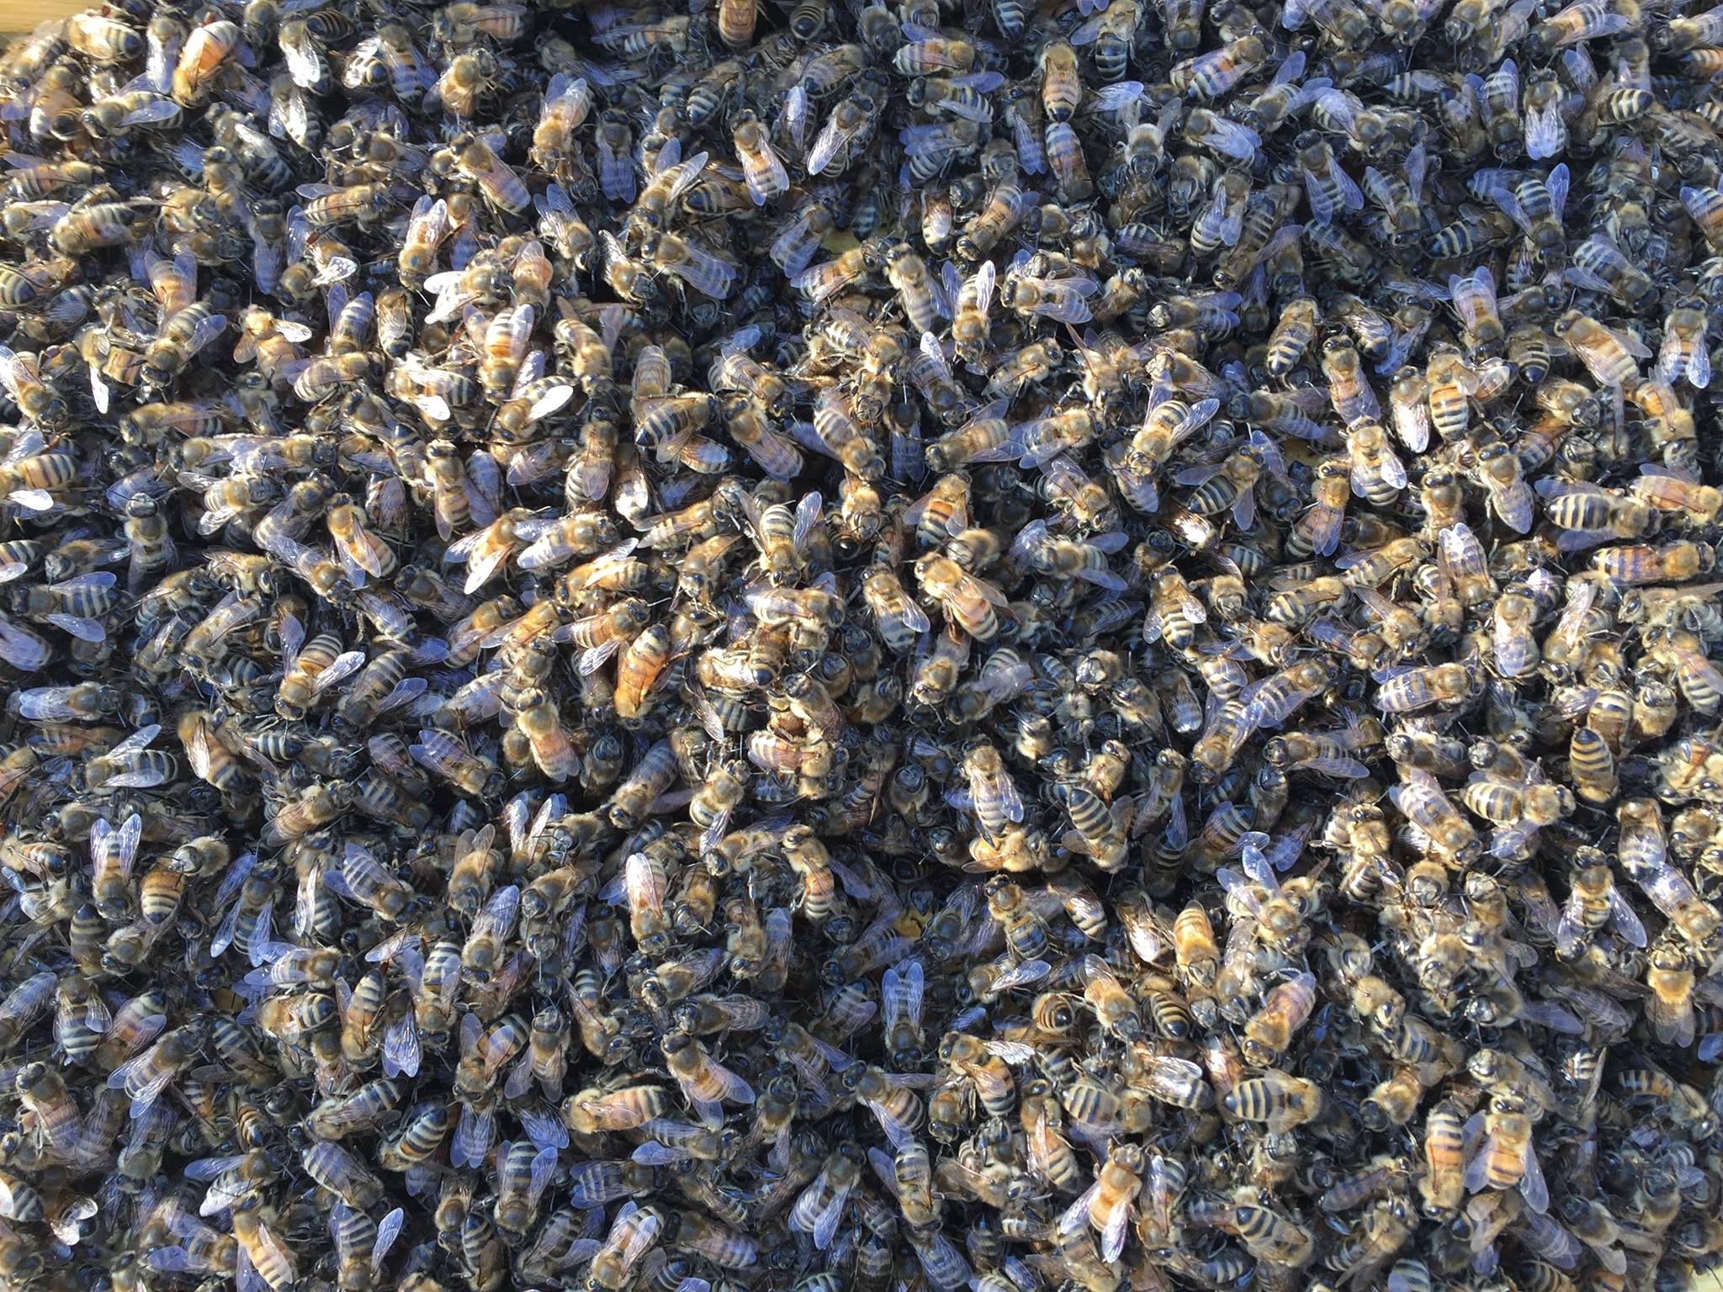
  Beekeeping Questions
  Ask Extension: pollinators.msu.edu/questions
  © 2021 Michigan State University
© Ana Heck
Photo: © Ana Heck

Slide 83
Summary
Virtually all colonies have or will have mites each year.
If left unchecked, varroa mite populations will grow quickly over the summer, and will reach dangerous levels.
Colonies with high varroa levels are profoundly sick, do not have a good chance of survival, and can affect neighboring bees.
Some resistant stocks are helpful but temporary fixes are still needed to keep mite populations lower.
Consult MSU’s KeepBeesAlive.org for varroa information and resources.
© 2021 Michigan State University
Slide modified from the Honey Bee Health Coalition

Slide 84
Please do your part to keep your bees healthy!
© 2021 Michigan State University
Graphic design by Anne Turnham, University of Minnesota Bee Squad for NCR-SARE PDP grant "Training an Influential Network of Farming, Beekeeping and Extension Experts to Promote Bee Health“ [grant no. ENC17-160] from the USDA National Institute of Food and Agriculture.

Slide 85







This work is supported by a NIFA CARE grant "Mite Check: A national strategy to reduce honey bee colony loss from the varroa mite“ [grant no. 2017-08680] from the USDA National Institute of Food and Agriculture.
Content and graphic design for many slides was supported by an NCR-SARE PDP grant "Training an Influential Network of Farming, Beekeeping and Extension Experts to Promote Bee Health“ [grant no. ENC17-160] from the USDA National Institute of Food and Agriculture. Graphic design by Anne Turnham, University of Minnesota Bee Squad
© 2021 Michigan State University

